Slide 1

WBL – MODULE 1
Helping Care workers to teach seniors how to use digital technology
﻿www.housingcare.net
The European Commission support for the production of this publication does not constitute an endorsement of the contents which reflects the views only of the authors, and the Commission cannot be held responsi­ble for any use which may be made of the information contained therein

Slide 2

Learning Outcomes
The tutor/care worker:
Is able to identify what works to aid learner retention and apply the necessary pedagogical tools to enable people to learn IT technology
Understands the different learning processes
Is able to apply a positive and empathic attitude to training
Is able to provide knowledge of ethics of digital security

Slide 3
Contents:
Psychological aspect
Knowledge of learning and cognitive abilities
Motivation
Active listening
Positive feedback
Empathetic approach
Patience/speed
Technical aspect
Teacher understands different learning processes
Memory retention
Repeating
Simple steps
Avoiding IT-slang
Ethics of Privacy
Setting boundaries
Ethics
Privacy protection

Slide 4

Psychological aspect
The demand for basic IT skills has evolved following the rising number of official digital solutions in many countries
Tutors teaching care workers ( co-workers)
Tutors teaching care workers teaching seniors
The obstacle to learning in a mature age:
Natural deterioration of brain function – weakening of concentration
weakening of memory and mental flexibility
The brain is plastic in all stages of life – It is possible to maintain the functionality of the brain to learn if older people engage their brain in new challenging tasks; e.g. learning IT

Slide 5
Psychological aspect
Motivation
During teaching and training, it is important to keep up and promote motivation
Set intermediate objectives
Give positive feedback
3.
Learning objectives
2. Intermediate objective
1. Intermediate objective

Slide 6
Psychological aspect
Active listening
The teacher/tutor/care worker needs to be interested in the needs and problems of the learners (care workers / seniors)
The teacher needs to adopt a situational approach and not a theoretical approach
The learning effort enhances when oriented towards experiences connected to real life, useful in daily practice

Slide 7
Psychological aspect
Positive feedback
Positive feedback during learning is essential for the learning experience and learning progress
Positive feedback can make the learning process easier
The learner’s confidence can increase because of a successful experience
Positive strokes are useful

Slide 8
Psychological aspect
Empathetic approach
It is important to connect the course content to the personal needs and motives of the learner
The tutor must meet care workers with an empathetic approach in order to keep up the motivation, attention, and curiosity
The tutor needs to take a real interest in the needs, competences and requirements of the care workers

Slide 9
Psychological aspect
Patience/speed
This is important to both care workers and seniors
The cognitive functions, including learning, are slower with age, due to the natural deterioration of brain function
The course design must allow the learners to progress at the right speed
Patience of the teacher is important to move forward step-by-step at the learner’s own speed

Slide 10
Technical aspect
Tutor understands different learning processes
To be able to plan a learning process, the tutor needs to be aware of competencies connected to different teaching roles
The learning conditions of the learner are an important aspect, of understanding different learning processes
A didactic theory relates the six most important aspects when planning a course or learning process – see next slide

Slide 11
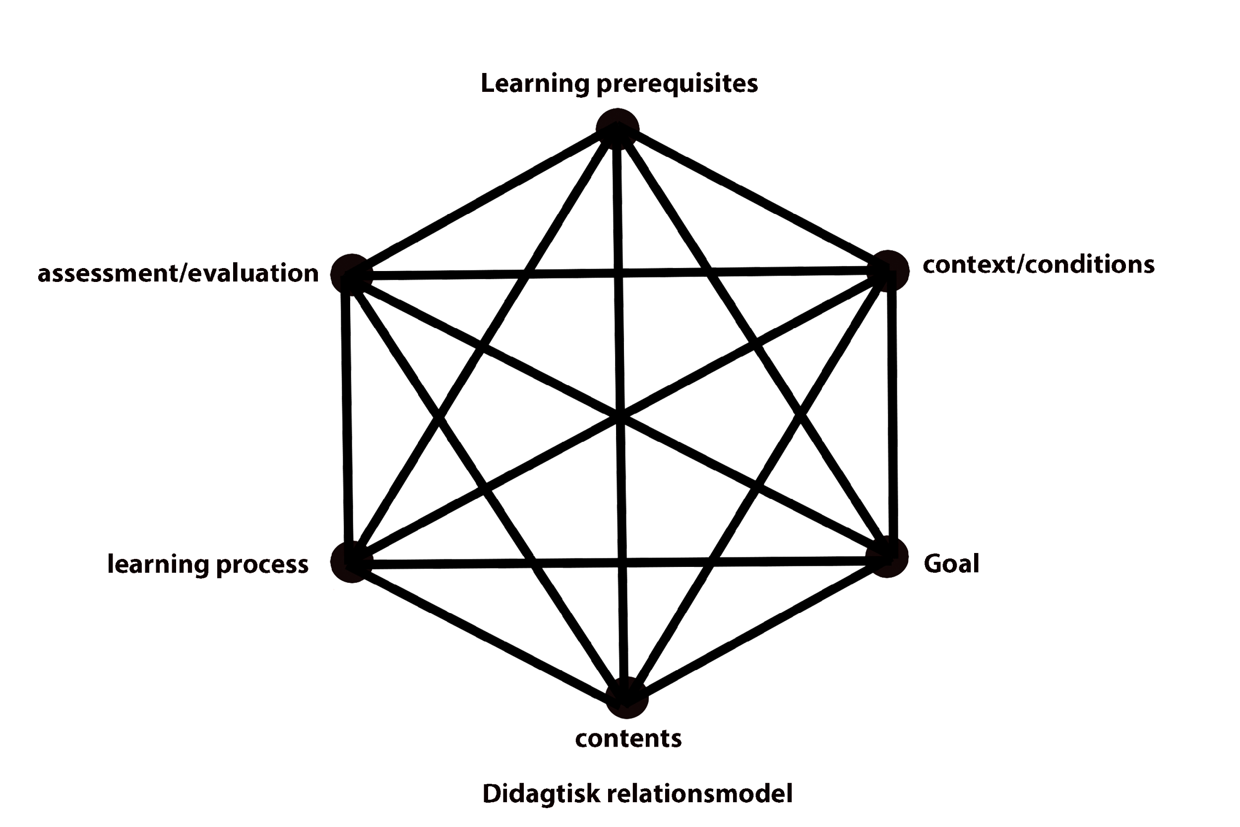
Technical aspect
Didagtisk Relations Model
Questions to ask about the learning conditions of the learner include:
What professional or other relevant skills does the learner have?
What communication skills does the learner have?
What collaborative skills does the learner have?
Is the learner motivated?
Does the learner have any special problems or need for resources related to the course?
How does the learner learn?
Learning Prerequisites
Assessment/ evaluation
Context / conditions
Goal
Learning Process
Contents

Slide 12
Technical aspect
Memory Retention
Memory can be affected by e.g stress, lack of motivation, or meaning.
In planning a course, the tutor needs to take the above factors into consideration and remember;
– Pace
– Repetition
– Simple steps

Slide 13
Technical aspect
Repeating
Develop our own method and practice
Repeating different steps in the learning process is essential when teaching others
The tutor needs to consider the best way to provide instruction and feedback, allowing time for the learner’s repetition

Slide 14
Technical aspect
Simple steps
Teaching the tutor may find the KISS rule (Keep It Simple, Stupid) helpful
Tutors must meet learners at their own level; Teaching based on simple steps is therefore an important factor
Open questions guiding to simple problem solving can motivate the learner to seek more information
This way the learner reaches for a higher level of knowledge or skill, by finding the answers themselves

Slide 15
Technical aspect
Avoiding IT-slang
The digital vocabulary is a challenge for many people, therefore:
The use of IT-slang should be kept at a minimum
Some expressions may need to be explained or “translated”

Slide 16
Ethics of Privacy
Setting boundaries
Setting boundaries, in terms of what kind of information is accessible or visible for the tutor or care worker, is important
The boundaries should be made clear to the learners at the beginning of the course
When it comes to digital services, it requires awareness of ethics of privacy

Slide 17
Ethics of Privacy
Ethics
Ethics of privacy varies depending on the relation between the tutor and the learner
Professional care workers and volunteers should be very aware of their responsibility regarding access to personal information
Within the teaching role is a responsibility for applying good ethics in teaching
Good ethics regarding digital services could be a helpful attitude with advice on how to create secure passwords, but NOT to gain knowledge of passwords

Slide 18
Ethics of Privacy
Privacy protection
Care workers and volunteers have an obligation to observe secrecy in contact with the learner’s private affairs
Teaching different IT skills, the teacher gets access to various information of which he or she is obliged to observe secrecy
That means that the tutor cannot share any private information of the learner with others, nor use any private information of the learner for his or her own gain

Slide 19
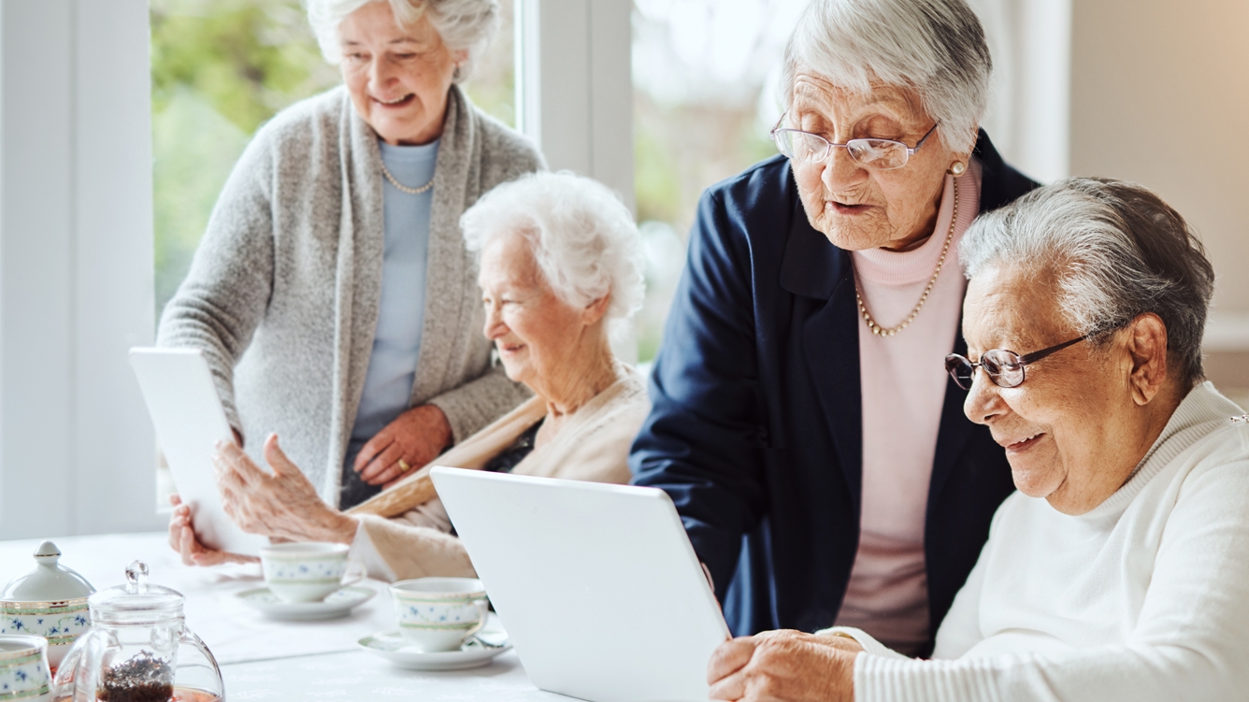
Every accomplishment starts with the decision to try
JFK

Slide 20

Thank you
﻿www.housingcare.net

