Slide 1

WBL – MODULE 2
Motivation to learn technology
﻿www.housingcare.net
The European Commission support for the production of this publication does not constitute an endorsement of the contents which reflects the views only of the authors, and the Commission cannot be held responsi­ble for any use which may be made of the information contained therein

Slide 2
Setting the scene / the Need
There are still repercussions from the pandemic
An ageing European population
Difficulties to recruit care workers
Economic crisis with high inflation
Increased use of technologies in municipalities and society in general
Continuous need for training of employees and volunteers

Slide 3
Motivation – Why is this important
Many people are nervous about new technology and the risk of being disconnected from communication with public authorities, family and friends.
Uncover which reasons and examples can be used in training to maintain motivation
Find out what can convince them that technology is helpful in everyday life
Make a good plan for the training

Slide 4

The tutors and trainers
Tutors and care workers / volunteers working with seniors
IT teachers working with seniors
Family teaching seniors
Seniors teaching seniors

Slide 5

Observations
Be aware of learning difficulties
Motivation arises when you find out how training can make everyday life easier
Make the training relevant for the care workers
Clarify the benefits
A need for training care workers
The selected devices are relevant for the vast majority of both care workers & seniors

Slide 6
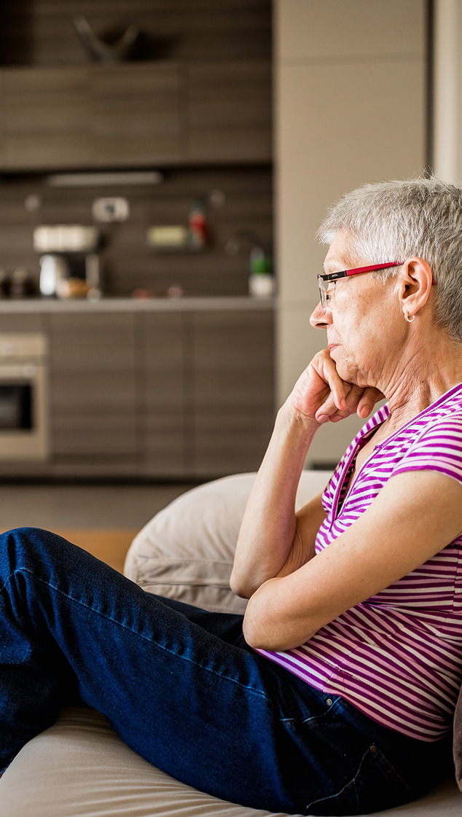
Examples
What hobbies and interests do the care workers have? – use them as examples in training
Use your own examples
Consider how technology can make a difference to someone’s life
Put yourself in the care workers shoes – how would technology help you?
Tell stories that will help relate to the examples you give
BE PREPARED!

Slide 7
Technology
- How can it help?

Slide 8
Family
My family lives far from me and is busy in everyday life.
Messages – SMS (text), WhatsApp
Email – quick and easy
Send and receive photos
Facebook / Instagram
See the technical guide on how to do it.

Slide 9
Friends
My friends are busy or the same as me, we don’t meet as often.
Group Skype session – with a webcam
WhatsApp group
Sharing information on mutual interests
Do virtual walks
Facebook group

Slide 10

Hobbies
Example: I like knitting, but need inspiration and someone to share it with.
Do a Google search for patterns and print them out.
Search for groups with the same interest, meet new people online and share patterns.
Take pictures of your crafts and share them with family, friends and groups online.
Comment on others’ crafts and use the right emojis
See the technical guide on how to do this.

Slide 11
Hobbies - Travel
Example: I like to travel, but not sure where to go or how.
Search online (Google) for places you like to visit and look up tourist information
Search online for hotels and flight, bus or train and read the review
Use Google maps or Streetview to see what it looks like online
Use google images to look at photos visitors have put online
See the technical guide on how to do this.

Slide 12
Hobbies - Travel
Example: Maybe I can find a cheap way to travel?
Find flight, train and bus timetables or options online
Check the destinations, prices and the best time to travel
Find the specific companies but also websites such as Momondo, Skyscanner and others that search for many different companies
You can book online if you have an e-mail address
See the technical guide on how to do this.

Slide 13
Frustration – it doesn’t work
Something isn’t working, is it broken or am I doing something wrong?
Search for a YouTube video that can guide you on how to troubleshoot
Search for a forum for discussion, a lot of good ideas can guide you
Search for an instruction manual online
See the technical guide on how to do this.

Slide 14
Shopping online - groceries
Example: I don’t have time to shop, or the stores are miles away / I am unable to shop.
There are a lot of supermarkets online now and you can order your groceries online eliminating this problem
You can order and pay online and collect (click’n’collect)
You can order, pay and get your groceries delivered
You will need an e-mail to order.
See the technical guide on how to do this.

Slide 15
Shopping online – Gifts or miscellaneous
Example: I need to buy a present for my granddaughter but from a store that is far away.
There are a lot of supermarkets online now and you can order your groceries online eliminating this problem
Most larger stores offer online shopping from their webpage
Search for the item in the online store, choose size/model and colour etc., pay and check-out.
You will need an e-mail to order.
See the technical guide on how to do this.

Slide 16

Terminology
Example: People talk about ‘messenger’ as communication tool, I don’t know how to use it.
Training in technology will develop your skills
Once you have learned it becomes easy and you can talk to a lot of people with messenger
See the technical guide on how to do this.

Slide 17

Tech gives the quietest student a voice.
– Jerry Blumengarten

Slide 18

Thank you
End of Module 2
www.housingcare.net

