Slide 1
An introduction to
Our MOOC
﻿www.housingcare.net

Slide 2
Welcome

Slide 3
The Project
Housing Care: Using Reframed Skills for Senior Carers, arises with the intention of improving the quality of life for dependent seniors, through the updating and training in new technologies of their care workers.
As the years go by, this senior care sector will become larger as the data shows, the population over 65 years of age is going to increase dramatically. And therefore, the percentage of people in need of specialised personal care, adapted to the current social situation will also increase.
The Housing Care Project aims to offer a new perspective on care, adapted to the present day and whose main driver for change is the adaptation of new technologies both inside and outside the home of SENIORS.

Slide 4
To reach our Project aim we have designed 2 Project results…the first PR1 involves the development of a
MOOC

Slide 5
But what is a MOOC?
A MOOC = A Massive Open Online Course
So, a MOOC is an online course that is designed to be open to a large number of participants. MOOCs are typically offered by educational institutions and can cover a wide range of topics.
They are often FREE or low-cost & are ACCESSIBLE to anyone with an internet connection.
They can include video lectures, quizzes, discussion forums, and assignments.
MOOCs may also offer various levels of certification or credit, depending on the institution.
MOOCs have the ability to reach a large & diverse audience, which can include learners from all over the world.
They are a way to providing education to people who might not otherwise have access to traditional forms of education.

Slide 6
The Care Workers, at the end of the MOOC will be able to
MOOC Objectives
Through this MOOC, we want to give care workers the updated tools and adequate skills so that they can carry out their profession efficiently, with the sole intention of improving their well-being, as well as that of their clients or patients.
We do this by showcasing the latest education techniques, offering a variety of platform content and providing resources that can be used on a day-to-day basis.
Test Ambient Assisting Living & E-Health devices to assist and take care of seniors
Practice assistance and care interventions using new and available technologies, integrated with a strong humanised element
Manage the multi-functionality of devices at a basic level;
Understand and use some of the data produced by the technologies.

Slide 7
We categorized Care Workers by their level of experience & ASK…
If you have more than 15-20 years of experience…
How has the way of working changed since you started?
Does technology make it simpler?
2) If you have less than 10 – 15 years of experience…
Do you believe that technology is necessary to carry out your work?
What kind of technology do you need in your work?

Slide 8
2 Questions each but many Answers
In recent years there has been a major leap in the quality of technology dedicated to the care of dependent persons.
For many workers, dealing with technology in the workplace can be a real challenge, and many times is considered a barrier to developing their work efficiently (Andersson et al., 2016), and one of the main causes of stress.
One of the main problems is that care workers are often poorly trained regarding new technology and options available to them.

Slide 9
Is it possible to care through technology?
WE BELIEVE the answer to this question is .... Of course!
For example, some studies have found that simple positive digital monitoring at home would avoid trips to check on seniors, allow for required home maintenance and facilitate monitoring by professionals (eg Doctors).
On the other hand, home care workers have the possibility to reduce the time spent on daily paperwork and devote it to paying more attention to the client
Other studies have shown that the use of technology increases the client's responsibility for their health, reduces their anxiety and improves their overall physical and emotional state. It also improves communication between the care worker and the user.

Slide 10
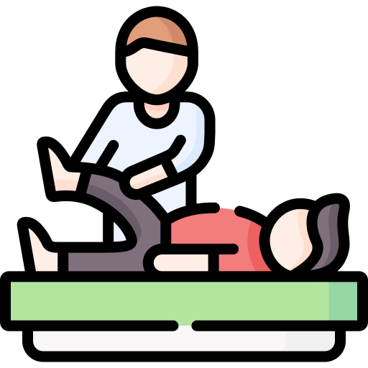
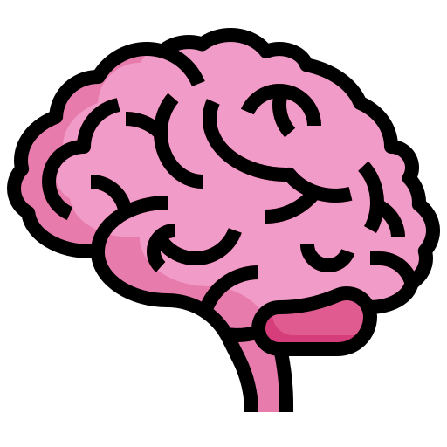
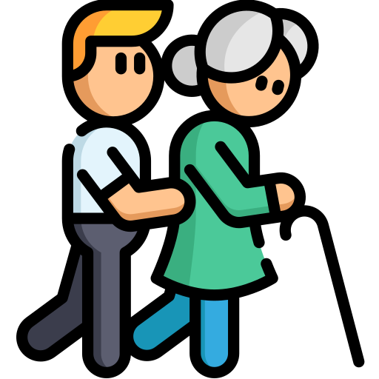
Caring for others... a journey of many possible paths
In this MOOC that we have prepared, you will understand that there are many ways of caring and that each one can be reached in a thousand different ways.
Dependent people, especially the seniors, require that we work with them on aspects such as memory, executive functions...
It can be one of the simplest interventions and one of the most effective, we just need to work on active listening.
Cognitive
Company
Physical
Emotional
Learning
Understood as the traditional form of basic care, such as wound care.
Dependent people can suffer from many emotional problems, and if this aspect is not taken care of, it can lead to more serious problems such as depression.
The fact that the people we care for are dependent does not mean that they cannot learn new things. Teaching them and giving them new tools is not just caring, it is a right.

Slide 11
The situation of Care Workers
Covid-19 has WORSENED WORKING CONDITIONS OF CARE WORKERS around the world, due to the shortage of biosafety equipment, scarce of infection control systems, lack of recognition programs and work incentives, and finally physical and psychological abuse and discrimination by patients, which has an impact on their mental health.
According to the American Healthcare Association (AHCA) and National Center for Assisted Living (NCAL), long-term care facilities are facing the worst labour crisis of any health care sector today.
And the Bureau of Labour Statistics data from November 2021 shows that NURSING AND RESIDENTIAL CARE FACILITIES LOST OVER 11,000 JOBS.

Slide 12
How Technology Can Help Senior Living Staff?
Education
How Housing Care can help…the generation of health, housing and care leaders require support if they are to continue to develop themselves, and therefore their teams and services.
The education of professionals within these sectors is crucial in enabling a cultural shift so that staff understand the value and use of technology, and how it can support them in effective caregiving, as well as improving the quality of life of the people being cared for.
Providing them with the right technology being able to give their opinion every week or month in order to know how they fell while they are working, how they believe that they can improve their skills…

Slide 13
Change is always the result of all true learning.
let the beauty of what you love be what you do.
El cambio es siempre el resultado final de todo verdadero aprendizaje
RUMI
Leo Buscaglia

Slide 14
What is Ambient Assisted Living (AAL)
Ambient Assisted Living (AAL) is an approach in healthcare that uses technology to support individuals in their daily lives, especially seniors or those with chronic conditions, to improve their quality of life, independence, and overall health outcomes. AAL aims to assist individuals to remain in their own homes or assisted living facilities, rather than in hospitals or full-time care facilities.
AAL technology can be integrated into the users life via, smart home systems, sensors, alarms, or wearables, and can monitor an individual's health status, behaviour, and activity patterns.
AAL solutions can also promote social interaction, cognitive stimulation, and physical activity, which are essential for maintaining a healthy and active lifestyle.
Overall, AAL offers an innovative and practical approach to support individuals in managing their health and living independently, while also reducing the burden on caregivers and healthcare providers.

Slide 15
Digi-Human Senior Care MOOC
The project result is a professional development course in MOOC mode that provides Care Workers with the basic skills to assist and care for Seniors also through Ambient Assisted Living (AAL) technologies.
Care Workers, at the end of the MOOC will be able to:
Test AAL devices to assist and care for older adults;
Deliver care and treatment interventions through the use of AAL technologies, with a strong humanized component;
Manage at a basic level the multifunctionality of devices;
understand and use some of the data produced by the technologies.

Slide 16
The MOOC is composed of:
Training Content Area
Structured in 3 different modules, it takes an in-depth look at new technologies and their application in the care sector through a theoretical and practical methodology.
Tools
Training Content Area
The course provides all kinds of tools (videos, infographics, manuals) to make learning easier for the student.
Tools
Learning Environment
Learning Environment
A professional learning platform has been created to make it more accessible to any type of care worker.

Slide 17
The Structure of the Mooc
Health Care Management Apps
Module 1
Module 3
Digital technologies healthcare field
Digital Literacy
Fluid balance App for seniors
Module 2
Human Digital Skills
Social
Activities Apps

