Slide 1
PR2
Human-Digit WBL Toolkit
Second TM – Carrick on Shannon (IR)– October 11th – 12th 2022
Toolkit contents
﻿www.housingcare.net

Slide 2
contents
01
Project Result Objectives
02
What is the Toolkit
03
What we already have
04
Work group
05

Slide 3
01
Objectives
Human-Digit WBL Toolkit and its Pilot Test

Slide 4
Objectives
Developed adequate levels of knowledge and skills in the humanized (person centred) use of AAL or E-Health technologies by Care Workers;
Updated the competences of care workers to the evolving needs of their work.
VET provider partners have developed the capacity to implement organic training on the use of humanized AAL or E-Health technologies that are appropriate and attractive to women workers;

Slide 5
02
What is the
Human-Digit WBL Toolkit

Slide 6
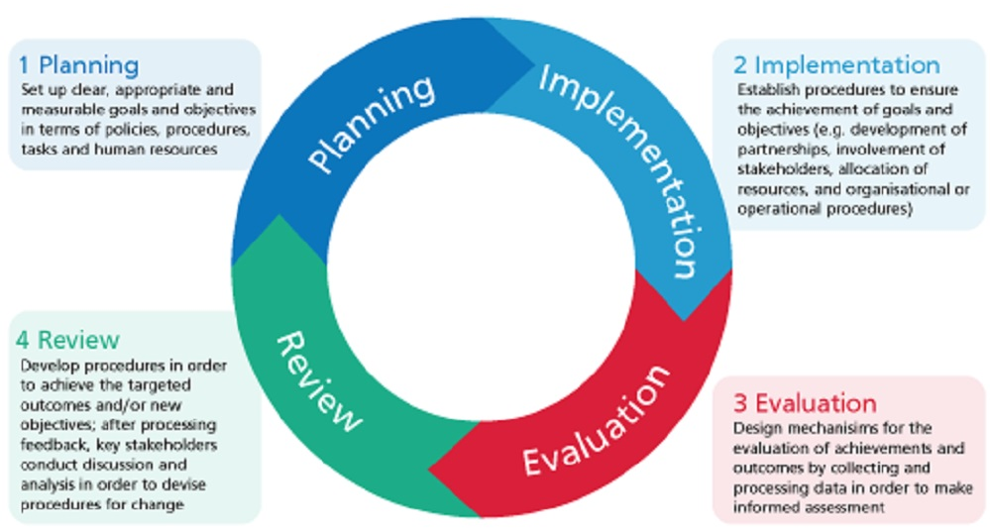
EQAVET Quality Assurance Cycle

Slide 7
The Human-Digit WBL Toolkit
A set of useful tools for designing and implementing hands-on learning activities addressed to Care Workers to be implemented in a work-based pathway.
It includes content, activities and tools to manage the work-based learning experiences of the learners/care workers
The toolkit is addressed to the trainers/tutors who will support the care workers in the work-based learning experience and to the learners/care workers
It includes also training materials to train the WBL Tutors
It will be developed according the EQAVET+ principles

Slide 8
Components of the toolkit
1
One work based learning units for Care Worker
3
Two Practical Guides for Care Workers
5
Tutor training curriculo
7
EQAVET+ guidelines
2
Self-assessment tool
4
Tutoring guidelines
6
Training Materials to train the tutors

Slide 9
The toolkit into the Quality cycle
Planning
Implementation
Check
Review
1
One work based learning units for Care Worker
3
Two Practical Guides for Care Workers
7
EQAVET+ guidelines
5
Tutor training curriculo
2
Self-assessment tool
6
Training Materials to train the tutors
4
Tutoring guidelines

Slide 10
1
One work based learning units for Care Worker

Slide 11
Work based Learning Units for Care Workers
Learning unit
Title
Service Performance | Report the service performance the learner/care worker have to provide
Measurable and specific learning Outcomes | Report learning outcomes (step 1)
Targeted and Expected Competences aligned to learning outcomes | Report the targeted and expected Competences aligned to learning outcomes (steps 2)
Work Based Learning Experiences | Report the main learning activities (step 3)
Monitoring | Plan and monitoring tools (see monitoring paragraph 3.3)
Assessment What will be assessed it has already been partly defined in the learning outcomes | Report assessment tasks step 4 and refers to steps and tools (see Assessment paragraph 3.4)

Slide 12
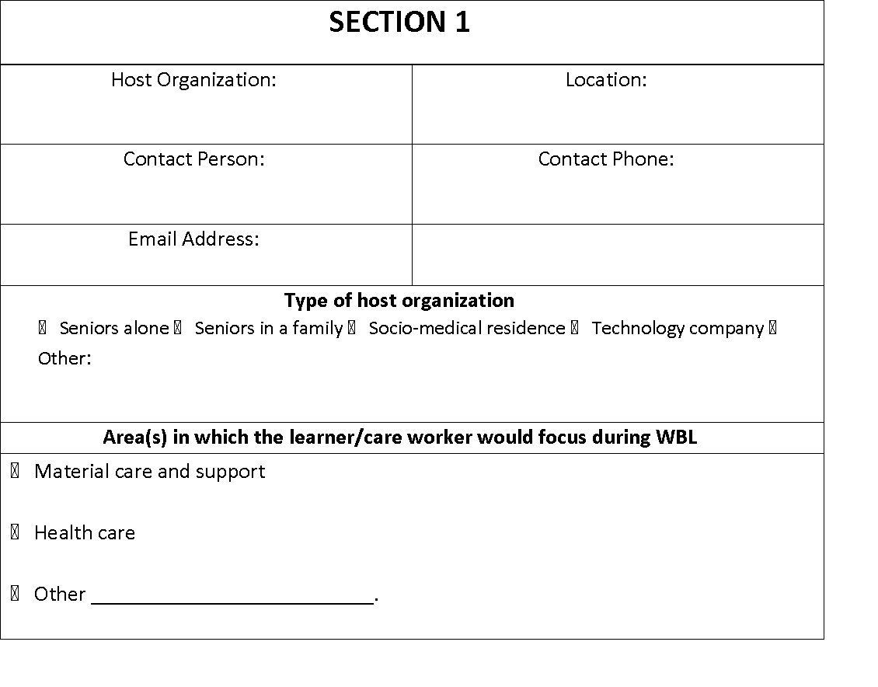
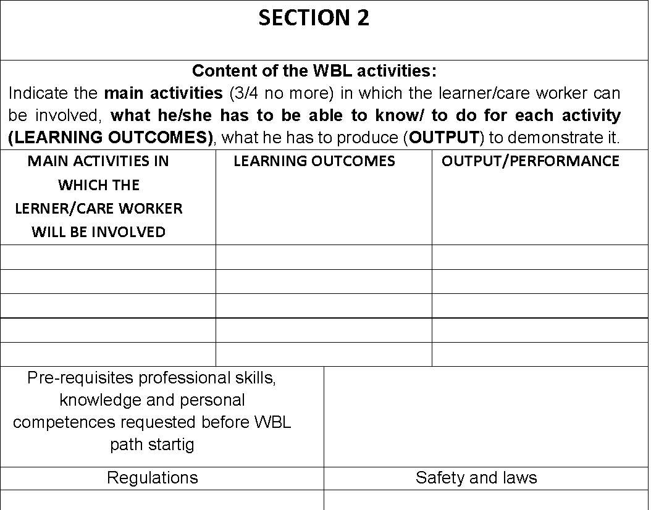
Template – Co-planning grid

Slide 13
Template – Guide on study visit
Before the meeting
Evaluate how the study visit can help you to achieve your tutor objectives Make sure that the meeting will help learner/care worker understand the context in which they will be challenged, acting as a valuable tool for applying academic concepts learned through the MOOC to work real situations.
Select suitable host organization for the work based learning experience. Make sure they are appropriate organizations able to link academic learning acquired through the MOOC to the world of work.
Organize in detail the logistical part of the visit
Prepare learner/care worker to best maximize their learning:
Discuss with them about their expectations about the meeting they are about to accomplish and what they expect to learn
Ask learner/care worker to prepare a list of learning questions and goals they would like to accomplish during the meeting.
Suggest the learners/care workers the following questions they could do during the meeting:
What are the main needs of the senior I have to support?
What are the tasks that I will have to accomplish during my experience?
What is the most important thing to learn for me as soon as I start working there?
When I finish my WBL experience there, what do you hope I will have learned/I’ll be able to do?
During the meeting
Ensure that learners/care workers receive information on the learning activities she/he can do in the context of the host organization.
Ensure that learners/care workers receive safety instructions at the workplace.
Make sure that learners/care workers come into contact with all aspects / environments of the host organization.
After the meeting
Help learners/care workers understand and determine the next steps of learning their pathway. The meeting allows learners/care workers to discover further elements for the development of their careers.
Use host organizations and learners/care workers feedback for continuous improvement of study visit organization

Slide 14
Template Hypothesis – Individualized WBL pathway
Grid - Interview to Workplace tutor
Grid - Individualized plan

Slide 15
2
Self-assessment tool

Slide 16
2 Self-assessment tool
Self-assessment tool through which the care workers can assess their initial and final level of mastery
It could be used as a useful guide to choose the best place where to do the work based learning pathway
The tool will be presented by Momentum

Slide 17
3
Two Practical Guide for Care Workers

Slide 18
3 Two Practical Guide for Care Workers
Practice guide on the use of Smart and Ambient Assisted Living technologies, on the use of innovative and friendly devices connected to IoT, to be used in home care, e.g. hoover robot, virtual robot, apps to stimulate cognitive skills, but also E-Health platforms and devices for monitoring vital parameters, etc. (TECSOS)
Practical guide on Social & Emotional Skills integrated with Technological Competences. It will be a simple and practical tool containing a series of tips and suggestions on the best behaviours and attitudes to adopt in certain situations of technology use. It is connected with the Human Care Mindset already learnt in the MOOC (SOSU)

Slide 19
4
Tutoring guidelines

Slide 20
4 Tutoring guidelines
It should include:
Tutoring process
WBL learning design tools
Monitoring and support tools,
Assessment
Quality assessment procedures and tools

Slide 21
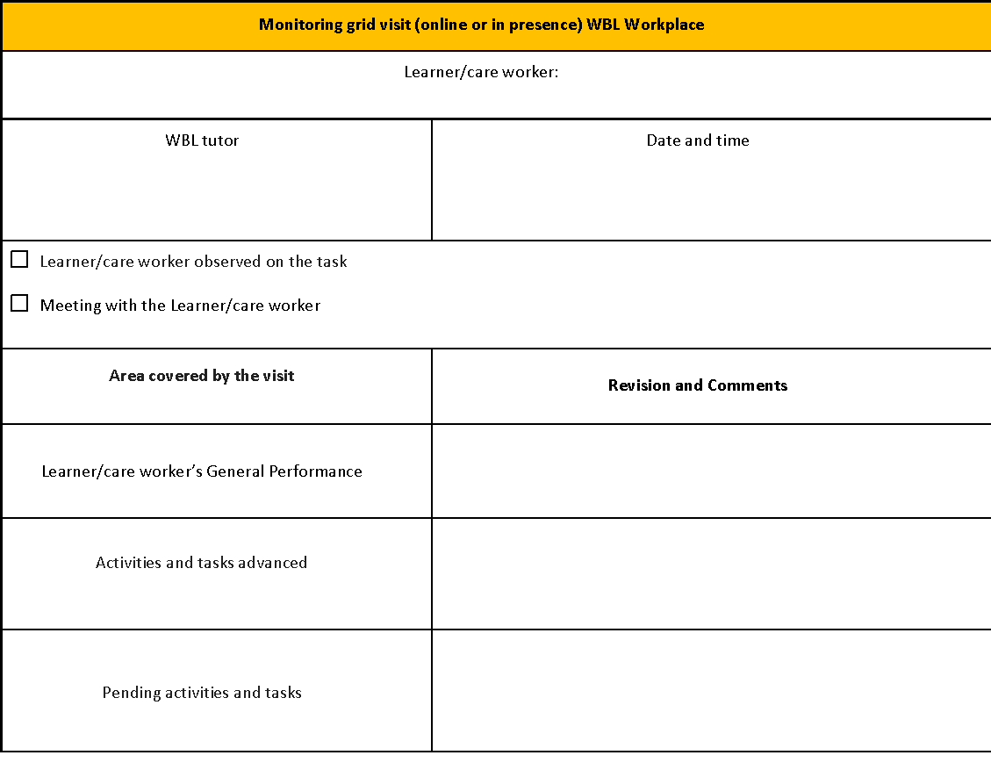
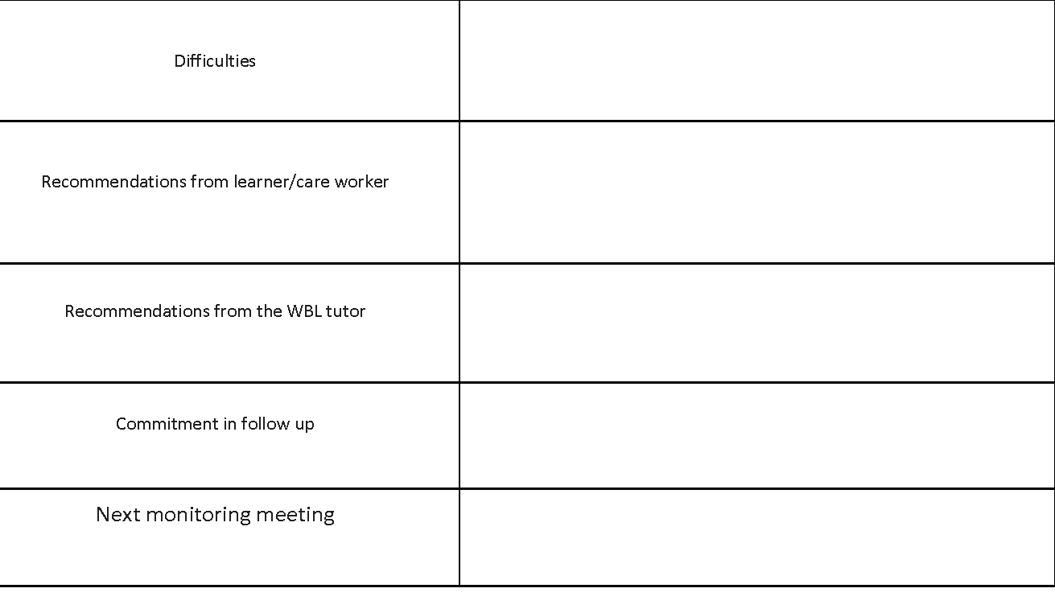
Some templates – Monitoring visit WBL workplace grid
Grid - Monitoring visit WBL workplace grid

Slide 22
Assessment – formative feedback
Ageing Lab tool
The tools will be presented by Ageing Lab

Slide 23
Summative assessment – Assessment Form
Momentum tool
The tool will presented by Momentum

Slide 24
5
Tutor training curriculo

Slide 25
5 Tutor training curriculo
It’s the curriculum aimed at train the tutors that will support the care workers during the WBL pathway
It is the curriculum of the current LTTA
It include all usefull training content on process and tools aimed at:
design the WBL pathway,
support the care workers during the implementation,
Assess and certicificate the developed skills
Part of the curriculo is included in the Learning Agreement

Slide 26
6
Training Materials to train the tutors

Slide 27
6 Training Materials to train the tutors
The training materials are related all tools that will be included in the toolkit
These training material will be used during the LTTA
Each partners will develop the training materials related the part of the toolkit that will design and develop
The training materials might be different:
presentations
video
guides
etc

Slide 28
7
EQAVET+ guidelines

Slide 29
7 EQAVET+ guidelines
Guidelines on Quality Assessment and Self-Assessment in line with the updated EQAVET+ framework
It will be an easy tool that will guide, in the future, other organization in implement the CVET WBL pathway in line with the principles of the Quality framework EQAVET+
It could be also a kind of check list

Slide 30
EQAVET+ guidelines references (March 2022)

Slide 31
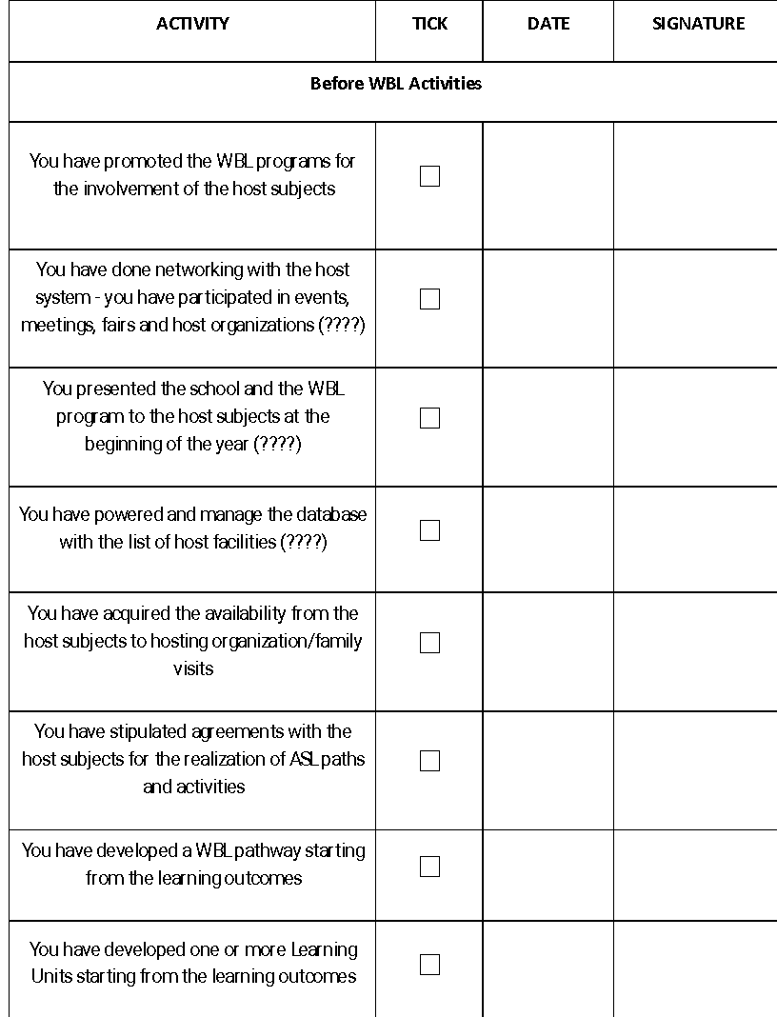
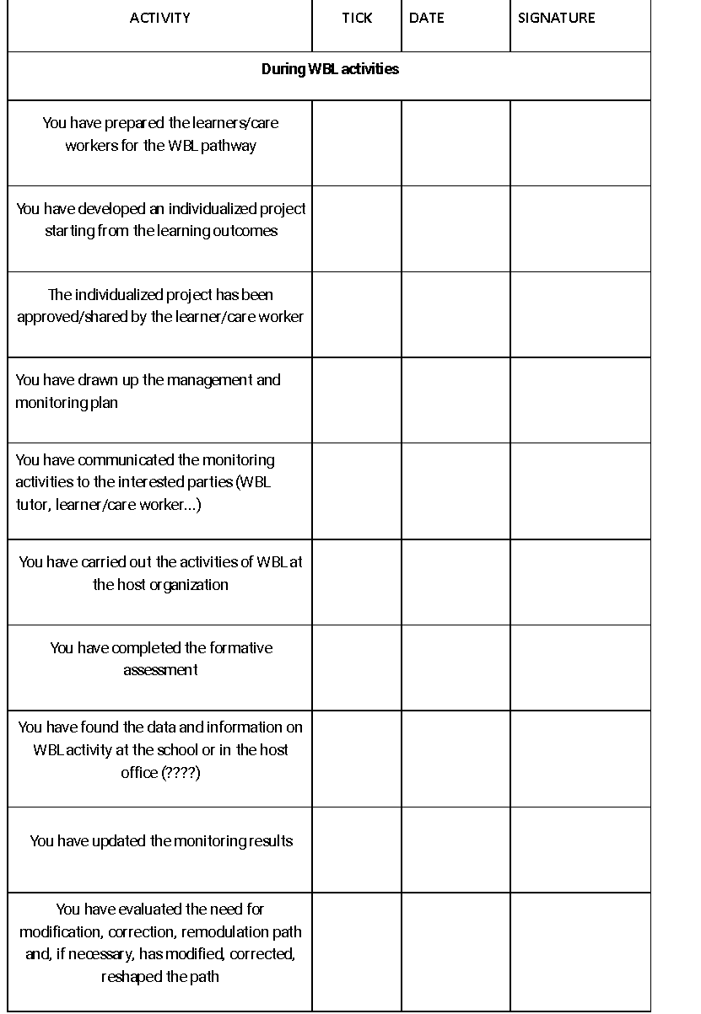
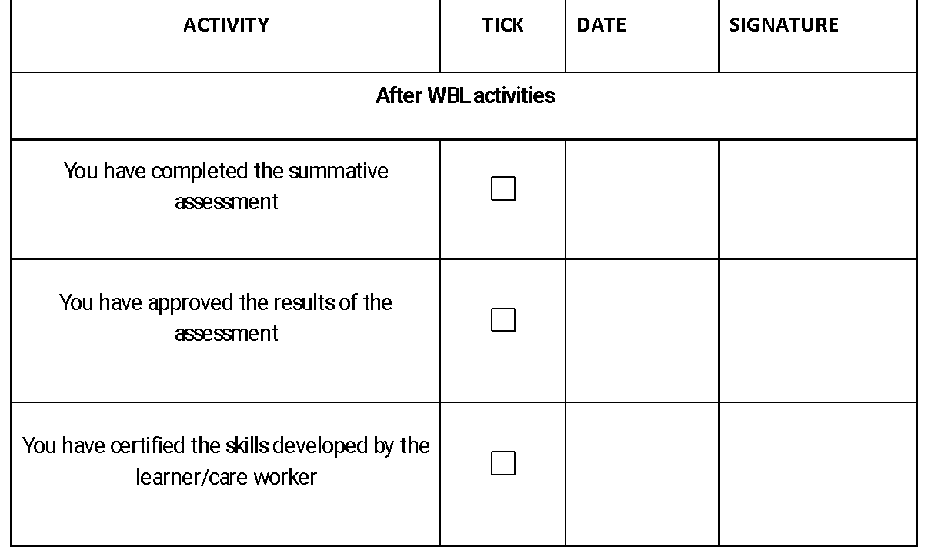
Possible tool: the checklist
Check list - Quality procedures before, during and after the WBL

Slide 32
03
What we already have
and what we can do

Slide 33
The tools
Planning
Implementation
Check
Review
1
One work based learning units for Care Worker
Learning unit TEMPLATE
Co-planning grid
Learning grid individualization
Guide to workplace visit
(Guides to create all the tools)
3
Two Practical Guide for Care Workers
We created two practical guides
7
EQAVET+ guidelines
Check list
List guidelines
5
Tutor training curriculo
We know what the training designers and the tutors have to learn
We finalize it at the end of LTTA
2
Self-assessment tool
We created a new one
6
Training Materials to train the tutors
Each partners created training materials on the tools they developed
4
Tutoring guidelines
Monitoring tools
Formative assessment tool
Summative assessmente tool

Slide 34
04
Learning Unit

Slide 35
Learning unit
Title | Human digit senior care work-based learning
Service Performance | Report the service performance the learner/care worker have to provide
Measurable and specific learning Outcomes | At the end of the work-based learning pathway the care worker will be able to master the use of relevant technological devices and apps on active and healthy ageing useful to care the seniors during their care service to individuate the benefits, the opportunities and the potential functionalities of the technologies and apps and to select the most suitable to match senior needs during their care service to update and make downloads as required during the health and social care service to keep their technologies updated to deal with GDPR / confidentiality of the senior using the technologies/apps to establish a proper connections and communicate with effectiveness with the seniors to communicate effectively in a virtual environment with the senior relatives, friends, health personnel etc. to use specific apps that allow her/him to give importance to self-care and to enhance their own health and well-being during the care service providing to manage accessibility on digital devices in order to guarantee the senior data safety

Slide 36
…… Learning unit
Targeted and Expected Competences aligned to learning outcomes | Starting with knowledge of the benefits and functionalities the technological devices and apps on active and on healthy ageing the care worker is able to select those devices and apps that match senior needs, to master their use keeping them updated Starting with knowledge on the effective helping relationships, the care worker is able to establish a proper connections with the seniors and an effective communication with him, the relative, the friends, the health personnel also using virtual communication apps and dealing with her/his GDPR / confidentiality while use the technologies/apps Based on the importance of own wellness for and effective care service, the care worker is able to use specific apps that allow her/him to self-care, self manage and to enhance their own health and well-being during the care service providing

Slide 37
…… Learning unit
Work Based Learning Experiences (1/2) | Digital technologies for the health field (experience areas) 1. Managing elderly people's health care using apps . . . 2. Managing physical activity, healthy lifestyle and the prevention of cognitive decline in the elderly [connected LOs: (a) + (b)] . . . 3. Supporting and facilitating the social activities of the elderly person . . ..

Slide 38
…… Learning unit
Work Based Learning Experiences (2/2) | «Digi-human» competences (experience areas) 4. Implementing activities that promote a work-life balance and increase the quality of life . . . 5. Practice Empathy competence in digital communication and co-operate in the working environment . . . 6. Organising and conducting activities to educate the elderly in technology . . .

Slide 39
…… Learning unit
Monitoring | Plan and monitoring tools (see monitoring paragraph 3.3)
Assessment What will be assessed it has already been partly defined in the learning outcomes | Report assessment process and tools

Slide 40
05
Group work sessions
Learning Unit

Slide 41
Learning Unit Group Work
OBJECTIVE
The objective of the group work is to conceive as much as possible Work Based Learning Experiences/activities in the different indicated areas that allow the care workers to attain the learning outcomes
It helps us to create a Macro-Learning Unit that already contains hypothetical Work Based Learning Experiences/activities
The Macro-Learning Unit is a useful reference to co-design and individualize specific Work Based Learning pathways

Slide 42
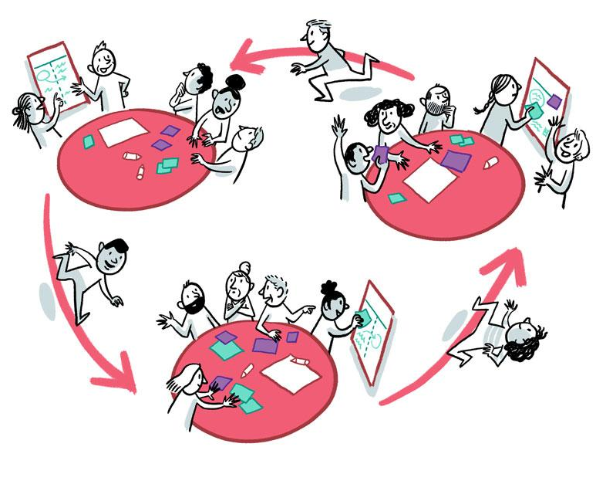
HOW TO WORK
We use the Word Cafe process
We work in two sessions
First session Digital technologies for the health field (experience areas)
Pause 15 min.
Second session: «Digi-human» competences (experience areas)
3 groups in the first and in the second session
In each table it is possible to work on a specific "experience area” for 15 minutes. Then each group move to another table

Slide 43
HOW TO WORK
For each experience area each group should:
Conceive and describle some work based learning activities. It means practical activities aimed at apply the acquired knowledge (through the MOOC) to develop the relevant skills connected with the learning ouctomes
To describe the measureable performance/s that have to be fullfilled through each activity
Experience Area - ___________
Connected Learning Outcomes | …………………
Work based learning activities ___ | Expected Performance

Slide 44
Examples of Work based learning activities
Management of health conditions through the use of diabetes Apps
Look for, select and use Apps for specific health conditions
Fostering the control of the elderly's water balance using the WaterMinder application
Plan the own care activities using self-management Apps
Communicate writing e-mails and messages with high empathic approach

Slide 45
06
Roleplay sessions
Co-planning grid

Slide 46
Roleplay session on Co-planning grid
Objective
To describe host organization related WBL possible experiences/activities for the care workers. These WBL possible experiences/activities have to be more specific
Each WBL experiences/activities have to be connected with the one or more LOs and the specific Performance
Here you have to be more specific, you have to conceive consistent with the choosed archetype

Slide 47
Roleplay session on Co-planning grid
Please, create groups of 3 or 4 members
1 has the role of tutor
1 has the role of host organization member
1 or 2 have the role of observer
Before start, the host organization member choose one of the Archetypes of Residential care home or Families; then read the features of the choosed archetype
The tutor, dialoguing with host organization representative, has to fill in the grid using also the macro learning unit.
The observer have to take note of something they should do in better way
At the end of the first grid, the two observers will become the tutor and the host organization representative, the previous ones will become the observers

Slide 48
Archetypes of Residential care home
1. Residential care home for elderly HIGH TECH
In this residential care home different types of technologies are available:
Type 1 Monitoring systems for vital functions and parameters
Type 2 Nurse/Care worker call systems technologies
Type 3 Software that records calls, intervention times, the interval between taking charge and the end of the intervention.
Type 4 A digital monitoring system that makes it possible to improve the care of the many patients by means of modern electronic devices (wearables), capable of detecting information on behaviour and space. It is possible to constantly and precisely monitor each individual elderly guest in the facility, identifying risks, dangers, emergency situations and needs in real time. The transmission of the alert signals on a specific web-based platform allows the staff to intervene promptly, receiving notifications about falls, prolonged exits of the guests, states of agitation or urgent situations. This ensures safety and independence for the elderly.
Type 5 Prospective memory aids. Artificial intelligence devices delivering reminders or procedural guidance as necessary to wearer for task completion. Examples Reminder messages; clocks and calendars; automatic pill dispensers

Slide 49
Archetypes of Residential care home
2. Residential care home for elderly MEDIUM TECH
In this residential care home, there is a minimum level of technology:
Type 1 Monitoring systems for vital functions and parameters
Type 2 Nurse/Care worker call systems technologies
Type 3 Software that records calls, intervention times, the interval between taking charge and the end of the intervention
3. Residential care home for elderly BASIC TECH
In this residential care home, there is a minimum level of technology:
Type 1 Monitoring systems for vital functions and parameters
Type 2 Nurse/Care worker call systems technologies

Slide 50
Archetypes of Families
1. Family HIGH TECH
In this family there is a minimum level of technology:
Type 1 Monitoring devices for vital functions and parameters
Type 2 Smartphone/Tablet
Type 3 Internet connection
Type 4 A digital monitoring system connected with modern electronic devices (wearables), capable of detecting information on behaviour and space. Alert signals on care worker smartphone allows him/her to intervene promptly, receiving notifications about falls, prolonged exits of the elder, states of agitation or urgent situations
2. Family SOFT TECH
In this family there is a minimum level of technology:
Type 1 Monitoring devices for vital functions and parameters
Type 2 Smartphone/Tablet
Type 3 Internet connection
3. Family NO TECH
In this family there aren’t available technologies. The care worker can use:
Type 1 TV
Type 2 Own Smartphone/Tablet

Slide 51
Grid n. 3 Co-planning with the Hosting Organization

Slide 52
07
Roleplay sessions
Individualized WBL pathway
By Italia Salute srl

Slide 53
08
Group work
Processes

Slide 54
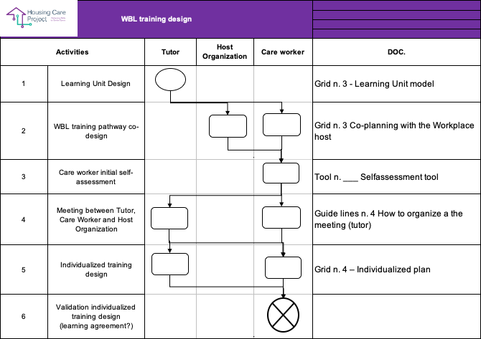
Group work processes – WBL design

Slide 55
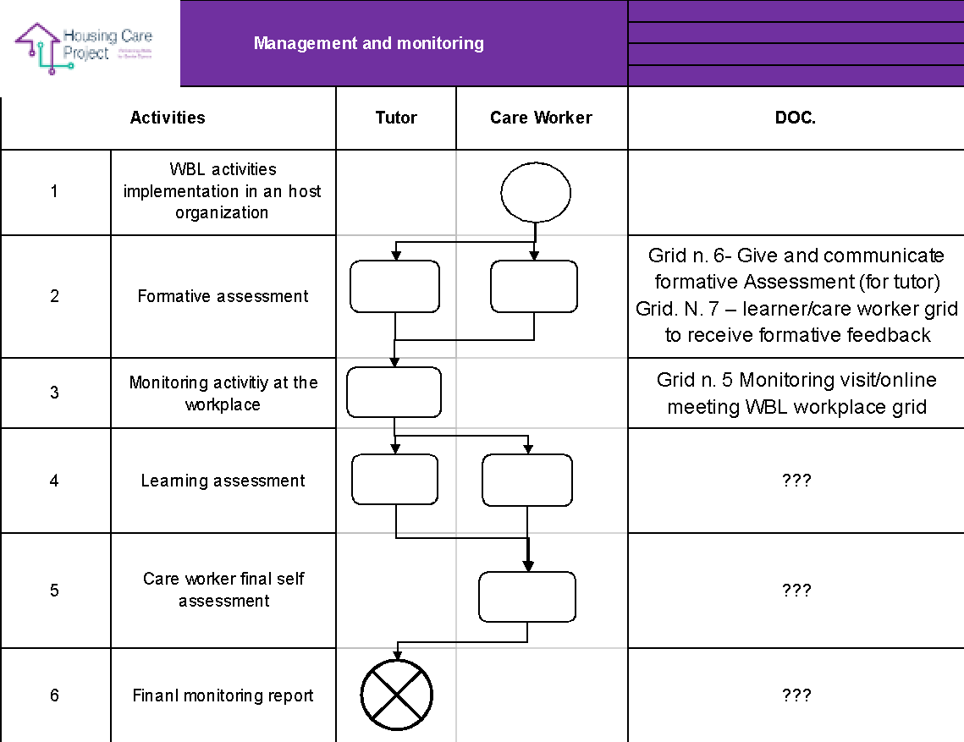
Group work processes – Management and monitoring

Slide 56
Group work on process
Create two groups
The first group will work on «WBL design» process and the second group will work on «Management and monitoring» process
We propose you to work according the following steps:
Add activities/tasks that in your opinion are missing
Describe the final output of the process
Describe more in details each listed activity/task
Connect the modules and the tools we presented to each activity/task.
Please, work directly on excel documents
Duration: 60 minutes

Slide 57
Thank you
﻿www.housingcare.net

