Slide 1
PR2
Human-Digit WBL Toolkit
Training Materials
HOW TO CO-PLAN THE WBL PATHWAY
﻿www.housingcare.net

Slide 2
01
02
03
WHAT DO YOU NEED?
SELF-ASSESSMENT QUESTIONNAIRE RESULTS
RESULTS OF CONVERSATION WITH THE CARE WORKER
SEE GUIDELINES N.4 «HOW TO ORGANISE A MEETING»
GRID. 2 LEARNING UNIT MODEL

Slide 3
03
04
05
WHAT DO YOU NEED?
GRID. 2 LEARNING UNIT MODEL
GRID. 3 CO-PLANNING WITH THE HOST ORGANISATION TOOL
GRID. 6
INDIVIDUALISED
PLAN

Slide 4
02
RESULTS OF CONVERSATION WITH THE CARE WORKER
Organise a meeting with the care worker, after he/she has filled out the self-assessment questionnaire.
The conversation aims to let him/her know better what the expected results are and be sure they have a clear picture of the pathway.

Slide 5
03
GRID. 2 LEARNING UNIT MODEL
In the learning unit, you’ll find a list of activities aimed at reaching the LOs outcomes already individuated in the MOOC. The work-based learning pathways is the occasion for the care workers to switch the knowledge acquired in competencies. Of course, the activities could require some adaptation according to the needs of the Host Organisation, the technologies and facilities available, and the needs and expectation of the care workers.
Before analysing the Host Organisation and exploring their needs, we suggest to have a strong knowledge of the activities proposed because it will help you better understand which ones can be implemented or not.

Slide 6
04
GRID. 3 CO-PLANNING WITH THE HOST ORGANISATION TOOL
The tool must be used to profile the host organisation and collect the following pieces of information:
TYPE OF ORGANISATION
ICT AND TECHNOLOGIES IMPROVING WORKERS PERFORMANCE
HEALTH AREA WORKING IN
TYPE OF ACTIVITIES THAT CAN BE DONE IN THE ORGANISATION
FACILITIES AND TECHNOLOGIES AVAILABLE

Slide 7
05
GRID. 6 INDIVIDUALISED PLAN
NAME SURNAME OF THE LEARNERS/CARE WORKERS
Learners’ Interests and passions emerged during the self-assessment
Individualised learning outcomes
Planned activities in the host organisation - co-planning grid

Slide 8
PROFILE SIMULATION
WORKSHOP

Slide 9
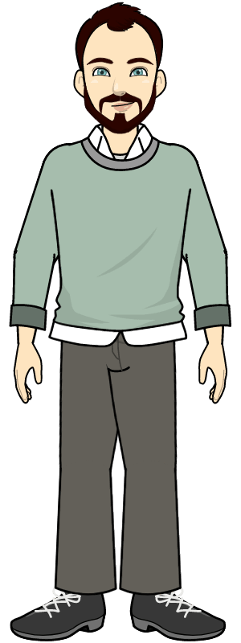
PROFILE 3 – HIGHER
PROFILE 2 – MEDIUM
PROFILE 1 - LOWER

Slide 10
This type of care workers generally have a migrant and/or disadvantaged background from the start, so they do not have a high educational profile. He or she works in the care sector performing the purely monitoring and care tasks of the elderly, but does not have all the necessary formal skills. Digitally, he is low in literacy.
The care worker identifiable in the low profile has the following characteristics:
The technological device he/she uses most frequently is the cell phone, and it is the one he/she knows best. He/she has little knowledge of the use of other commonly used devices such as smart TVs.
Uses cell phone casually for what they know about communication and the use of social interaction and entertainment apps.
Has little knowledge of other commonly used apps related to management, work planning, and task and document sharing.
Has little perception of what technology can do if properly deployed and integrated into their work, but is willing to learn.
In the health context:
Is familiar with commonly used apps such as those for weight control, rehydration, or exercise apps, yet does not know how to apply them in their work context.
Does not know more advanced or sophisticated prevention apps or tools.
Knows of the existence of apps and tools to help monitor a patient's pathological condition, but does not know how they work.
PROFILE 1 - LOWER

Slide 11
This type of care worker works in the sector to support themselves while studying or seeking employment more suited to their qualifications. He or she has taken a course to be able to do the job, so he or she has the basic knowledge of both the technologies and the socialization techniques to be adopted.
The average profile care worker the following characteristics:
Has excellent knowledge of everyday technologies, such as cell phones, PCs, tablets and smart TVs
Has an excellent knowledge of their use for both communication purposes, intervention, task management, production and exchange of documents and content.
Knows the potential of using technology in their work and uses some tools to support it, lacks the motivation to strengthen their knowledge in this regard.
In the health sector:
Knows the most popular monitoring and prevention apps such as exercise, hydration, and kalorie counting apps, but uses them mainly for personal use and does not integrate them into his own work.
Knows some more specific technologies such as care monitoring and emergency sensors, knows how to operate them but does not use them or have them available
Does not know the technologies related to e-health or telemedicine
PROFILE 2 – MEDIUM

Slide 12
This care worker decided to work in the care field because he is passionate about the topic of health and has the propensity to help others, so he chose this career path. He has obtained the qualifications to perform his role and is motivated to improve in order to advance in his career.
The high-profile care worker has the following characteristics:
Has excellent knowledge of everyday technologies such as cell phones, PCs, less than smart TVs.
He/she has excellent knowledge of the use of these tools for communication, entertainment, work management, production and exchange of documents and content.
He is aware that technology can contribute to the performance of his duties and is willing to learn them to improve himself.
In the health domain:
Is familiar with apps for weight control, hydration, kalorie counting, and physical activity, and uses some of these in his or her work but not systematically.
Knows some advanced technologies such as emergency calls, sensors, and apps for monitoring and preventing some diseases, but does not know how to use them appropriately
Knows some e-health and telemedicine tools but does not know how to use them
PROFILE 3 – HIGHER

Slide 13
Thank you
www.housingcare.net

