Slide 1

Smart and Ambient Assisted Living technologies
Work Based Learning Guide
The European Commission support for the production of this publication does not constitute an endorsement of the contents which reflects the views only of the authors, and the Commission cannot be held responsi­ble for any use which may be made of the information contained therein

Slide 2

Introduction
This guide is designed to help you with very specific practical tasks, you can use it as a cheat sheet while you navigate your way through the Work Based Learning unit or in any other situation.
This guide is centered around the technology you could use or need on a daily basis and aims to explain little tasks step by step. It also offers some external documentation so you can Deep dive into a specific topic and also, we want to give you some tips & tricks.
Don’t forget to use
your course notebook!

Slide 3

Introduction
Remember that in some cases you may need to explain these technologies to other people and encourage them to use it properly. For this purpose, there is another guide to help you with this task: “Social and emotional skills working with technologies”
It is in your hands to put it to good use and make it to your liking, we encourage you to take notes and write down other relevant information you feel complements this guide.

Slide 4

Practical examples
1
Accessibility configurations on Smartphones
2
Take a note & forwarding via e-mail
3
Google calendar: the basics
Click to go directly to these learning slides !
4
Google AR map assistance
5
Easy Launchers: simple yet powerful

Slide 5
Practical examples
6
Facebook basics
7
Android safety mode & Samsung Alarm
8
Voice assistants: Alexa basics
9
Yuka App
10
Keepass

Slide 6
Practical examples
11
General & Useful resources
12
Wrap up

Slide 7
1
Accesibility configurations

Slide 8


Accessibility configurations on Smartphones
Ring a bell?
This topic is related to Module 1
This topic covers some points in order to adapt smartphones to your needs or the needs of the person you are configuring the phone for (your Client).
Accessibility configurations are very important, it could be the decisive point for a senior when it comes to use a technological device or not, we should foster and promote its use and make it easier to interact with.
We encourage you to spend a few minutes to understand the needs and the reality of the person you are assisting, it is important to customise and adapt the way they interact with technology.

Slide 9
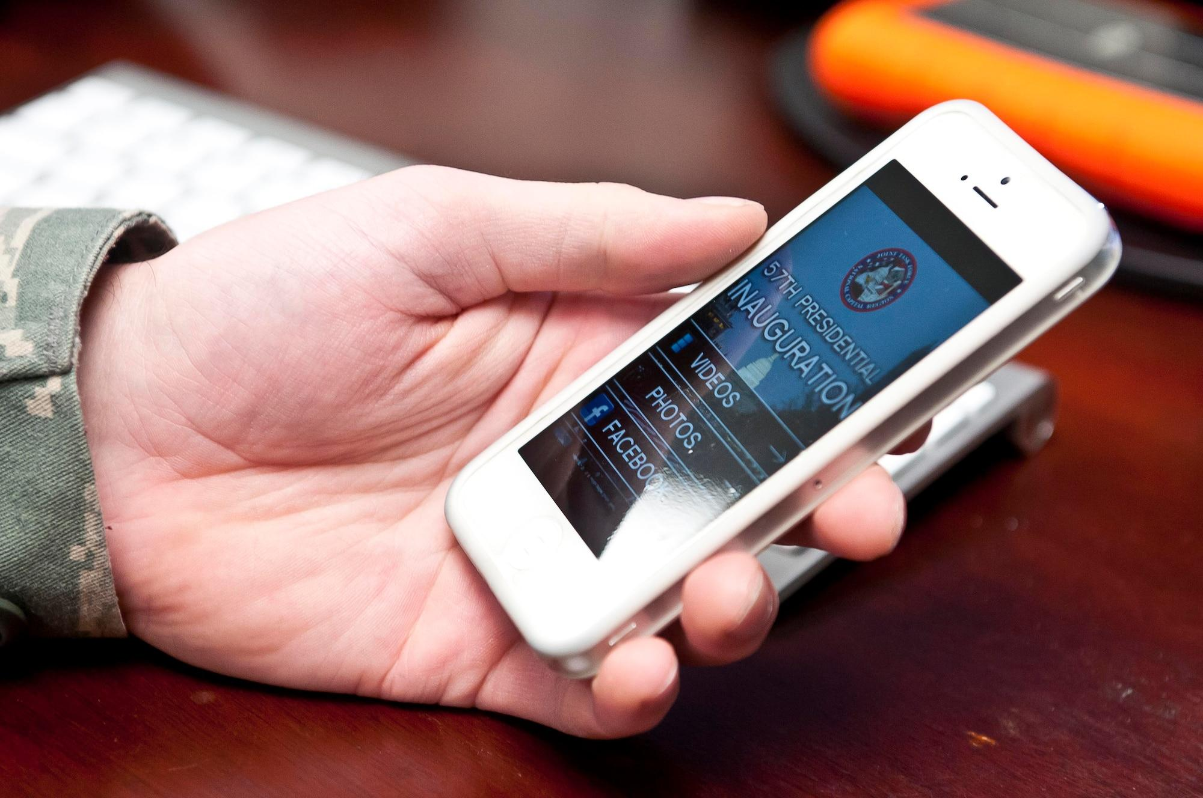
Accessibility configurations on Smartphones
1
The accessibility menu
2
Visibility enhancements
3
Hearing enhancements
4
Talkback
5
Voice Access

Slide 10
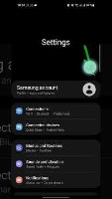
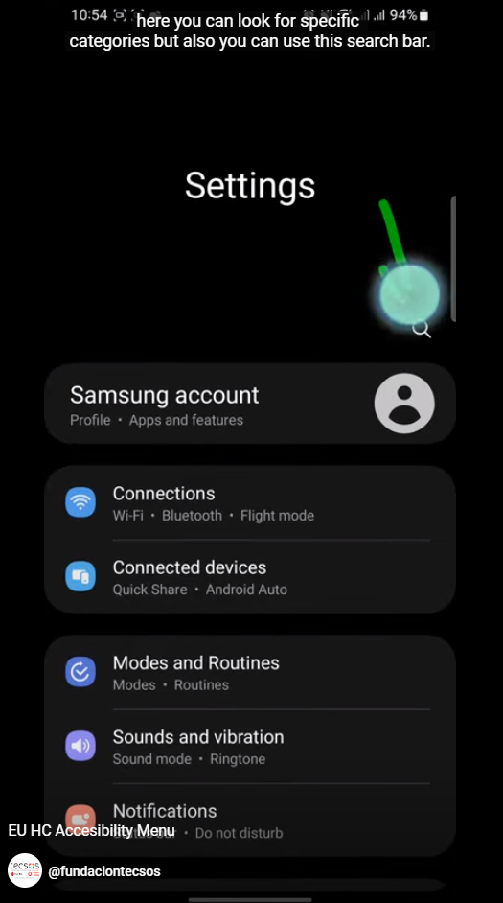

How to manage the accessibility menu
https://www.youtube-nocookie.com/embed/q9fS5Elq0YM?hl=en&cc_lang_pref=en&cc_load_policy=1
Locate settings
Look for “accessibility” keyword
Do you have Apple/iOS?
Don’t worry, follow the same steps.
https://support.apple.com/en-gb/guide/iphone/iph3e2e4367/ios

Slide 11
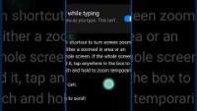
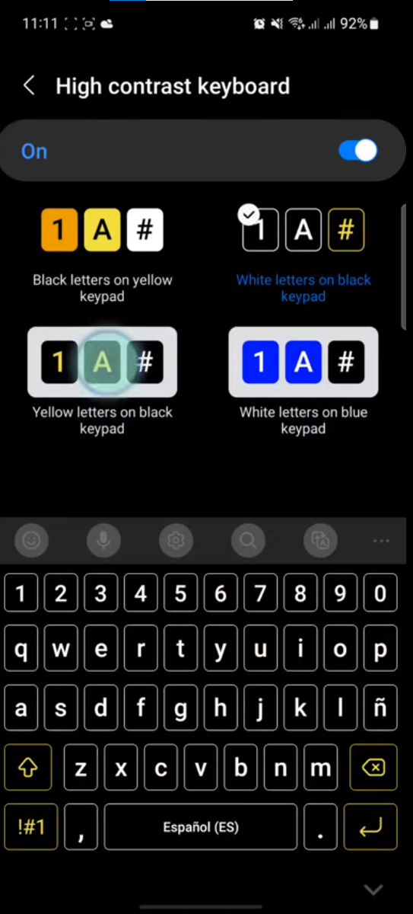
https://www.youtube-nocookie.com/embed/67N1E_AnF54?hl=en&cc_lang_pref=en&cc_load_policy=1
Visibility enhancements
Display size and font size: To change the size of items on your screen, adjust the display size or font size.
Magnification: To temporarily zoom or magnify your screen, use magnification.
Contrast and color options: To adjust contrast or colors, use high-contrast text, dark theme, colour inversion, or colour correction.
Select to Speak: If you want spoken feedback at certain times, you can turn on Select to Speak. Select items on your screen, or point your camera at something to hear it read or described aloud.

Slide 12
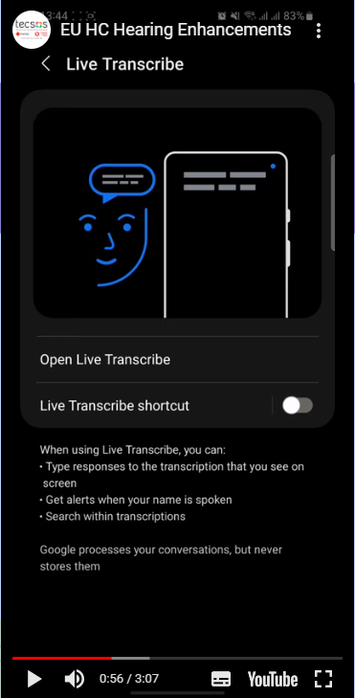
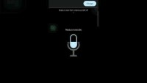
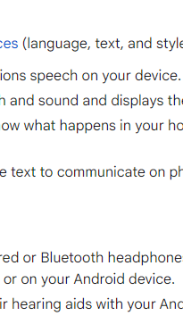
https://www.youtube-nocookie.com/embed/M7tuspgozmY?hl=en&cc_lang_pref=en&cc_load_policy=1
Hearing enhancements
You can choose caption preferences (language, text, and style) for your device.
Live Caption automatically captions speech on your device.
Live Transcribe captures speech and sound and displays them as text on your screen.
Sound Notifications help you know what happens in your home, like when a smoke alarm beeps or a doorbell rings.
Real-time text (RTT) lets you use text to communicate on phone calls.
Sound Amplifier lets you use wired or Bluetooth headphones to filter, augment, and amplify the sounds in your environment or on your Android device.
Hearing aid support lets you pair hearing aids with your Android device to hear more clearly.

Slide 13
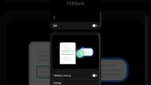
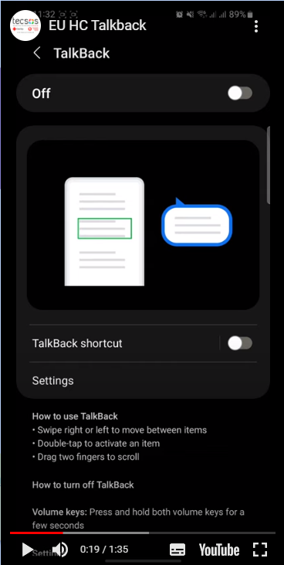
Talkback
To interact with your device with touch and spoken feedback, you can turn on the TalkBack screen reader. TalkBack describes your actions and tells you about alerts and notifications.
You can use the TalkBack braille keyboard to enter 6-dot braille on your screen. TalkBack braille keyboard is available in Unified English Braille, Spanish, and Arabic.
https://www.youtube-nocookie.com/embed/nvzPIfR4ugI?hl=en&cc_lang_pref=en&cc_load_policy=1

Slide 14
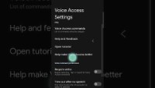
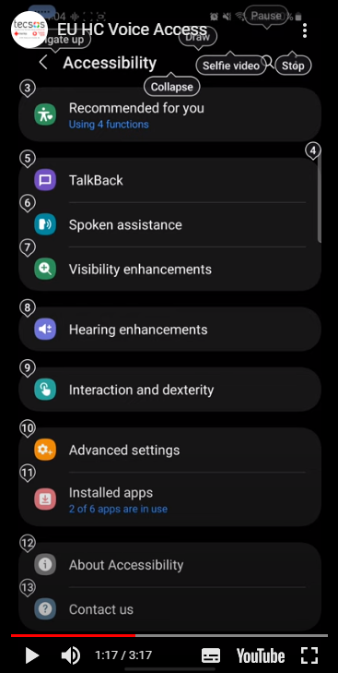
Voice Access
Open your notification shade and tap Touch to start.
On your Home screen, tap the Voice Access app .
Tap the Voice Access activation button . (You can set up the activation button in Settings and then Accessibility and then Voice Access and then Settings and then Activation button.)
Say a command, such as "Open Gmail." Learn more Voice Access commands.
https://www.youtube-nocookie.com/embed/fileanA1GG8?hl=en&cc_lang_pref=en&cc_load_policy=1

Slide 15
2
Take a note & forward it via e-mail

Slide 16
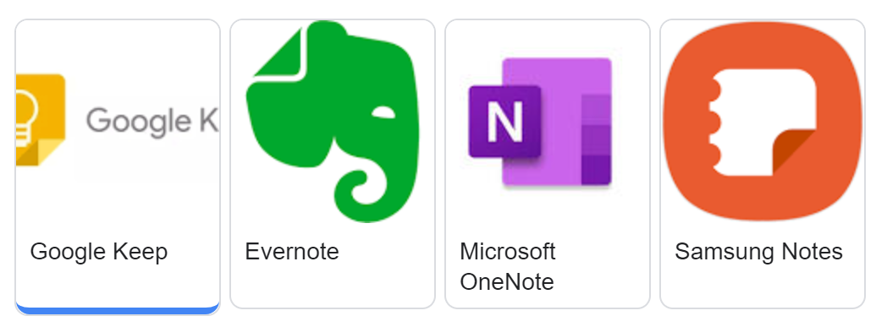
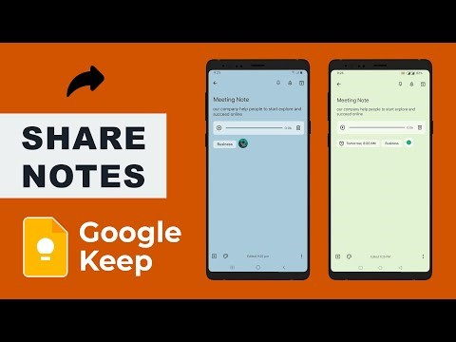
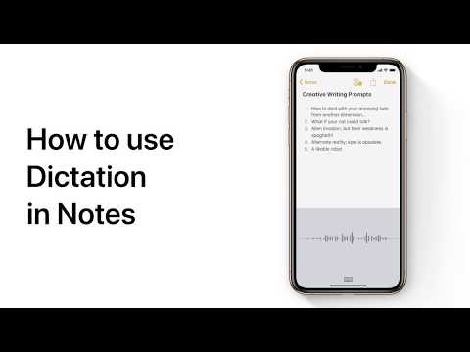



Take a note & forward it via e-mail
Locate notes app
Create new note with content
Tap share icon:
  iOS
  Android
You can also try to transcribe your voice!

Slide 17
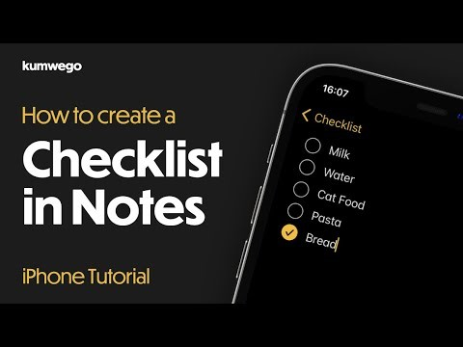
Take a note & forward it via e-mail
Download Android App:
Google Keep: Notes & Lists - Apps on Google Play
If you have any doubt about the process:
Share notes, lists & drawings - Android - Google Keep Help.
Download iOS App:
Notes on the App Store (apple.com)

Slide 18

3
Google calendar: the basics

Slide 19
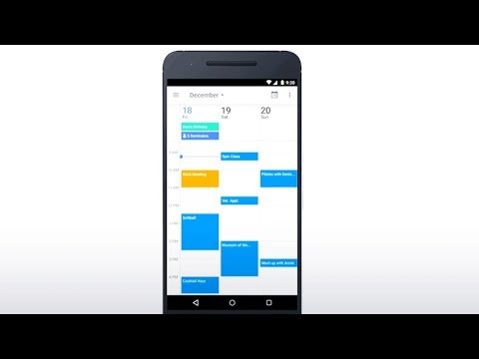
Google calendar: the basics
Get Calendar:
Web (calendar.google.com), Android, or iOS

Slide 20
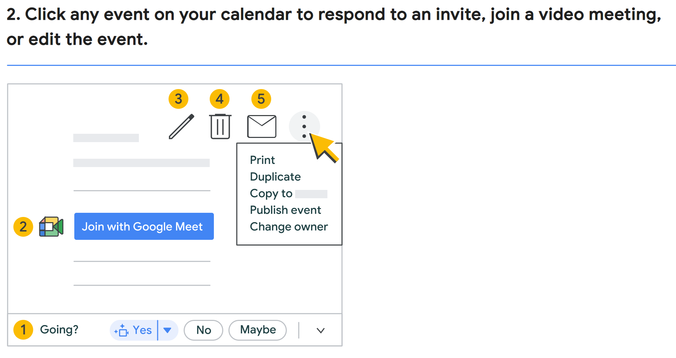
Google calendar: the basics

Slide 21
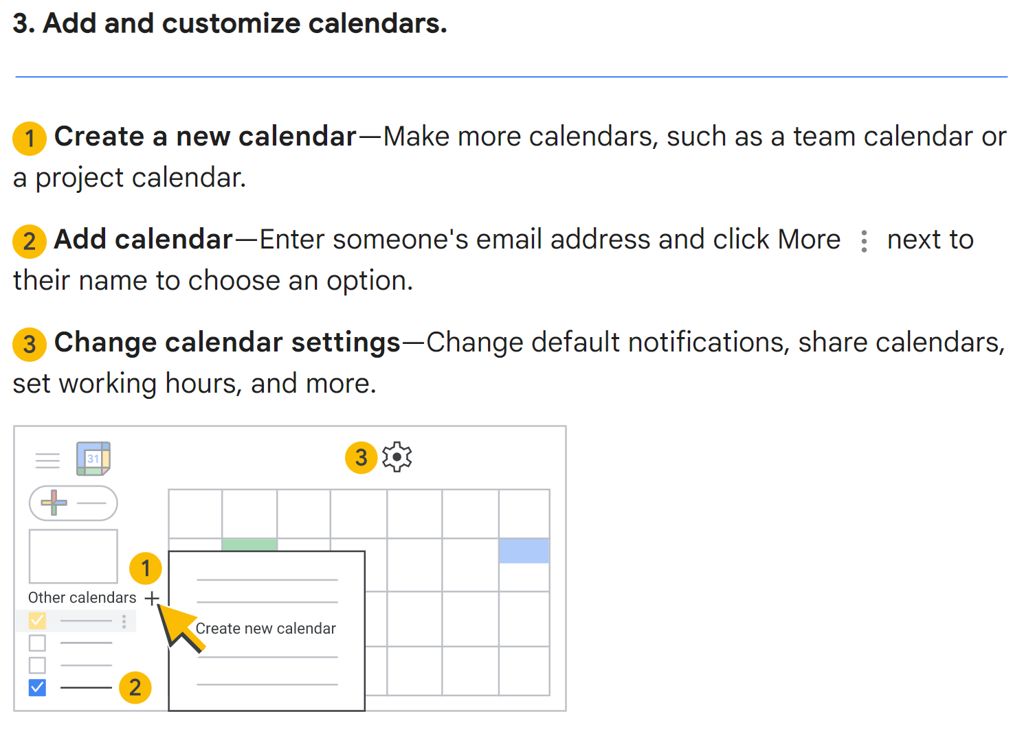
Google calendar: the basics

Slide 22
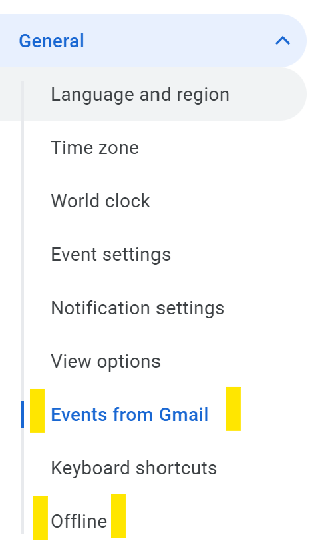
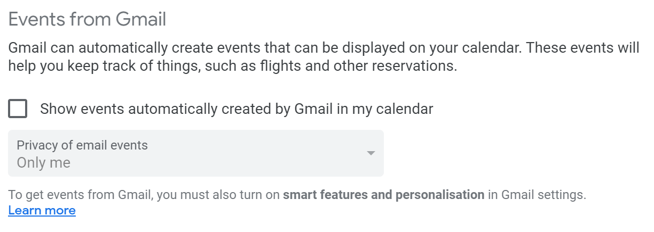
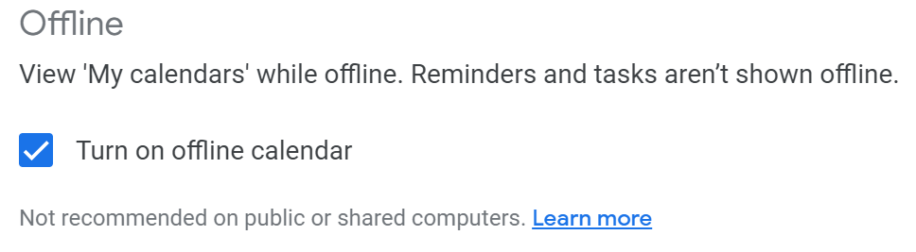
Google calendar: the basics
Configuration recommendations, pay special attention to the following:

Slide 23
4
Google AR map assistance

Slide 24

Google AR map assistance
Set the route
Press “Live view”
Scan and Follow AR landmarks
(vertical position)

Slide 25
5
Easy Launchers

Slide 26
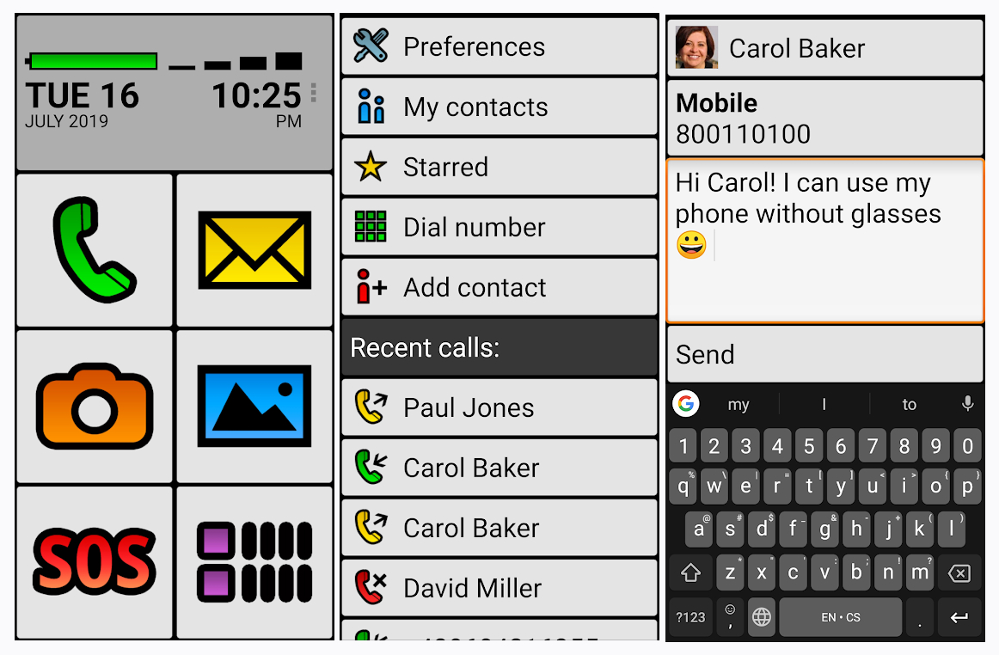
Easy Launchers: simple yet powerful
It is highly recommended to customise the visual elements to the user preferences before teaching how to use the simplified interface.
The App in the image is bigLauncher, but it is just an example, there are plenty of similar Apps out there.
Find the one that suits the situation best.

Slide 27
6
Facebook basics

Slide 28
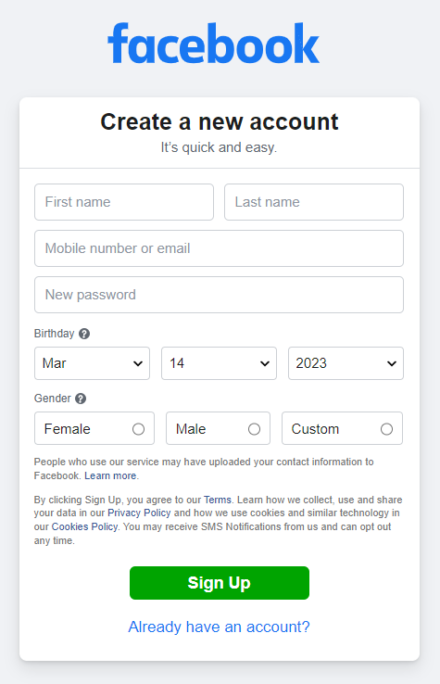
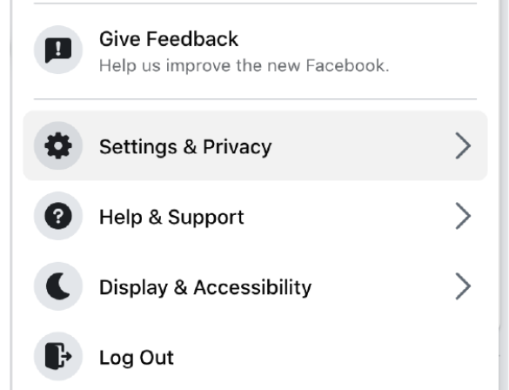
Remember we also talked about Facebook in Module 3!
Facebook basics
Create a new account (fill in the forms)
Set Privacy settings
Facebook terms Glossary : https://blog.hubspot.com/marketing/how-to-use-facebook

Slide 29
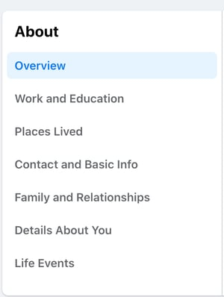
Facebook basics
Personalise your profile (choose a photo)
Add friends
Check your news feed
Interact!
  Like
  Comment
  Chat
  join groups…
Here you have simple video tutorials for more advanced stuff:
https://socialmedia4beginners.com/facebook-course/

Slide 30

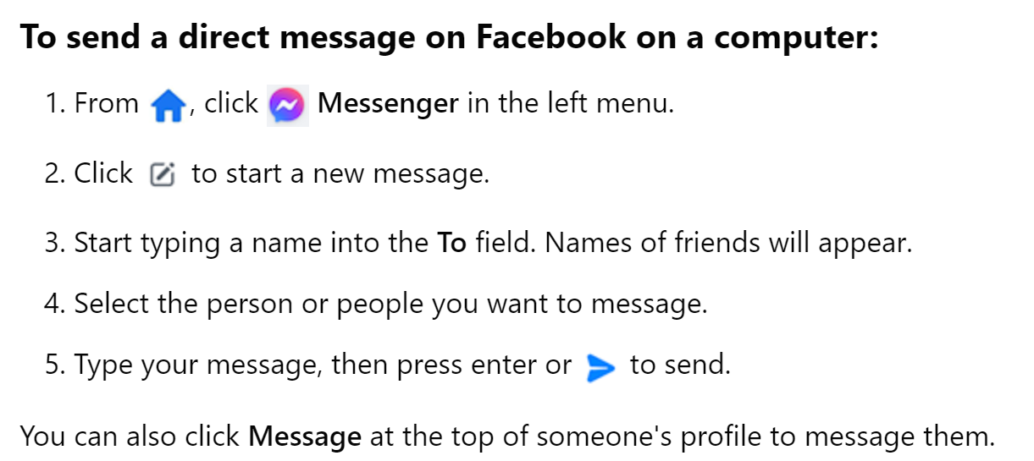
Facebook basics
Official documentation:
https://www.facebook.com/help/
Likes:
Clicking Like below a post on Facebook is a way to let people know that you enjoy it without leaving a comment. Just like a comment, anyone who can see the post can see that you liked it.
Chat:

Slide 31
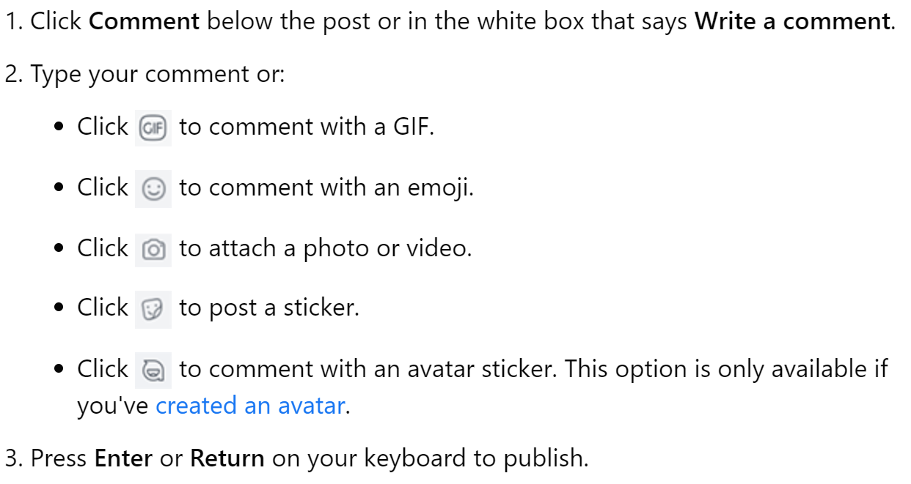
Official documentation:
https://www.facebook.com/help/
Facebook basics
Comment:

Slide 32
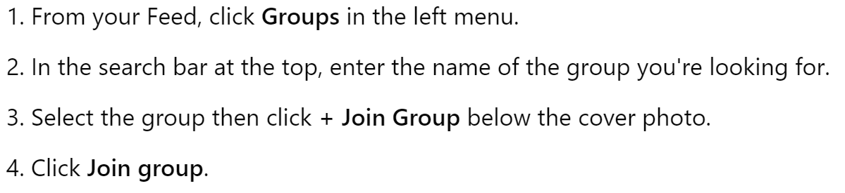
Official documentation:
https://www.facebook.com/help/
Facebook basics
Join Group:

Slide 33
7
Android safety mode & Samsung Alarm

Slide 34
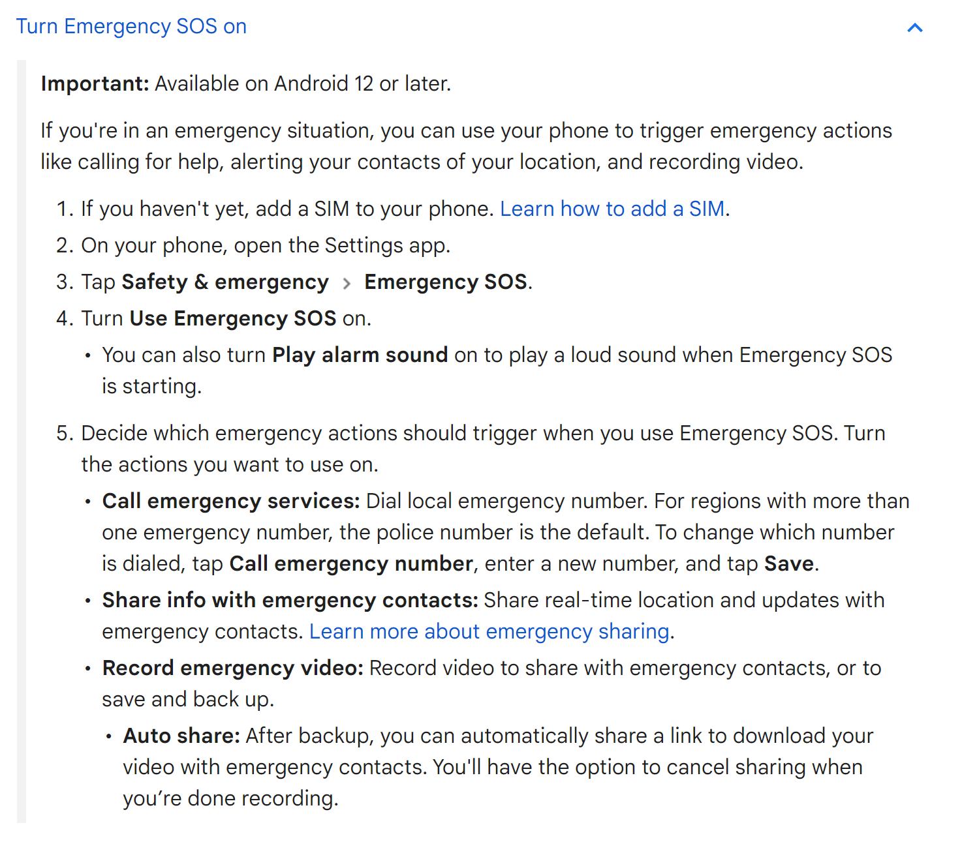
Android safety mode & Samsung Alarm
Android safety mode & Samsung Alarm
Need a Deep dive into the docs?
Get help during an emergency with your Android phone - Android Help (google.com)

Slide 35
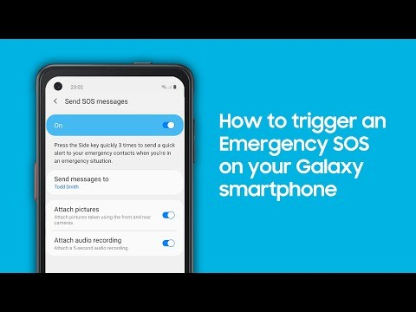
Android safety mode & Samsung Alarm
Samsung Alarm documentation:
How to set up an emergency SOS on your Galaxy smartphone (samsung.com)

Slide 36
8
Voice assistants: Alexa basics

Slide 37
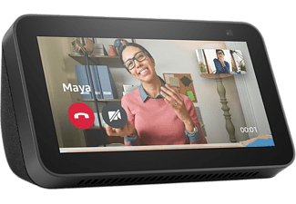
Voice assistants: Alexa basics
Alexa can undestand you in many ways, it is there to help you and answer your requests, feel free to chat with Alexa!
Remember to say Alexa before each request!
Alexa, help.
Alexa, mute or Alexa, unmute.
Alexa, stop or Alexa, shut up.
Alexa, set the volume to 5, Alexa, louder or, Alexa, turn up/down the volume.

Slide 38
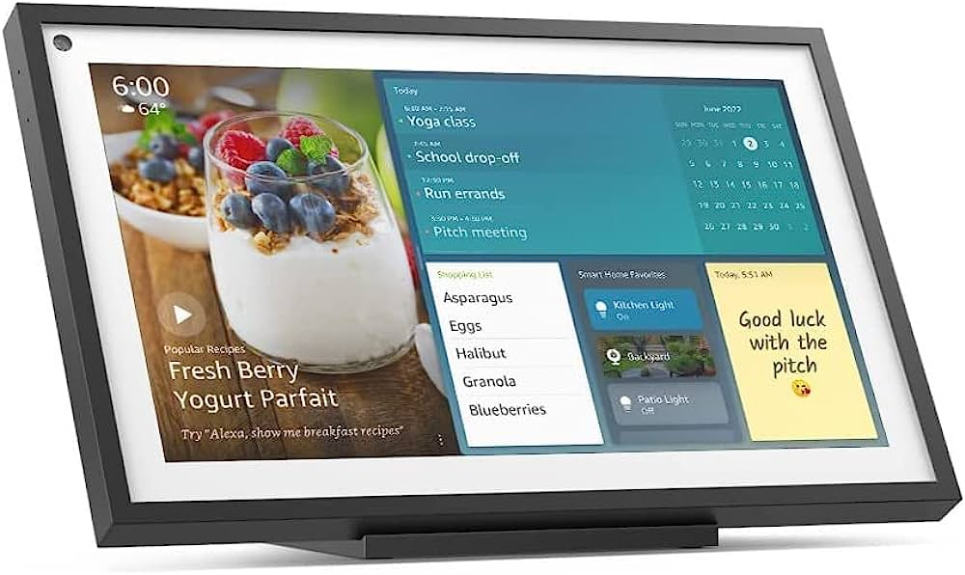
Voice assistants: Alexa basics
Alexa, play some music.
Alexa, what’s the weather in (name your city)
Alexa, wake me up at [time]/ remind me to turn off the oven in 45 minutes.
Alexa, add eggs and potatoes to my shopping list. (carry the list on your phone)
Alexa, ambient sounds ocean
Alexa, how old are you?/Alexa, which comes first: the chicken or the egg?
Alexa, call my grandson.
Alexa, is the pharmacy still open?
Alexa, how far is the cinema?/Alexa, what movies are playing?

Slide 39
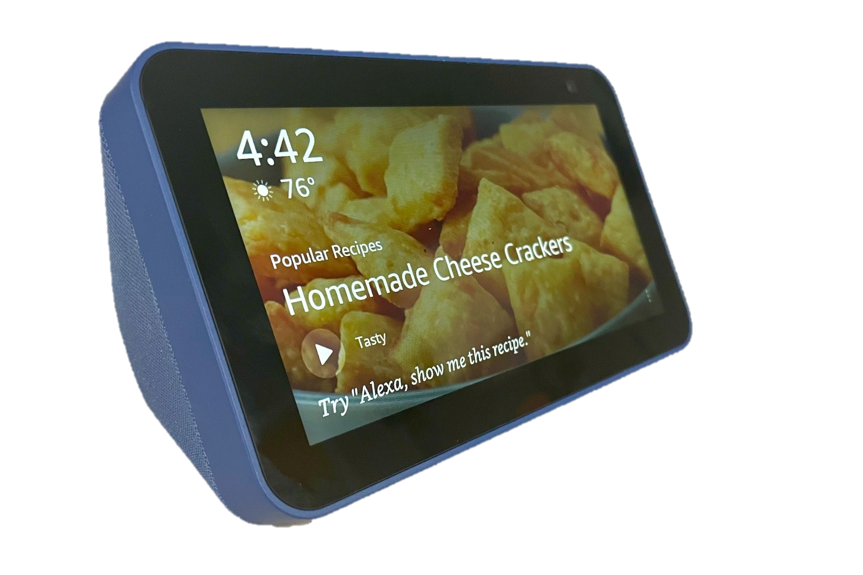
Voice assistants: Alexa basics
Alexa, play some music.
Alexa, call my grandson.
Alexa, what’s the weather in (name your city)
Alexa, wake me up at [time]/ remind me to turn off the oven in 45 minutes.
Alexa, add eggs and potatoes to my shopping list. (carry the list on your phone)
Alexa, ambient sounds ocean
Alexa, how old are you?/Alexa, which comes first: the chicken or the egg?
Alexa, is the pharmacy still open?
Alexa, how far is the cinema?/Alexa, what movies are playing?
Alexa, I don’t know what to cook

Slide 40
9
Yuka APP (healthy lifestyle)

Slide 41
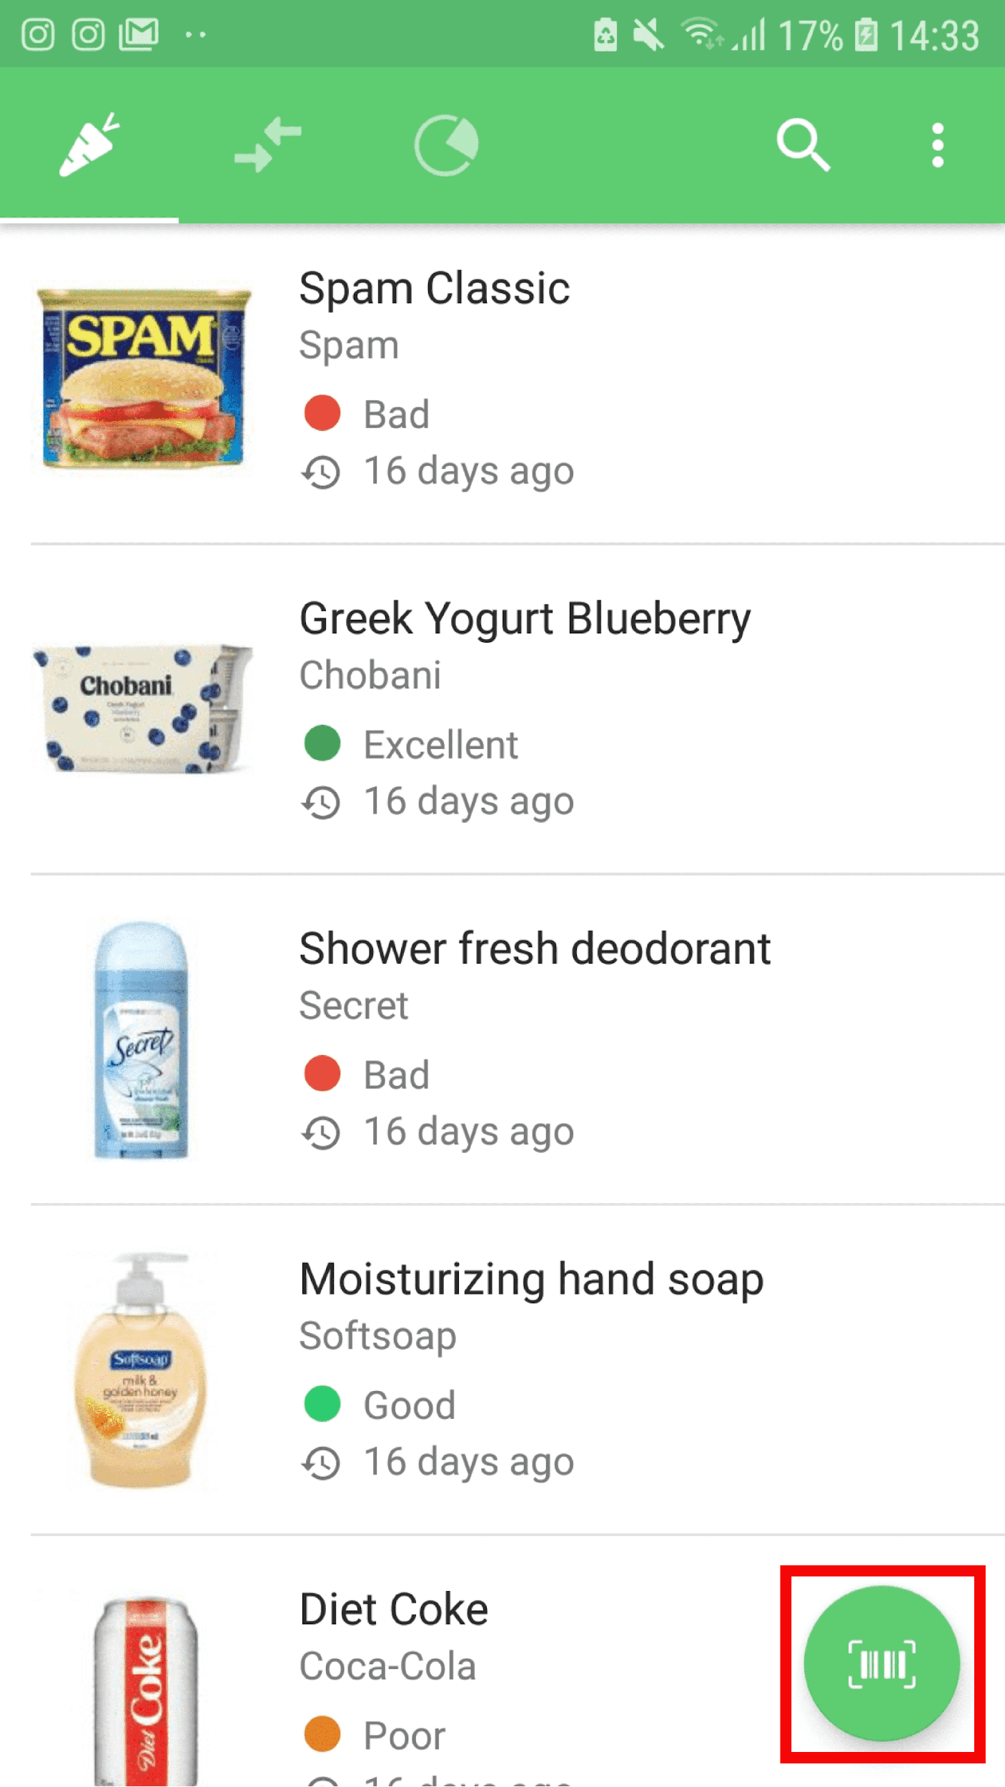
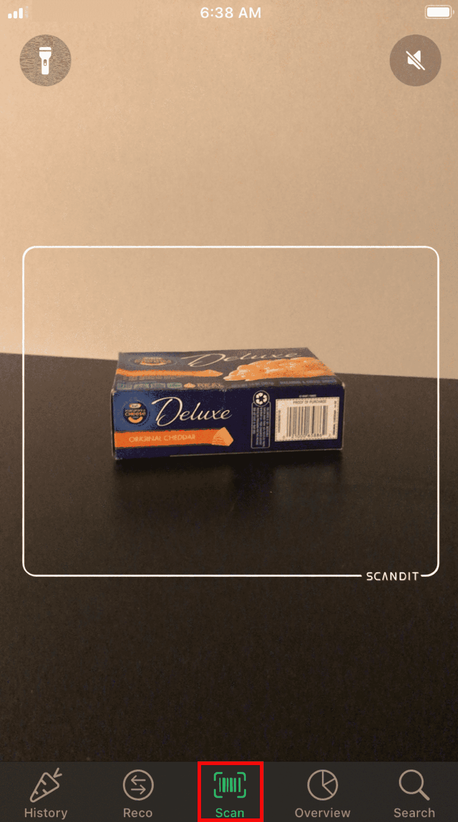
Yuka APP
Scan
Read nutritional or cosmetic score

Slide 42
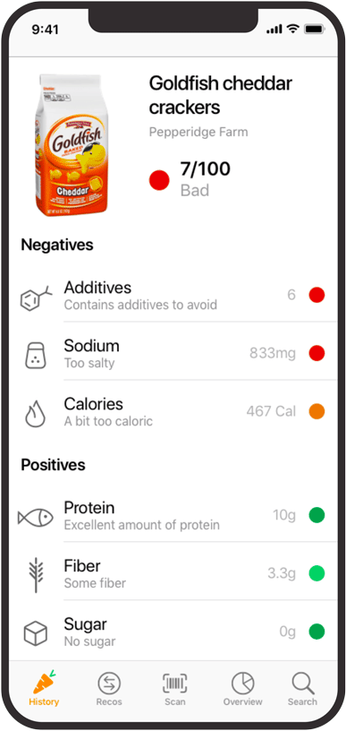
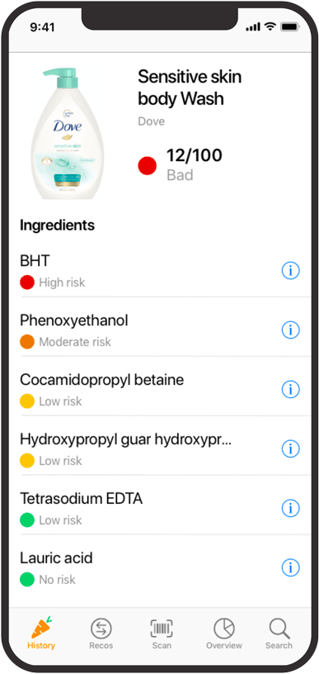
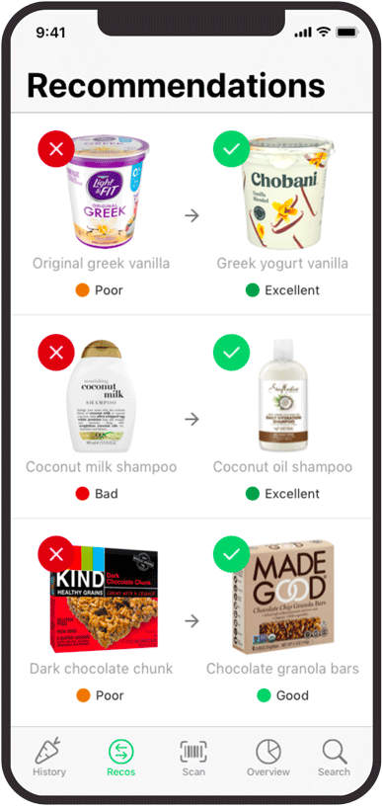
Yuka APP
Nutritional Score
Cosmetic Score
Yuka's nutritional analysis, based on the Nutri-Score, only takes into account the sugar content and not the total carbohydrate value. So it is not a suitable metric for diabetic people.

Slide 43

10
KeePass (GDPR, simple & safe password manager)

Slide 44
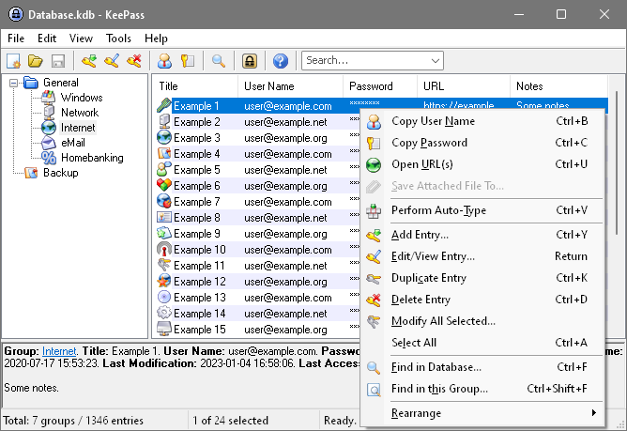
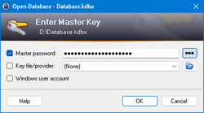
It can be overwhelming at first, but you will quickly realise it is really easy to setup and use.
KeePass
A password database consists of only one file that can be transferred from one computer to another easily or stored in the cloud.
One master password decrypts the complete database of credentials (you only need to remember one strong password).

Slide 45
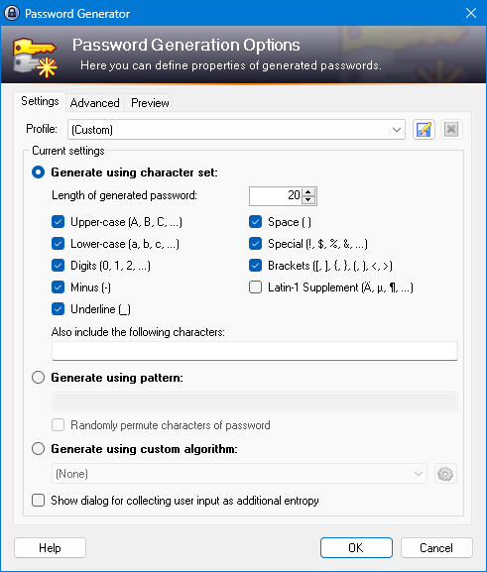
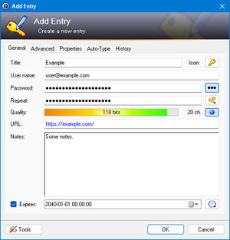
KeePass
You can create, modify and delete groups, in which passwords can be sorted into.
KeePass can minimize itself and type the information of the currently selected entry into dialogs, webforms, etc. On top of that, all fields (title, username, password, URL and notes) can be dragged & dropped into other windows.

Slide 46
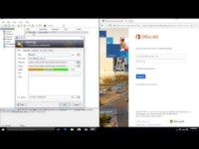
Keepass
TRY TO CREATE YOUR OWN DATABASE
  Choose a strong but easy to remember password for the master key
  Create at least:
    - 3 passwords entries
    - 2 groups
  Additionally, try to execute the autotype feature
    - ctrl+u to navigate to URL,
    - ctrl+v to autotype credentials).

Slide 47
11
General & Useful
resources

Slide 48
General & Useful resources
Official Apple support Youtube channel:
https://www.youtube.com/@applesupport
Official Android Support documentation: https://support.google.com/android/?hl=es#topic=7313011
Official Facebook help documentation:
https://www.facebook.com/help/
Official KeePass help documentation:
https://keepass.info/help/base/index.html

Slide 49
12
Wrap UP

Slide 50

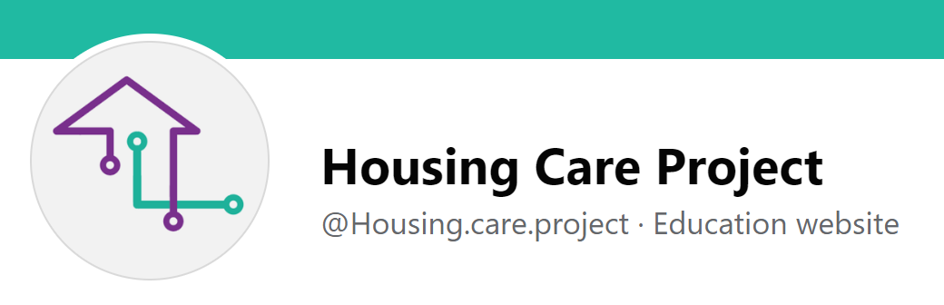
Congratulations!
Remember to reflect your impressions and learnings into your Learners notebook so you can revisit and consolidate the information.
Remember that not all tech products are for everyone, your role is also to “prescribe” the technologies that may fit the best to a person (and adapt it!)
Do you have something to share with us?? How About leaving a comment on our Facebook Page?

Slide 51
The European Commission support for the production of this publication does not constitute an endorsement of the contents which reflects the views only of the authors, and the Commission cannot be held responsi­ble for any use which may be made of the information contained therein

