Slide 1
MODULE 1 –
Digital Literacy Skills
﻿www.housingcare.net

Slide 2
We want to Assist YOU as Care Workers Keep up with Digitalisation?
Things to consider…
1
2
3
4
Do You have the digital equipment:
Smart phones
iPads/Tablets
Laptops
Your Digital Literacy:
Online Tuition
Availability of classes
Motivation
Availability of Assistance:
Family
Co-workers
Peers/friends
Tech Support
Ease of Use:
Devices
Apps
Platforms
Ordering systems

Slide 3
Module 1
By the end of this module, we aim for you as Carers to be able to:
Realise and understand the benefits & basic functionality of 3 devices
Identify the component parts of these devices
Create awareness of IT (information technology) systems in our everyday lives
Examine the safety element when using these devices even at a basic level

Slide 4
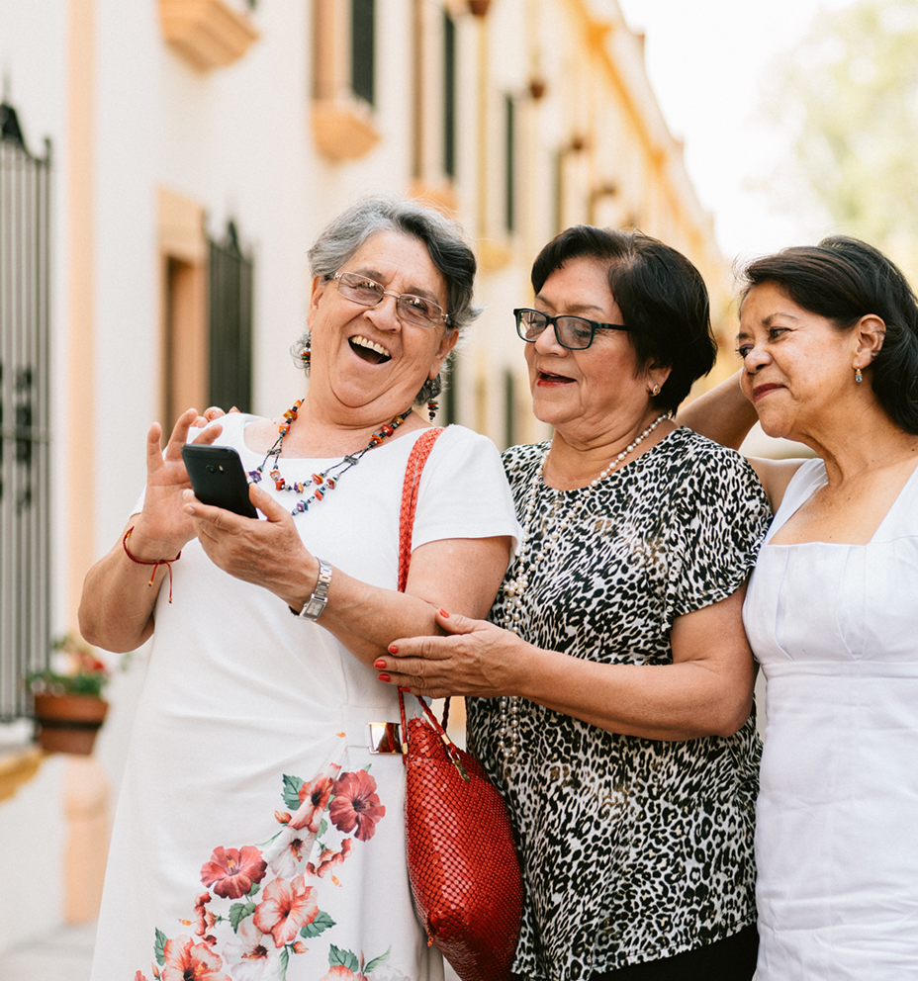
contents
TIP: TAP ON THE TOPIC TO BRING YOU TO IT DIRECTLY
01
The importance of digital literacy in our everyday lives
02
The Effective Use of Mobile Smart Phones
03
The Effective Use of IT Tablets
04
The Effective Use of Smart TVs
05
Creating awareness of how data security must be considered

Slide 5
01
The importance of digital literacy in our everyday lives

Slide 6
What is Digital Literacy?
Digital literacy is defined as an individual’s ability to search, find, evaluate, and compose clear information through typing, writing, tapping, and by using other mediums (e.g., multimedia videos, video calling, and messaging) on various digital platforms, which requires a basic level of computer competency (Bawden, 2008).
Source

Slide 7
The Importance of Digital Literacy…
From school to the workplace to personal use, digital literacy is vital in many areas of life — but simply, having it is an absolute necessity for anyone who uses the internet.
Sometimes forms and applications are only available online, so you’ll need to be comfortable accessing and using them. The ability to evaluate whether a website is authentic or not can save you from headaches and knowing how to share documents can help keep workflow moving.
In short…digital literacy is a necessary skill for navigating work in our modern, digital world.
We want to show you how it can help you in your care worker role on a day-to-day basis.

Slide 8
The 3 Cs
TIP: TAP ON THE TOPIC TO BRING YOU TO IT DIRECTLY
Much like “literacy” is the ability to read and write, DIGITAL LITERACY is the ability to perform tasks in a digital format. While the exact definition may vary between companies, universities, or institutions, you can generally break down the concept of digital literacy into three main skills.
Source
How you CONSUME information
1
This is the ability to complete digital tasks like using an e-reader (kindle), viewing your online banking statements, or searching & reading an online article.
How you CREATE information
2
This skill includes everything from making and editing videos to writing articles to creating and editing PDFs.
How you COMMUNICATE information
3
Once you have information, you’ll need to know how to share it. Communication can be composing a tweet to sending an email to sharing documents online and more.

Slide 9
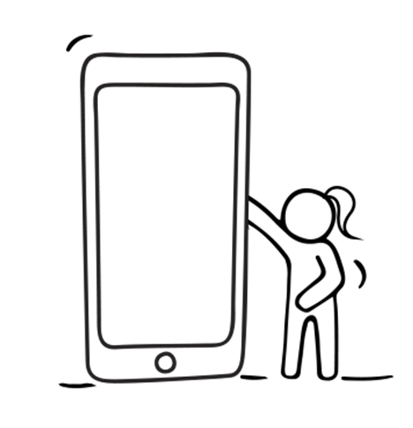
How you CONSUME the Information…
Digital literacy requires both:
Technical knowledge and so it is important you know how to access the information via the tools available to you…devices, programs and applications. Understanding how to use services like Google Search to find information
Cognitive knowledge then concerns how one should be capable of gathering information, conducting research, and analysing data by using technology, as well as determining the accuracy of the information.

Slide 10
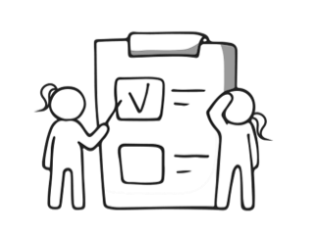
How you CREATE information
Digital competence -
Choosing the software & format
Creating file names
Storage and back-up
Know relevant best practices
Plan for sharing
IF YOU ARE CURIOUS TO LEARN MORE ABOUT DIGITAL TOOLS THAT COULD HELP YOUR PRODUCTIVITY, CLICK HERE OR REVISIT AT A LATER STAGE
Enhancing Productivity - The ability to employ digital tools that could enhance productivity in your daily workstream

Slide 11
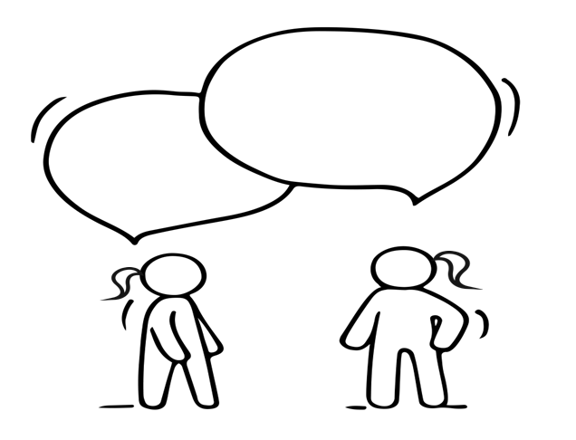
How you COMMUNICATE information.
Communicating Digitally - A significant example of digital literacy is the ability to use technology effectively for communication, which is one of the main reasons people get online in the first place. Sharing information via email, or messaging services or being able to perform video calls, will greatly enhance your communication style.
Protecting Yourself Online - One must understand the rules of internet safety considering the vast amount of information available online. Creating strong passwords, managing the privacy settings of you or client's personal information, and knowing what not to post on social media all contribute to being digitally literate

Slide 12
The Importance and Benefits of Digital Literacy
In today’s world, where the use of new technologies prevails, it’s almost essential to understand that this is the new way of connecting with people and communicating both with them and the world…both in your professional life and personal life.
Digital literacy goes beyond learning digital tools and programs and has great benefits. For example it:
Develops critical thinking: By accessing more information, you can better contrast it, thereby fostering critical thinking. This keeps your mind active and effective.
Allows access to better jobs. Knowing and mastering ICT (Information and Communications Technology) today increases the possibility of accessing more and better-paid jobs and creates more sustainable futures for care workers.
Favours social inclusion and development. In fact, a lack of access to technology creates more differences in the cultural, economic, social, and educational spheres.
Improves the day-to-day. New technologies can be integrated into your day-to-day work & personal life and improve your quality of life, making it easier and more comfortable.

Slide 13
Global Digital Literacy Skills…
Internet
There has been substantial growth in home use of the internet over the past 25 years. Over 3 billion people, which is approximately 40% of the world’s population, access the internet using a variety of devices. Source
Social media
The number of social media tools has also risen significantly. Social media are web-based communication tools, as opposed to more traditional media such as newspapers, radio and TV.
Social media enables people to communicate with each other. This can include sharing and consuming information.

Slide 14
Popular social media sites
TIP: TAP ON THE ICONS OR NAMES TO ACCESS THESE SITES
Facebook | Twitter | Instagram | YouTube | LinkedIn | Wikipedia
Users upload pictures, photos and videos, and send messages. It now a common place for business use | Users post tweets up to 140 characters of text, that may contain photos, pictures, videos, links etc. | Users share videos, pictures and photos taken on smartphones. It is a very visual platform and is used by businesses too | Users share videos for anyone to see. It has open access for watching videos. | This is designed for the business community to make professional connections with others. | This is an ‘encyclopedia’ that has been written collaboratively by the people who use it.
Estimates suggest that there are around 2.3 billion social network users worldwide. People use these sites and applications for personal, employment & business purposes
Source

Slide 15
The downsides of social media…
Despite the popularity of social media, there are some downsides that affect individuals. These include:
reputation damage
lack of privacy
safety concerns including cyberbullying
fake-news
potential for addiction

Slide 16
The next few slides get a bit technical as we introduce you to and describe some common digital literacy terms…you will be surprised how many you know already…just wait and see!!

Slide 17
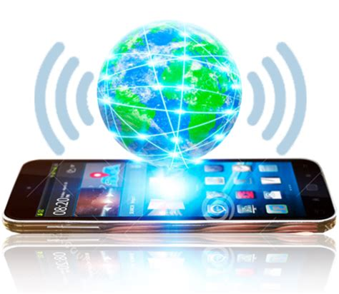
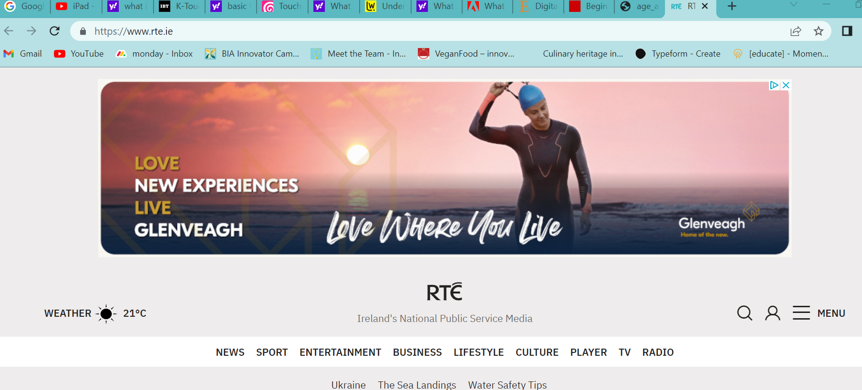
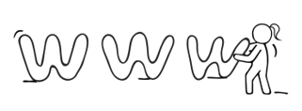
Some Digital Literacy – Terms
1. The Internet
The Internet is a network of billions of computers that share information around the world. Because we can’t see the internet, we often call it ‘virtual’ rather than physical.
3. A Website
A website is made up of pages of information. For example, the RTÉ website is a
collection of pages on TV listings, radio schedules, news, sport – in words, photos, sound and video.
2. Email
Email is Electronic Mail – an electronic version of a letter or note. When you type a message and send it, it can reach its destination in seconds.
4. A Web address & Links
A web address is a unique address (URL) for each webpage, like an electronic version of a postal address. Because there is such a huge amount of information on the internet, if we know the address of websites, it helps us to find things more easily. It nearly always starts with www. (World-Wide-Web). A link or hyperlink – This is part of a webpage that when clicked, opens a different web page. Links are usually underlined in blue.

Slide 18
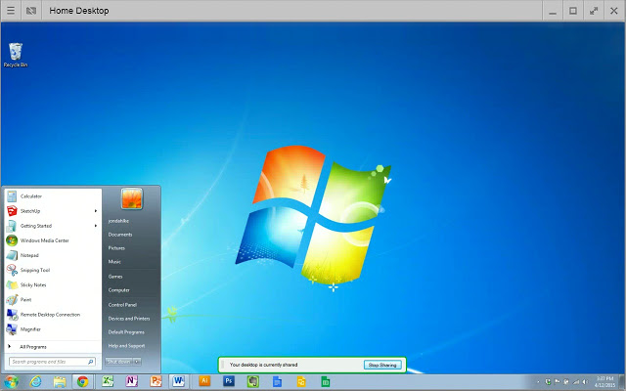
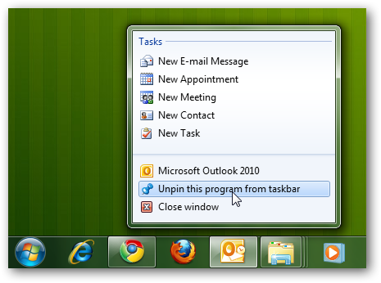
Some Digital Literacy – Terms
5. Icon
A small picture or image representing a command (such as print),
a file, or a program. When you double-click (i.e. click twice) on an icon,
you start a command, open a file, or launch a program.
7. Taskbar
A row of buttons or graphical controls on a device screen that
represent open programs, among which the user can switch back
and forth by clicking on the appropriate one.
6. Desktop
The information that appears on the device screen soon after the device is turned on. The desktop contains several icons, or images, that you can click on to start programs.

Slide 19
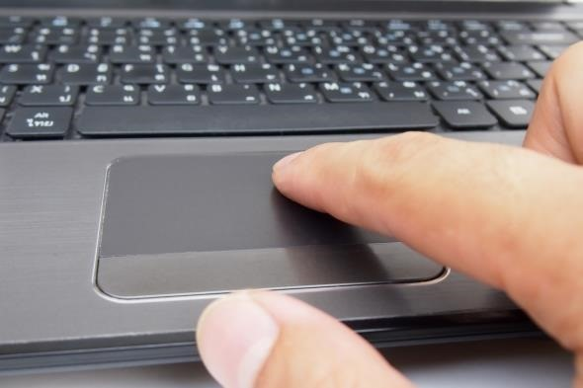
Some Digital Literacy – Terms
8. Power and Charging Indicators
These symbols indicate whether the battery is low, charged
or fully charged and charging or not. Typically, a battery symbol at the top right-hand side of the device screen will indicate the level of charge.
10. Keyboard
The keys that operate the computer, very much like a typewriter,
with extra keys for special functions. Tablets & smartphones have touchscreen keyboards
9. Touchpad
A touchpad is a built-in device for pointing (controlling input positioning) on a computer display screen. It is an alternative to the mouse. These are common on laptops.
11. Notification Area
The notification area is a portion of the taskbar that provides a temporary source for notifications and status. It can also be used to display icons for system and program features that have no presence on the desktop.

Slide 20
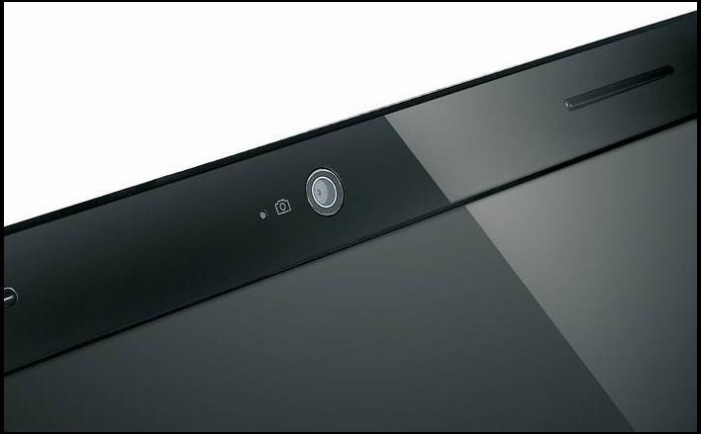
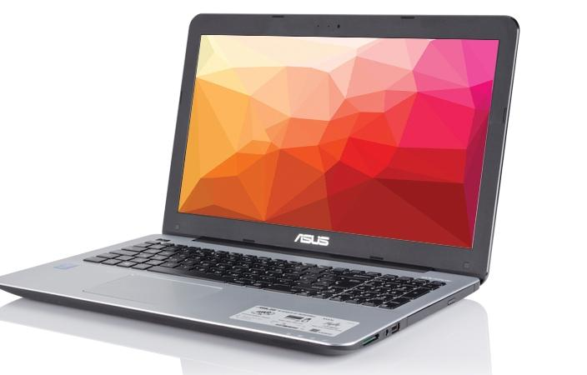
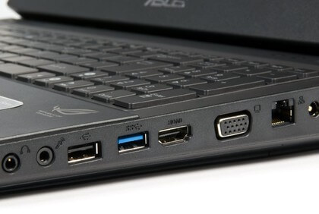
Some Digital Literacy – Terms
12. Built-in Camera
Camera, typically above the desktop, that allows you to part-take
in video calls and/or record a meeting via applications such
as Skype, zoom, Google-meet, Microsoft-teams etc.
13. Software
The instructions that tell the computer and computer
networks what to do. Software is programmes that are installed
on the computer on its hard-drive.
14. Hardware
The physical parts of a computer system.
15. Ports
On a computer, a tablet or a smartphone, a port (noun) is generally a specific place for being physically connected to some other device, usually with a socket and plug of some kind.

Slide 21
Some Digital Literacy – Terms
16. Cursor
A small image on the screen indicating where you are pointing; the mouse controls the movements of the cursor. The cursor can appear in different forms, including:
 | Arrow | Indicates where your mouse is positioned on the screen
 | I-beam (often blinking) | Marks a place on the screen where you can enter or select text
 | Moving Circle or Hourglass | Indicates that the computer is doing a task. You must wait until it goes before proceeding
 | Pointing hand | Indicates that you are hovering over a link, which when clicked opens a website window
 | No Access/ No | Indicates that a particular region/action is invalid for the current operation.

Slide 22
Some Digital Literacy – Terms
17. Browser or Search Engine
By entering words or web addresses into this box, you can locate the information you are searching for using the browser.
Software, such as these are used to access the web.
Mozilla Firefox
Safari
Google Chrome
TIP: TAP ON THE HYPERLINKS (Text in Blue) TO ACCESS THESE SITES
18. Folder(s)
Similar to storing files in a physical file cabinet, you store computer files,
such as documents or pictures, in a folder. To open a folder, you double-click on the folder icon with the left mouse button. When you open a folder, its contents will appear in a window.

Slide 23
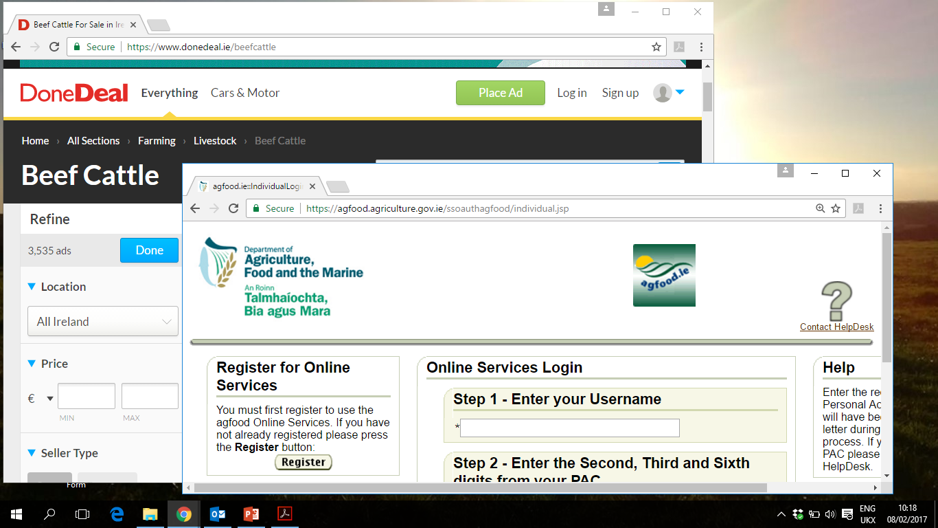
Some Digital Literacy – Terms
19. Window(s)
Is a framed area of a device screen that appears in front of the desktop. Sometimes the appearance of a window means that you have entered another website, or it may mean you are still on the same website. You can have multiple windows open at a time. The active window moves in front of the others. Click on the minimise button to hide a window. The window disappears, but you can bring the window back by clicking on its button in the taskbar (see diagram).
Minimise Window
Inactive Window
Maximise Window
Exit Window
Active Window
Task Bar
Minimised Windows

Slide 24
Exercise Time…
Take your Smart Phone or tablet and if you don’t already have an email account choose your preferred provider (Yahoo Mail, Gmail, Microsoft Outlook )and set up an email account for yourself or one of your clients.
Browse and explore the internet. For example, you could search for the website for this project www.housingcare.net
Click on the various tabs or words along the top of the page and get familiar with how websites work. Don’t be fearful!!

Slide 25
A recap of this Glossary of terms…
TERM | BRIEF DESCRIPTION
1. Internet | A network of computers…the virtual world
2. Email | Electronic Mail an instant messaging system
3. Website | A group of pages of information accessible online (or on the internet)
4. Web Address | Is like an electronic version of a postal address
5. Icon | A small picture or image representing a command on your device
6. Desktop | The main screen where information that appears on your device
7. Taskbar | A row of buttons/graphical controls that represent open programs
8. Power/charging icons | Often on a device screen to indicate the level of charge etc
9. Touchpad | Common on laptops they are an alternative to a mouse

Slide 26
A recap of this Glossary of terms…continued
TERM | BRIEF DESCRIPTION
10. Keyboard | The keys that operate the computer, very much like a typewriter
11. Notification area | An area of the taskbar that provides shows notifications and status
12. Built-in Camera | An integrated camera facing you that allow for video calls
13. Software | Programs that give instructions to the computer
14. Hardware | The physical parts of a computer system
15. Ports | Where one connects the charge cable or another device
16. Cursors | An icon that moves around the screen and allows editing or selecting
17. Search engine | Acts like Directory Enquiries to help us find web addresses/ websites
18. Folder | A virtual folder to store your files
19. Windows | A framed area on the desktop

Slide 27
Well Done!!
You have just been bombarded with information and an entire glossary of digital terms and you survived. Great Job!!
TAKE A BREAK…
then we want you to restart (at your own pace) but please stay with us. Knowing all the above terms will make sense as you journey onwards. Next, we are going to discuss Smartphones

Slide 28
02
The Effective use of Smartphones

Slide 29
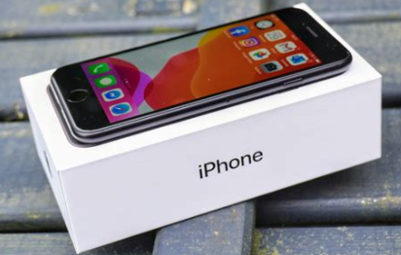
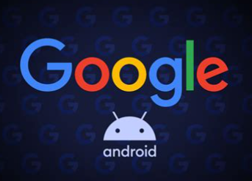
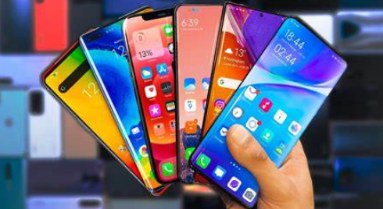
Types of Smartphones…
Smartphones are like mini-computers
The two most popular operating systems in smartphones are iOS and Android this is what categorises the phones into different types…
The iOS is from Apple and specifically runs on Apple iPhones.
The Android from Google is quite open and runs on a wide range of phones.
These operating systems are so advanced, and they perform many functions other than just phone calls

Slide 30
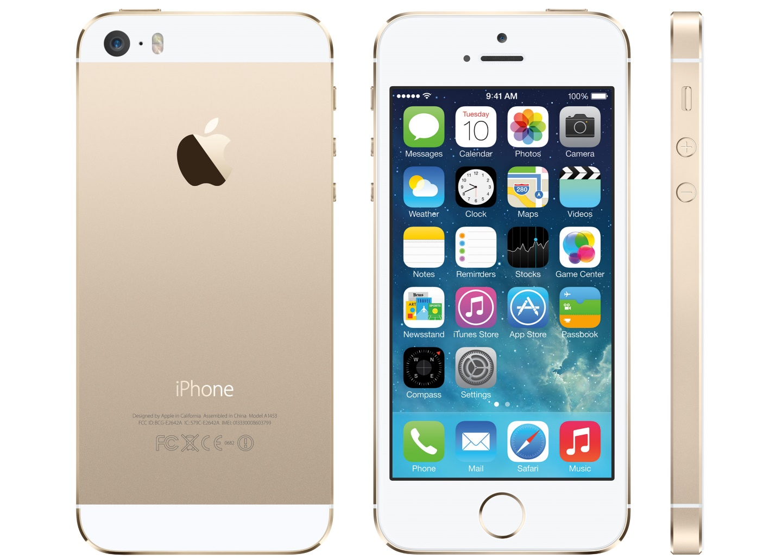
Smartphone – Basic Parts of an iPhone
Status Bar
LED Flash
Front Camera
Main Camera
Power Button
Silent On/Off Button
Volume Up
Volume Down
Widget/ Icon to allow access to App
Home TouchScreen
Home Button

Slide 31
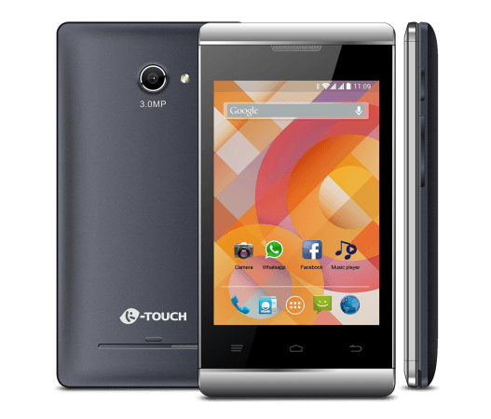
Smartphone – Basic Parts of Android phone
Status Bar
LED Flash
Front Camera
Main Camera
Power Button
Volume Up
Volume Down
Home TouchScreen
Widget/ Icon to allow access to App
Back Button
Search/menu Button
Home Button

Slide 32
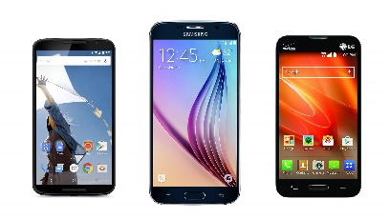
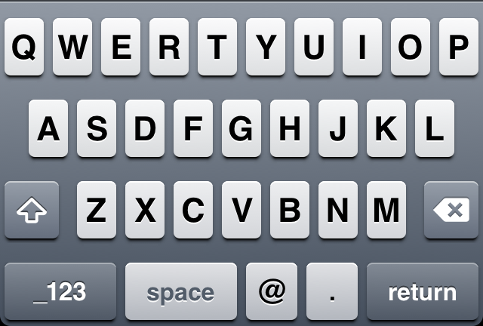
Smartphone – Keyboard
Letters
Shift UP
Delete/
Backspace
Numbers & Symbols Selection Mode
Go Back/Return Button
@ Symbol
Full Stop
Spacebar

Slide 33
Functions available in a Smartphone
An average smartphone has:
a sizeable touch screen display
a camera
Wi-Fi connectivity
access to applications, etc.
The smartphone’s ability to run APPLICATIONS allows one to access email, social media, timers, calendars, and many more work and fun-based programmes.

Slide 34
What is an App or Application?
An app or mobile app is an application, i.e., computer software application, typically one that users download onto their mobile devices. Smartphones and tablets are examples of mobile devices.
The vast majority of apps that we download onto our phones have very narrow or specific uses. For example, a shopping app is an application for purchasing things online, often from one website. (There are exceptions though!)
The most popular app of all time is WhatsApp, which ex-Yahoo employees launched in 2009 as a startup. In 2014, Facebook bought it for $19 billion.

Slide 35
DOWNLOAD Versus UPLOAD…
Simply put:
Download = Save You're taking data from elsewhere and putting it onto your device, essentially bringing it "down" from the internet. All sorts of information can be downloaded from the web: books, movies, and software Apps.
Upload = Send loading the data "upward" to a website, or another user's computer, or a network location, etc., you're sending data from your device to the other device. For example, if you upload an image to Facebook, you're sending the picture from your device to the Facebook website.

Slide 36
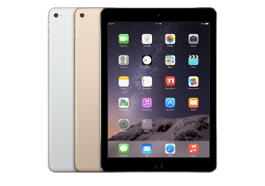
Tablet & Smartphone – Basic Moves
A Double Tap is used to activate editing instructions eg copy & paste
Tap is used to activate a screen or an icon etc.
A directional Swipe- this can be used to flick onto the next page, to bring down the menu to return to the homepage or to scroll through pages
The ‘Tap and Hold to Drag’ is used to drag content from one location to another
The Spread or pinch action is sued to zoom in or minimise an object

Slide 37
The Four basic Smartphone Set-up Steps
1
2
3
4
Fully Charge – Before using for the first time plug your new phone in for ~1-3 Hours
SIM Card – Insert the Sim card in the correct slot. This will connect you to your mobile service provider
Connect to WiFi – Choose a safe network one with a password ideally
Set-up – Follow the phone set-up instructions this will enable your phone for proper functioning

Slide 38
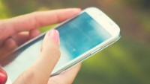
Some simple yet useful functions of a smartphone
In this short Video:
learn how to CONNECT your android phone to a Wifi network
Learn how to SEARCH for Apps in the Google Play store
Learn how to SHARE photos or videos that you have captured with your smartphone
These instructions can be applied to an iPhone also except for the Apps you go to the Apple App-Store.
Smartphone Basics (Android) - YouTube

Slide 39
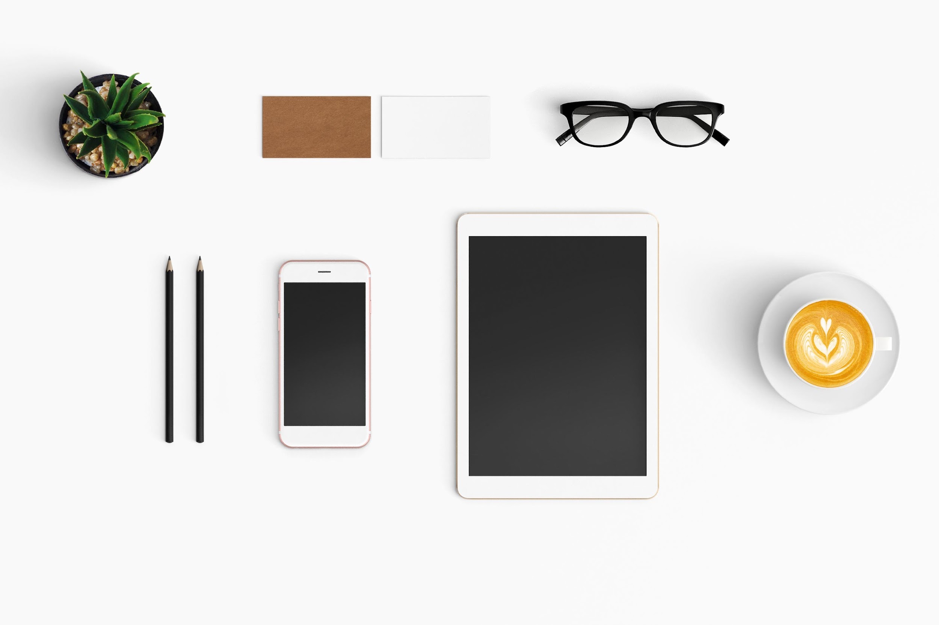
Benefits of using a Smartphone…
Smartphones are the first choice for communicating since you have the choice of calling, texting, and using a huge range of messaging apps. This makes staying in touch with clients and colleagues very easy.
Ability to store personal and important details facilitating instant communication/interaction. Client details, (phone numbers, addresses, Medical details) can be stored easily
Smartphones facilitate instant retrieval of data as you require it. Easy to find information with search functions
Access to an infinite number of functions and applications at the touch of a button/screen. See Module 3

Slide 40
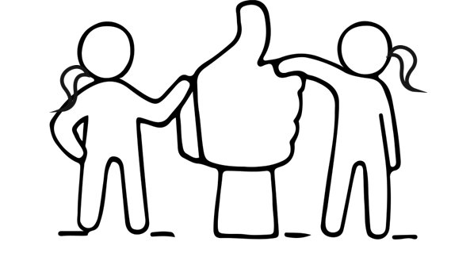
Opportunities of Using Smartphones
Smartphones make communication very accessible allowing everyone to stay in contact with one another. Example: For visually impaired people there is an opportunity to use the zoom function to see messages or voice assistance to read messages.
Having access to real-time information allows people to keep up to date with the latest news, this facilitates and enhances learning, advice and guidance which can be applied to real-life situations.
Cameras on phones are usually superior to those on many other devices allowing for a range of photo and video opportunities instantly. This can be useful for documenting events or occurrences.
The opportunities available using Apps are endless and can suit every need whether social or medical or educational.

Slide 41
Potential Functionality of a Smartphone
In addition to phone calls and text messaging the potential functionalities of a smartphone are:
Instant and quality voice and video communication- reducing isolation and risk
Optimised and personalised Health Tracking – (See Module 3) leading to enhanced physical activity
GPS enhancement e.g assistance in finding rural/urban addresses when trying to locate client locations
Wireless and Bluetooth connection capability between it & other devices –giving improved nutrition and lifestyle opportunities
Smart Phones via Apps have endless functionalities e.g, Diet & well-being trackers, broadening social capabilities and networks, lifestyle & health trackers/promoters

Slide 42
More Useful Videos on Smartphones for Seniors…
Click on the LINKS
iPhone Tips for Seniors: Basic Settings – YouTube Tips of how to set-up screen brightness, text-size, home-screen set-up etc.
iPhone Tips for Seniors 2: Using Apple Contacts – YouTube learning how to set-up and search for contacts in your phone etc.
Set Up a Smartphone for an Older Family Member [How-To] – YouTube this short video highlights smartphone options that can be set up for seniors you may care for.
Apps for Seniors – YouTube some simple suggestions of senior suitable apps

Slide 43
More Useful Videos on Smartphones for Seniors…
Click on the LINKS
Setting up an Apple ID - YouTube A video on how to set up an Apple Id for any Apple device.
How to Download an App (iOS) - YouTube A short video giving instructions on downloading Apps from the Apple App store.
How to Download an App (Android) – YouTube this short video shows how to download an App on an Android phone
Tech Tips Video Tutorials - Senior Planet from AARP for lots of other useful instructional videos use this link.

Slide 44
Great Job! You have now completed your second section in this learning journey…keep going now and see what Section 3 brings!!!

Slide 45
03
Effective use of a Smart Tablet (IT Tablet)

Slide 46
Types of Tablets…
Similar to Smartphones there are generally two types of Tablets. Those that perform using the IoS system (iPads) or Android Tablets that function via the Google Android system.

Slide 47
Benefits of using a Smart Tablet (IT Tablet)
Tablets contain larger screens than smartphones, thus allows for easier typing (larger screen size = larger key size).
They are useful for video calls, watching movies, or using software that's too tricky to use on the screen of a SmartPhone.
Using a tablet can be good for when you need to access data on the move.
Accessories such as keyboards or screen pens/styli for tablets allow for easier typing, especially for seniors. This makes it ideal for using it as an alternative to a laptop.
IT tablets come with ample built-in storage, some also give the option to use an external SD card for additional storage
Tablets possess cameras for taking photos and videos and engaging in video calls. When video calling with a group, the large screen size makes it easier to see everyone clearly.

Slide 48
Opportunities of Using Smart Tablet (IT Tablet)
Similar functionality of a laptop without the bulkiness - They are portable, allowing to go places where conventional computers cannot. This may suit seniors for hospital stays or when in respite care.
Opportunity to add extras to the tablet to enhance user friendliness and accessibility. Text size can be enlarged, or voice activation modes can be used.
Many Tablets come equipped with integrated wireless networking, and some even have high-speed broadband (e.g., 4G enabled)
Extra storage options offer greater opportunities for use. They can become photo albums for Seniors or medical record storage devices.
Most tablets allow for use of useful Apps just like on your Smartphone that can be used around the home or while on the go if you have a WiFi or broadband connection

Slide 49
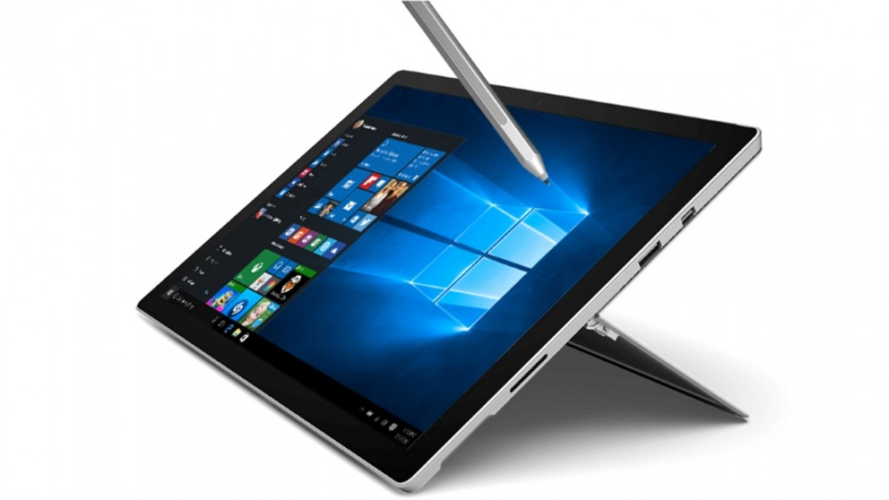
Tablet – Basic Parts
Pen/ Stylus
Desktop
Taskbar
Ports
Tablet Stand
Notification Area

Slide 50
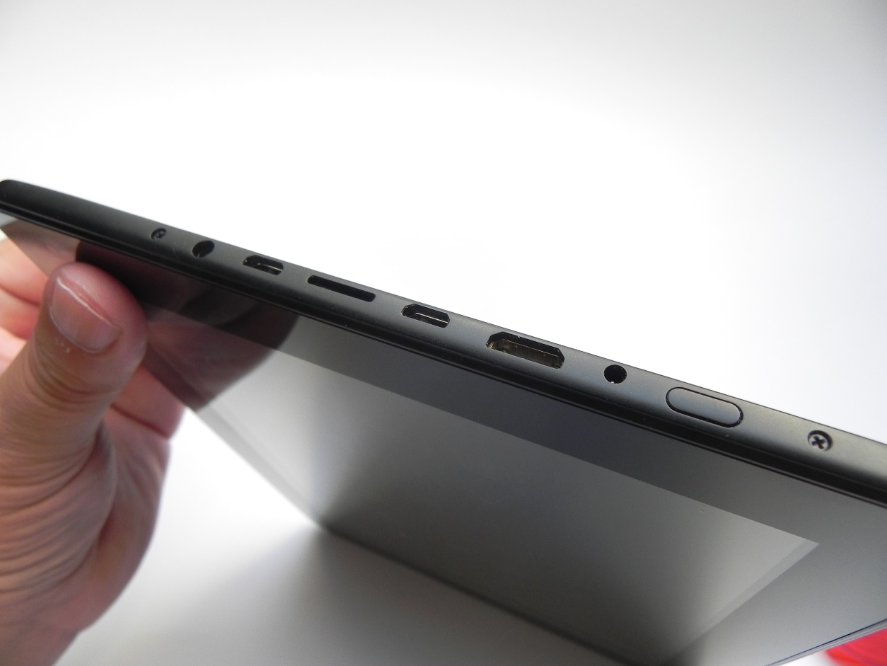
Tablet - Ports
NOTE THIS CONFIGURATION CAN ALTER BETWEEN BRANDS AND MODELS AND IS ONLY MEANT AS A GUIDE!
Power Button
Headphones
Microphone port
Micro SD Card Slot
USB Port
HDMI Port
USB Port

Slide 51
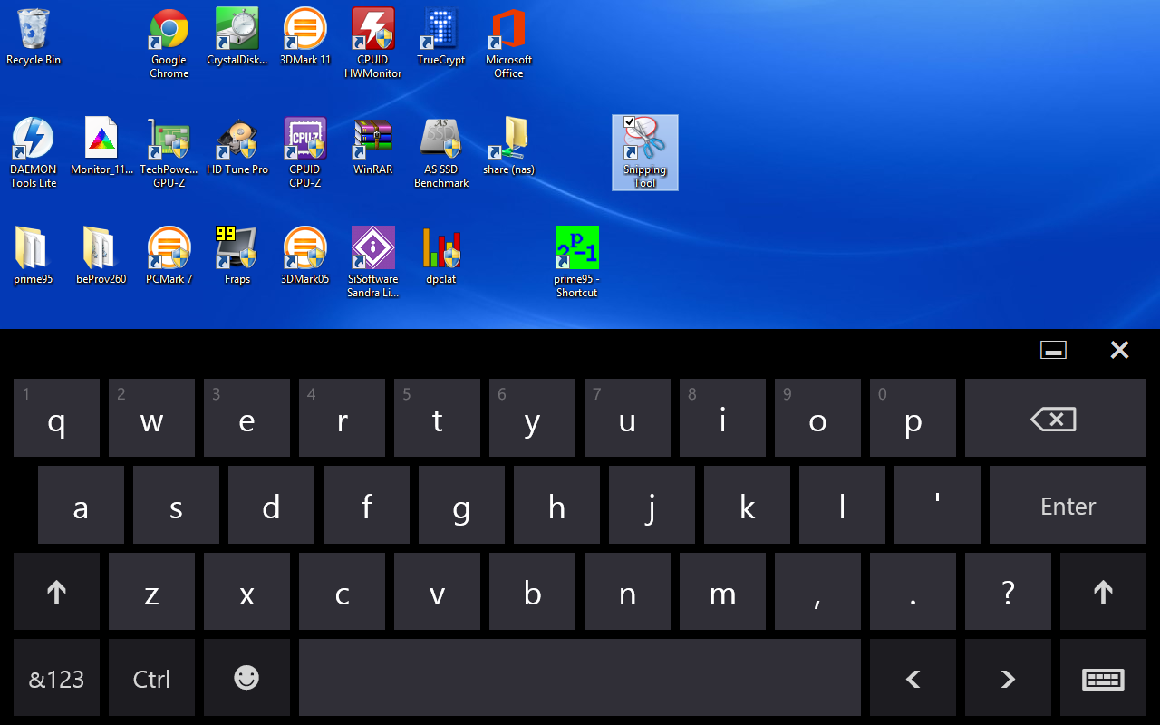
Tablet - Keyboard
Minimise Keyboard
Apostrophe, Comma, Full Stop & Question Mark
Exit Keyboard
Letters
Delete/Backspace
Enter/OK
Shift UP
Shift UP
Numbers & Symbols Selection Mode
Language Selection
Control Key
Emoticon Key
Spacebar
Navigation Keys

Slide 52
Tablet – Keyboard Definitions
1. Key
One of the icons that you press on a keyboard touchscreen to make it produce letters, numbers, etc.
2. Delete/Backspace
The key that you press on a keyboard to move one space backwards in a document or delete one or more characters, i.e. letters, numbers, etc.
3. Enter Key
The key that makes the computer perform an action or start
a new line of writing
4. Control Key
Key that is used in combination with other keys for doing particular operations. This key is usually marked ‘Ctrl’

Slide 53
Tablet – Keyboard Definitions
5. Shift Key
The key that you press when you want to write a capital letter
6. Space Bar
The long, narrow bar at the bottom or front of a keyboard that you press to make a space between words when you are typing
7. Emoticon Key
A key that produces a selection of emoticons
8. Navigation Keys
Typically, 4 but sometimes 2 keys, which allow you to navigate up, down, left and right in text. They also allow you to scroll up and down and left and right on a web browser or document. Your finger can perform this function too since tablets are touchscreen operated. (See the basic finger moves above in Section 1).

Slide 54
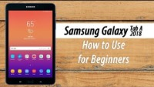
A simple tutorial on how to use your Android Tablet
This video is an in-depth guide on how to set up and perform several functions on an Android Tablet. It may be necessary to watch it several times to capture all the tips.
The use of Smartphones and Tablets is very similar so don’t be afraid to carry out various tasks or to explore either device so that you find the best resources for your required or desired functionality.
Samsung Galaxy Tab A (2018) for Beginners - YouTube

Slide 55
Potential Functionality of Smart Tablet (IT Tablet)
Similar to smartphones Tablets by design have many of the same potential uses
Universal sim card for all tablets in order to make phone calls and send text messages
Tablet case that charges the tablet when not in use
Possibilities of more functionality through the use of extra storage banks
Integrated wireless networking functionality and high-speed broadband provide a huge opportunity for the expansion of the current use of IT Tablets.
Some models may allow integration with other health management devices via Wi-Fi or Bluetooth
Some models may include Client safety alarms and panic alarm integration
It is a good idea to do your research or seek the assistance of someone who can help you determine which make and model suits you or your client’s needs best. It is a good idea to have a wish-list and see which Tablet matches up best!

Slide 56
More Useful Videos for Seniors…
Click on the LINKS
Samsung Galaxy Tab S6 Lite Unboxing and Setup Tutorial Instructions, Guide, Video Help - YouTubeTips of how-to set-up your new tablet.
iPad - Complete Beginners Guide – YouTube this is a comprehensive tutorial on how to set up and use an iPad.
How to set up an iPad for seniors – YouTube this simple short video highlights what options can be set up for seniors that may want to use an iPad.

Slide 57
04
Effective use of a Smart TV

Slide 58
You are doing GREAT and are more than halfway through this Module.
Keep going now to learn a little more about Smart TVs!!

Slide 59
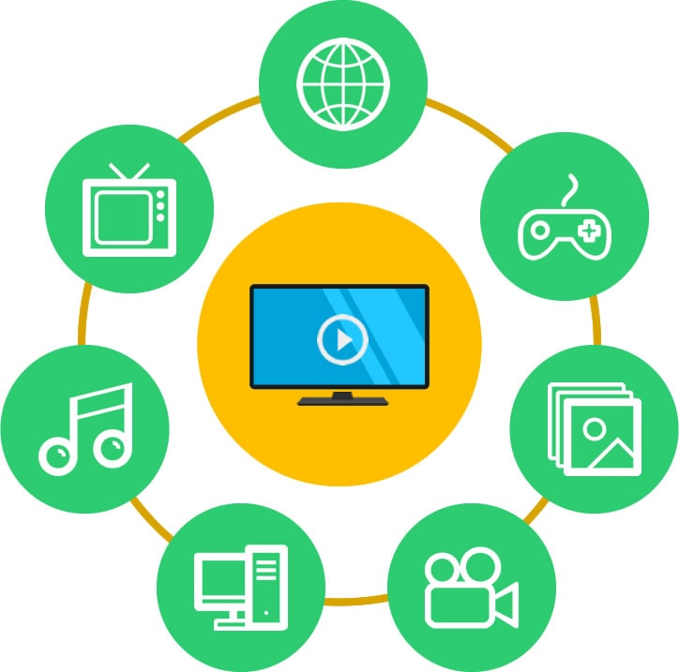
What is SMART TV?
At the very basic level, a Smart TV is a combination of a basic television set with an Internet connection (usually WiFi). Using this internet connection, the Smart TV can access a wide range of online services.
Generally, Smart TVs come with a multitude of features and some pre-installed Apps such as YouTube, Netflix, Amazon Prime, Now-Tv and are often ‘Powered by Android’ therefore the TV will allow you to download additional apps via the Google Play Store or such like. However, the range of inbuilt features varies from one model to the next.
All Smart TVs are operated via a wireless remote control and these remote controls also vary depending on the model or brand.

Slide 60
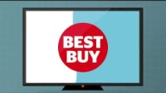
Choosing a SMART TV?
In this short video a simple description of what a Smart TV is given.
Seniors can spend several hours a day watching TV. However, as they age and struggle with their vision and hearing, the TV watching experience becomes less enjoyable. A newer, large-screen smart TV with a good set of speakers can bring back the joy of TV to their lives, but there is a minor problem. Most seniors are not, tech enthusiasts. A switch from their decade-old LCD TV to a modern, smart TV can be quite intimidating.
This Guide may help when choosing a new appropriate Smart TV
Top 7 Smart TVs for Seniors with buying guide in 2022 |
What is Smart TV? - a Which? guide - YouTube

Slide 61
Benefits of using a Smart TV
Watch/View from the comfort of your own
Mini Cinema Experience at home with Smart TV's high visual quality and improved sound.
Brings TV into the digital age by having access to the internet, apps, files, games etc.
It gives access to numerous streaming services that provide TV shows, movies, and music without requiring a TV antenna or a cable or satellite subscription. (however, these streaming platforms can come with monthly subscriptions e.g., Netflix)
Setting up a Smart TV is usually involves simply plugging into the power supply and linking to the home network.
Using a Smart TV is similar to using a regular TV or streaming service just with added functionalities or features.

Slide 62
Opportunities of Using Smart TV
A convenient way of accessing information, entertainment and personal files & photos, etc. in times when leaving home may not be appropriate/possible
Compatibility with smartphones. The control of a Smart TV (on some models) may be placed in the palm of the hand using a mobile phone by simply installing an app and connecting it to the Wi-Fi network
A Smart TV provides an opportunity for the user to declutter from e.g. Pay TV box, Blu-Ray player, even DVD player, HDMI cards, Various Remote Controls etc.
The affordability of Smart TVs provides an opportunity for more people
Voice control optimisation is a feature of some models, which could provide an opportunity for those less mobile to avail of technology

Slide 63
SMART TV Accessibility Options
Most Modern TVs have several Accessibility Options suitable for Seniors or hard-of-sight or hearing viewers…
For Example:
VOICE GUIDES – reads on-screen text
AUDIO DESCRIPTION – available with certain programmes as an additional audio track
HIGH CONTRAST – improving the visibility of text
ENLARGE – a zoom-in feature
LEARN REMOTE CONTROL – where the TV enters teaching mode and explains what each button does
MULTI-OUTPUT AUDIO – allow for TV speakers to operate simultaneously with headphones
SUBTITLES – dialogue is displayed as text
Source

Slide 64
Potential Functionality of a Smart TV
The use of Apps/streaming services specifically aimed at Seniors
Interactive clocks and alarm functions
In built webcam to video chat other people e.g. gaming or video chat on a larger clearly visible screen
Voice control optimisation is now available on several models
Expansion of functions in line with compatibility with other devices e.g. IT Tablet & Smartphone. Some models can be connected to familiar household devices for ease of use and added functions via WiFi or Bluetooth.
Often seniors can’t follow TV schedules, but Channel Apps allow streaming of TV favourites at times that suit them. This allows seniors to watch what they want when they want.

Slide 65
More Useful Videos for SMART TVs…
Click on the LINKS
How to Download and Install Apps on Your Samsung Smart TV in 2 Minutes! – YouTube
Using Intelligent Mode on your TV | Samsung US - YouTube
Sony Android TV | How to update your Sony TV – YouTube
Sony | Learn How To Use Your TV Remote On Sony 2021 BRAVIA TVs – YouTube
How To Use Audio Guidance *New LG Smart TV - WebOS 6 - YouTube

Slide 66
05
Creating Awareness of how Data Security must be considered

Slide 67
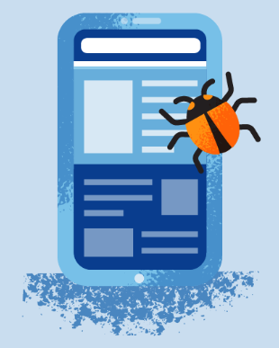
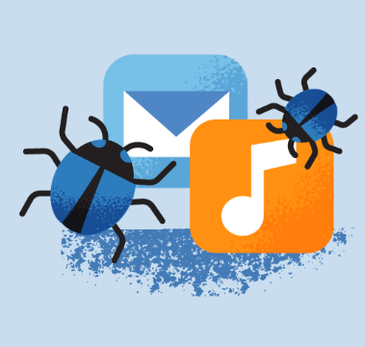
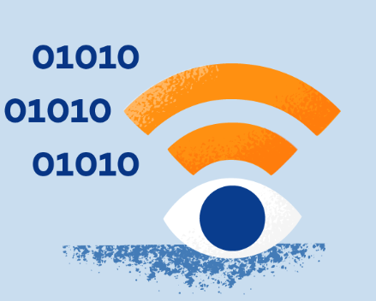
Types of Data Security threats…
Web-based – Websites that contain malware or malicious content compromise your data and device
It’s no secret that the technology we use can make us a target for viruses and cyber attacks if not secured properly.
When it comes to mobile device use, there is no manual that comes with a phone or tablet to teach the user mobile security. In addition, threats are always evolving and adjusting based on our habits.
To help you navigate devices in a secure way, we’ve created a list that includes 8 mobile security tips to keep your device or those that you assist safe.
App-based – Apps that contain spyware or malware can steal your data
Network-based – Hackers steal encrypted data through public WiFi networks
Physical – Hackers can use your device to access data

Slide 68
1. Keep Devices Locked
One potential threat is having devices stolen, which could give the thief complete access to personal information. To prevent this, be sure to have a lock on the screen. Whether this is a passcode, pattern, fingerprint or face recognition is up to you or the user and the device’s capabilities.
When enabling a lock screen, you’ll have the option to choose how long the phone can be idle before locking. Be sure to choose the shortest amount of time. This will protect the owner, by automatically enacting the lock screen even if forgotten by the user. It will also save battery usage as the screen will go dark after the set amount of time

Slide 69
2. Set Secure Passwords
Setting strong passwords on all apps will make it harder for a hacker to guess them. It’s also suggested to set a different password for each app. This way if one password is discovered, the hacker won’t have access to all the information. Set strong Passwords with uppercase and lowercase letters and numbers!
Not only are personal devices a concern, but professional devices are at risk as well. According to the Verizon Mobile Security Index 2018 Report, only 39% of mobile device users in enterprises change all default passwords and only 38% use strong two-factor authentication on their mobile devices. Having weak passwords can put an entire organisation at risk.

Slide 70
3. Keep Device operating systems (OS) Up-to-date
Mobile phone & Tablet operating system updates are intended to improve the user experience. This could entail anything from performance to security. Although they happen frequently and users tend to click through quickly or ask the device to remind them in the future, it’s important to stay up to date with these. These updates can protect both iOS and Android devices from newly discovered threats. To check if the device’s OS is up to date, go to “about phone” or “general” and click “system updates” or “software update.”

Slide 71
4. Connect to Secure Wifi
The beauty of mobile devices is that we can access the internet anywhere and everywhere we go. One of the first things we do at a restaurant or friend’s house is search for WiFi. While free WiFi can save us data, it’s important to be wary of unsecured networks or those that aren’t password protected.
To stay safe while using public WiFi, be sure to connect to a virtual private network or VPN. This allows you to enjoy a secure WiFi connection even on public networks. Changing your virtual network will protect your location and keep information from prying eyes.

Slide 72
5. Beware of Downloads
When you are downloading apps, be sure to download them from the official app stores and check reviews. Cybercriminals create rogue mobile apps that mimic trusted brands in order to obtain users’ confidential information.
To avoid this trap, be sure to look at the number of reviews, last update, and contact information of the organisation.

Slide 73
6. Don’t ‘Jailbreak’ or ‘Root’ devices
Jailbreaking or rooting devices is when you unlock your device and remove the safety features the manufacturers have put in place so you can access anything you want. It may be tempting to jailbreak or root your phone to access app stores other than the official ones, but this puts the device at high risk. The apps on these illegitimate stores have not been vetted and can easily hack into your phone and steal information.

Slide 74
7. Encrypt Data
Mobile devices hold a lot of data. If it’s lost or stolen, emails, contacts, financial information and more can be at risk. To protect your mobile device, you can make sure the data in encrypted, which is stored in an unreadable form so it can’t be understood.
Most devices have encryption settings you can enable in the security menu.

Slide 75
A quick exercise…
Check if your device is Data Encryption enabled
To check if an iOS device is encrypted, go to the settings menu and then click on “Touch ID & Passcode.” It will prompt you to enter your lock screen code. Then scroll to the bottom of the page where it should say “Data Protection is enabled.”
To encrypt an Android, you must first be sure your device is 80% charged, and unroot your phone before continuing. Once these things are done, go to “Security” and choose “Encrypt Phone.” If you don’t charge your device, unroot it or interrupt the encryption process, you may lose all your data. Encryption can take an hour or more.

Slide 76
8. Install Anti-Virus Software
You’ve probably heard of anti-virus programmes for laptops or desktop computers, but your handheld devices can benefit from them, too. These programmes can protect against viruses and hacking attempts. Some software like Panda’s free antivirus software has VPN features included.
Smartphones are pocket-sized computers that can hold all your important data and personal information. Keeping these mobile security tips in mind will help you protect your devices

Slide 77
GDPR – General Data Protection Regulation
GDPR is a law created in the European Union (EU) to protect the personal data of its citizens. Although it was passed in Europe, it affects businesses worldwide.
When it went into effect on May 25, 2018, the GDPR set new standards for data protection, and kickstarted a wave of global privacy laws that forever changed how we use the internet

Slide 78
Why do we need GDPR?
Personal data is highly valuable — in fact, it supports a trillion-dollar industry. Companies like Facebook and Google make their profits by selling personal information to advertisers.
The GDPR tells companies of all sizes what they can and can’t do with your information. By understanding how this legislation works, you’ll have more control over your life online.
Personal data is information that can be used to identify you or others. Put simply, it’s any private details that you wouldn’t want to fall into the wrong hands. E.g., Name / phone number / address / date of birth / bank account / passport number / social media posts / geotagging / health records / race / religious and political opinions
Think of personal data like a jigsaw. One piece alone might not say much but connected together they can reveal a vivid picture of one’s life.
Any incident that leads to personal data being lost, stolen, destroyed, or changed is considered a DATA BREACH.

Slide 79
The following are two of the most common GDPR terms used by security analysts. Understanding them is a vital part of becoming familiar with data protection in general.
PRIVACY BY DESIGN (PbD)
1
This is the name of an approach toward privacy that all businesses should now take when creating products and building websites. PbD involves keeping data collection to a minimum and building security measures to prevent data leaks and breaches at all stages of a product’s design.
CONSENT
2
Obtaining consent simply means asking users for permission to process their data. Companies must explain their data collection practices in clear and simple language, and then users must agree. These standards of consent prohibit the use of pre-selected settings in apps or pre-checked boxes on websites.

Slide 80
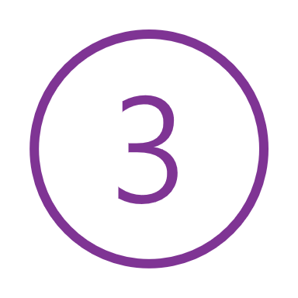
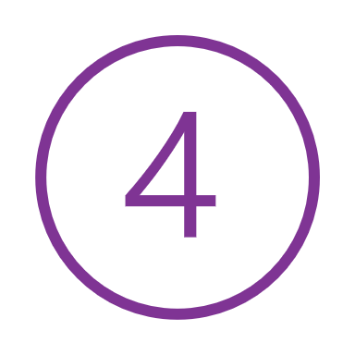
The Main INTERNET USERS’ Rights to Data Privacy under GDPR…
You’re entitled to know exactly how your data is collected and used
If there are mistakes in your data, you can request to have them corrected
You’re allowed to refuse data processing, for example, marketing efforts
You can ask what information has been collected about you (without paying anything)
You can have your data deleted from records

Slide 81
Names and Acronyms associated with the GDPR
Knowing these will help you navigate the policies that websites use to explain their data collection practices.
What is a data subject? | I’m one and so are you. A data subject is anyone who has their data collected by a company. Basically, everyone who ever used the internet.
What is a data controller? | A data controller is any entity that gathers and stores data — for example, a business.
What is a data processor? | This is who a large corporation hires to process data on their behalf. Usually, it’s a payroll company.
What is a supervisory authority? | Each country in the EU has its own supervisory authority. Like a data privacy sheriff, they enforce the GDPR in their region and hand out hefty fines for breaches as penalties.
What is a data protection officer (DPO)? | Companies and public bodies that process lots of data need to appoint an officer (DPO) to handle all their GDPR activities and paperwork.

Slide 82
GDPR Checklist: Dos & Don’ts
In your role you will have access to clients’ sensitive data on a regular basis…if you can follow these simple guidelines, you will be on the right track in terms of GDPR
Do: Collect information legally and use it fairly
Don’t: Mislead users about what you’ll do with their private details
Do: Collect as little data as possible
Don’t: Collect lots of data just because you can
Do: Protect data with strong security systems
Don’t: Assume data will take care of itself
Do: Only store data for as long as necessary
Don’t: Keep old data you don’t need anymore

Slide 83
AMAZING Job You have just Completed
Module 1

Slide 84
Thank you
﻿www.housingcare.net

