Slide 1
MODULE 2
Human Digital Skills
﻿www.housingcare.net
The European Commission support for the production of this publication does not constitute an endorsement of the contents which reflects the views only of the authors, and the Commission cannot be held responsi­ble for any use which may be made of the information contained therein

Slide 2
Module 2
By the end of this Module, we aim for you as Carers to be able to:
Apply rules and tools to support your own health, quality of life and longevity.
To establish empathetic communication and a safe virtual environment through technology with clients and their families.
To transfer digital skills to senior clients and support them in the use of technology.
to effectively communicate with colleagues to keep a serene working environment through technology

Slide 3
contents
TIP: TAP ON THE TOPIC TO BRING YOU TO IT DIRECTLY
01
Work-Life Balance and Quality of life
02
Digital Empathy and Communication
03
Teaching Technologies to Seniors
04
Work environment and Cooperation

Slide 4
01
Worklife Balance and Quality of life

Slide 5
Quality of life
Quality of life is a concept inextricably linked to that of well-being, which we define as an individual's optimal physical, psychological and social condition.
A natural enemy of it is negative stress, the alarm signal that is triggered in our body when an external factor upsets its internal balance.
To achieve a satisfactory level of quality of life, it is also essential to assess the quality of our work, in the context of which stress levels are often very high, so much so that in some cases it leads to the development of burnout syndrome.

Slide 6
What is burnout?
Burnout (burned out/exhausted) is a particular type of negative stress.
It represents a form of distress that workers express when feeling they are not able to cope anymore. This can be due to daily dissatisfaction or irritation, the sense of disappointment and helplessness that an individual experiences within their work context.
It is a form of stress specific to "helping professions" (doctors, nurses, psychologists, educators/teachers, social workers, etc.) those in which the relationship with the user holds fundamental importance, as it constitutes a form of support, help and guidance for those in difficulty.

Slide 7
Burnout syndrome results in the appearance of symptoms both of a psychological nature, such as decreased self-esteem, increased irritability, anxiety & depression... and of a physical nature such as headache, gastrointestinal disorders, hypertension and insomnia.
Also negatively affected are social and family relationships, which are likely to suffer progressive deterioration.

Slide 8
Work-life balance
The principal approach to burnout prevention involves person-focused strategies, i.e., those aimed at improving psychosocial well-being, relaxation, changing work habits, or even promoting the ability to manage and cope with malaise.
The main strategy that is commonly adopted is that of creating a work-life balance.

Slide 9
In the healthcare sector, issues/challenges such as staff shortages and work overload, which have increased in the wake of the Covid-19 pandemic, are correlated with increased difficulty on the part of workers in managing their activities, both work and personal.
Numerous pieces of research show that burnout is steadily increasing in this sector, and according to the data, it involves almost half of the operators. In addition, digital tools such as email, instant messaging systems and platforms that allow continuous availability, if not used correctly, can also increase stress levels (technostress).
Therefore, finding the right work-life balance becomes essential for one's own mental and physical health and that of patients.
TESI-BURNOUT..pdf (nurse24.it)

Slide 10
Here are some of the main ASPECTS OF LIFE that can benefit from a proper work-life balance:
Health
The quality of patient care
Career longevity
Social Relationships
Family life

Slide 11
1. Health
Very long workdays, increasing energy consumption, and tasks that are often not in line with one's role are factors that can deteriorate the psychological and physical health of caregivers, who often tend to underestimate their own health conditions and perceive them to be less important than those of their patients/clients.
If one does not take care of him/herself, it will be extremely difficult to take care of others.

Slide 12
2. The quality of patient care
Work-life balance is necessary to ensure adequate patient care; just think that in cases of high-stress levels, the risk of committing errors in care settings doubles.
TESI-BURNOUT..pdf (nurse24.it)
High levels of burnout, correlated often with a delicate working environment, cause the health care worker to feel detached from their work to the point of losing sight of why they have chosen that career and thus being led to abandon it.
3. Career longevity

Slide 13
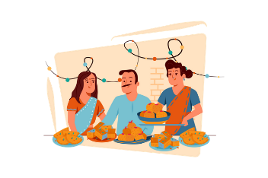
Having a network of relationships outside of work that is satisfying and to which we devote time enables us to lower burnout levels. However, we must remember that even these relationships can be a source of stress, especially if friends, relatives, and acquaintances use you as the carer or as a free therapist outside of your working hours.
4. Social relationships
Devoting time to family and having a harmonious home life is essential for our mental health. When work schedules are exhausting, we often come to neglect our loved ones, with negative consequences in both personal and professional spheres.
5. Family life

Slide 14
10 tips on how to Achieve and Maintain Balance

Slide 15
1. GET HELP
If you feel that you have problems and difficulties in your work, resulting in stressful situations, the first step is to IDENTIFY THE SOURCE of the discomfort. Once you find it, ask for help!
Talk to your supervisor; if he or she is a good manager, they will understand the situation and will be able to suggest a solution. If not, it might be an opportunity to think about changing jobs/role.

Slide 16
2. SCHEDULE ACTIVITIES AND TIME
In order to be able to distribute your time and energy fairly among the various activities that make up your life, it is essential to have a SCHEDULE, and above all that this is achievable.
If you have scheduled activities, and you realise that you do not have enough space for your personal life, it is advisable to consider reducing your working hours, even temporarily, until you find the right distribution of time.

Slide 17
3. LEARN TO SAY NO!
When faced with new, perhaps important assignments, it is often difficult to say no, especially if you are inclined to please others. Remember that although it is good to show yourself available to others, this is not possible if you do not take care of yourself first!
Saying NO to some tasks when they begin to be too much can help you do the tasks you are already performing better. Note, even in your personal life saying a few no's can help you reduce stress: you don't have to go out in the evening with friends if what you want/need to do is to spend it on the couch/relaxing.

Slide 18
4. USE VACATIONS
Several studies show that the tendency of workers to not take all their available vacation/annual leave time is increasing. This problem, especially in the social and healthcare sector, is due to the guilt of taking time and space away from patients.
However, it should be remembered that to do a job at its best, it is good to take breaks and carve out moments for self-care.
State of American Vacation 2018 (2018-05-08)| U.S. Travel Association (ustravel.org)

Slide 19
5. MAKE YOURSELF AVAILABLE ONLY DURING YOUR WORKING HOURS
The prevalence of new technologies and computer communication systems (email, social, and instant messaging) can make you feel constantly busy. Therefore, using your phone or email account only during working hours can help you.
Perhaps Turning your work phone off during your off-duty time is advisable

Slide 20
6. DEFINE YOUR SMART WORKING
Working from home runs the risk of losing the boundary between private and work life by mixing personal and work activities throughout the day; therefore, you need to give yourself limits.
Establish hours beyond which you do not work and define a space in which to carry out your activity so that, if possible, it does not coincide with those used in your free time.

Slide 21
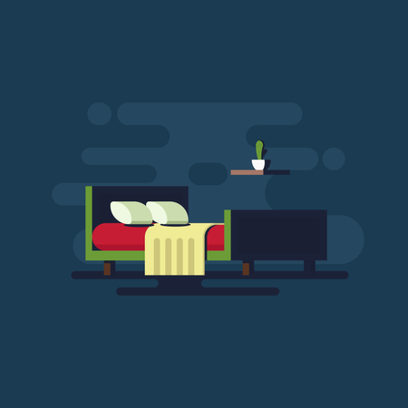
7. GET ENOUGH SLEEP
A great number of studies confirm that to be efficient and focused during the day, 7-8 hours of sleep per night is necessary, especially when constantly dealing with human lives. In the case of healthcare workers, it appears, however, they find it difficult to meet these standards.
So, take time to rest and regain energy.

Slide 22
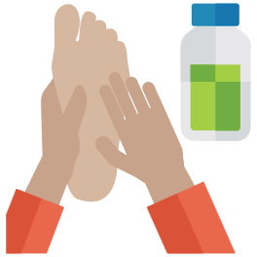
8. COMMUNICATION AND COOPERATION
To avoid heavy individual workloads, it is advisable to communicate properly among colleagues, even in difficulties, always preferring a cooperative style.
9. BE KIND TO YOUR FEET
Health care workers spend a lot of time on their feet, so it is very important to take good care of them. Wear comfortable footwear that provides proper foot support, stretch, ice, massage or, at the very least, keep them up in the evening so that swelling can be relieved.

Slide 23
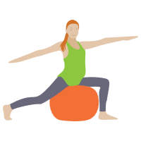
10. FIND A PHYSICAL ACTIVITY YOU ENJOY, AND CULTIVATE IT
Needless to say, physical activity improves mental and physical health and relieves stress, but it is also true that to be good for you it should be stimulating and enjoyable for you.

Slide 24
Tools
In our daily lives, technological devices for personal assistance and support are becoming more widespread and have the general purpose of achieving and maintaining psychophysical well-being. This is done, in the management of one's habits, through simple and affordable solutions.
The greatest strength of these tools is through awareness of those who use them, regarding the functioning and limitations of their bodies and minds. Measuring what is going on in our bodies allows us to understand what is really doing us good or bad, and thus to structure routines in a way that leads to better overall performance and a full and satisfying life.

Slide 25
Here are some useful tools for achieving a good work-life balance:
1.
Wearable devices such as FitBit, MiBand5 and GalaxyFit2 for supporting physical activity and monitoring key vitals.
2.
Apps for activity and time management (e.g., Google Calendar. This is a free downloadable app from both IOS and Android systems, and available in 33 different languages; Todoist, Google tasks).
3.
Apps for tracking one's habits (e.g.: Fabulous daily routine planner);
4.
Apps for sleep regulation (e.g.: Sleep Cycle);
5.
Meditation apps (e.g.: Calm, Meditopia).

Slide 26
Learner Exercise
Organise better, live better.
(At least 30 min.)
Organising and planning seem to be useful habits to free us from pressure and work stress. Careful planning will also allow us to manage work tasks more effectively. The enemy is procrastination, which takes over when we are in BurnOut. Therefore, we fight anxiety by planning activities and visualising goals, eliminating unnecessary actions and prioritising the necessary ones.
It seems to be very simple, but in reality, few people manage to be masters of their time, so how to do it?
FOR AN EXAMPLE OF A CALENDAR OR WORKFLOW PLATFORM CLICK HERE FOR
stack overflow
EXERCISE: Follow the next steps and apply them time after time to help form improved/good habits. Create a plan for your current work week NOW!
Stack Overflow - Where Developers Learn, Share, & Build Careers

Slide 27
Set and write the deadlines of each activity
Memory does not always perform, especially under stress. Choose a planner or calendar, digital or paper, and as soon as a deadline is set, write it down!
Prioritise tasks
Not all activities have the same importance! Define criteria for prioritising one or the other task. Is time always the predominant value? Not always, sometimes some tasks are more complex and although far away, they must start on time. Once you've prioritised, you can also visually differentiate them with different colours on your calendar.
Break down each task into stages
In order NOT to feel overwhelmed by time or things to do, analyse the activity and break it down into micro-actions. This way you will have more control of the process and it will also be easier to identify and overcome difficulties.

Slide 28
Create a daily to-do list
Once you have identified the micro-actions to be taken, transfer them to a daily to-do list. Be objective and distribute tasks over several days to maintain a work-life balance. For each task you complete, delete it from the list. You will feel fulfilled and motivated to continue.
Set rules
To create a positive habit, you need to set rules and abide by them. Do not be tempted to work beyond the scheduled hours, to remain available during non-working hours. Set limits not to be exceeded: life is not only made of work.
Organise your free time as well
To make sure you give yourself some free time, define a window of time for each day to devote to yourself, your hobbies and your loved ones. Sport, the book on the bedside table, that film at the cinema should not always be postponed.

Slide 29
Be Inspired…
The apps mentioned above require subscriptions.
In the meantime, however, you can follow some mini guides available on YouTube.
Daily Calm | 10 Minute Mindfulness Meditation |Be Present
Mindfulness Meditation – Guided 10 Minutes
Guided Mindfulness Meditation on Living Each Day – Peace and Positivity
How to Build A Routine
Anatomy of a Perfect Daily Schedule
TIP: TAP ON THE HYPERLINKS (Text in Blue) TO ACCESS THESE VIDEOS

Slide 30
You have completed the FIRST STAGE!!
Three more to go, but we assure you it will be a worthwhile and rewarding journey.
SEE YOU AT THE FINISH
LINE!

Slide 31
02
Digital Empathy and Communication

Slide 32
Digital Communication
Today, virtual environments allow communication between multiple users even if they are far apart. This causes different points of view to be represented within a multimedia context, experiences to be shared, opinions to be exchanged, etc...
But how is it possible to make people feel involved and comfortable in a common space by means of technology?
How can bonds be created through a communication medium?

Slide 33
But…what is meant by communication?
According to Paul Watzlawick, communication represents a “process of information exchange and mutual influence that takes place in a given context”.
Communication is strongly influenced by the different personalities involved and, therefore, by one's way of relating to the world, one's self-concept, personal history, affective needs, cognitive abilities, culture and reference values, motivations and expectations as well as social and professional roles.
Watzlawick P., Pragmatica della comunicazione umana. Astrolabio, Roma, 1981

Slide 34
To understand the other person's point of view and avoid flawed communication, it is necessary to decentralise from one's reference system and adopt an EMPATHETIC ATTITUDE.
…But what is empathy?

Slide 35
Empathy is the ability to place oneself in another person's state of mind or situation through an immediate understanding of his or her psychic processes and emotions, refraining from judging or being influenced by one's own feelings.
Berra, Empatia, comprensione e comunicazione, 2019

Slide 36
What is Empathy?
What is the best way to ease someone's pain and suffering?
In this beautifully animated RSA Short-video, Dr. Brené Brown reminds us that we can only create a genuine empathic connection if we are brave enough to really get in touch with our own fragilities.
Brené Brown on Empathy - YouTube

Slide 37
Empathy in a care environment…
Empathy represents a fundamental element of communication and social relationships, especially those defined as "helping" as it allows a real understanding of the client and his or her inner experience.
Especially at the beginning of the relationship, it is important to show a particular OPENNESS that allows the emotions and states of mind of others to be received, processed and reproduced inwardly. This applies to both the practitioner and the client who, before opening up in a relationship, needs to understand the availability and trustworthiness of the provider/receiver within this relationship. As you would expect, often the patient/client, when taken out of their natural environment, can often display a closed attitude that can lead to a lack of trust and poor communication of their physical and emotional problems.
Empathy allows a communication channel to be opened that provides access to key information to identify the most appropriate therapeutic approach for the patient.

Slide 38
The spread of new technologies has brought about a change in many social and behavioural dynamics both online and offline, consequently causing the emergence of new interrelation habits.
Among the negative effects of this technological revolution is a greater difficulty in being able to empathise with the client.
The effect of digitalisation…

Slide 39
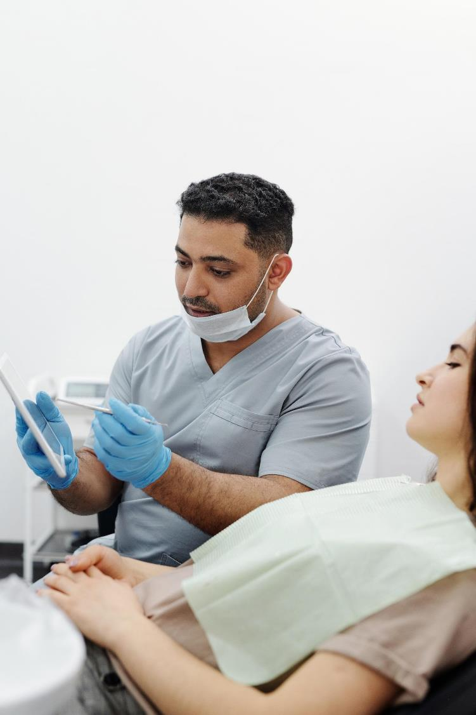
The effect of digitalisation…
Health care, too, has undergone a radical process of digitisation, resulting in an alteration of the construct of empathy, particularly in the context of digital communication, which is often devoid of many of the nonverbal cues and emotional cues that are experienced in face-to-face contexts, and which constitute important clues for the client/patient.
Digital communication patterns, in fact, tend to be geared toward immediacy, with regard to sharing thoughts, emotions and actions, the very instant one is perceiving them.

Slide 40
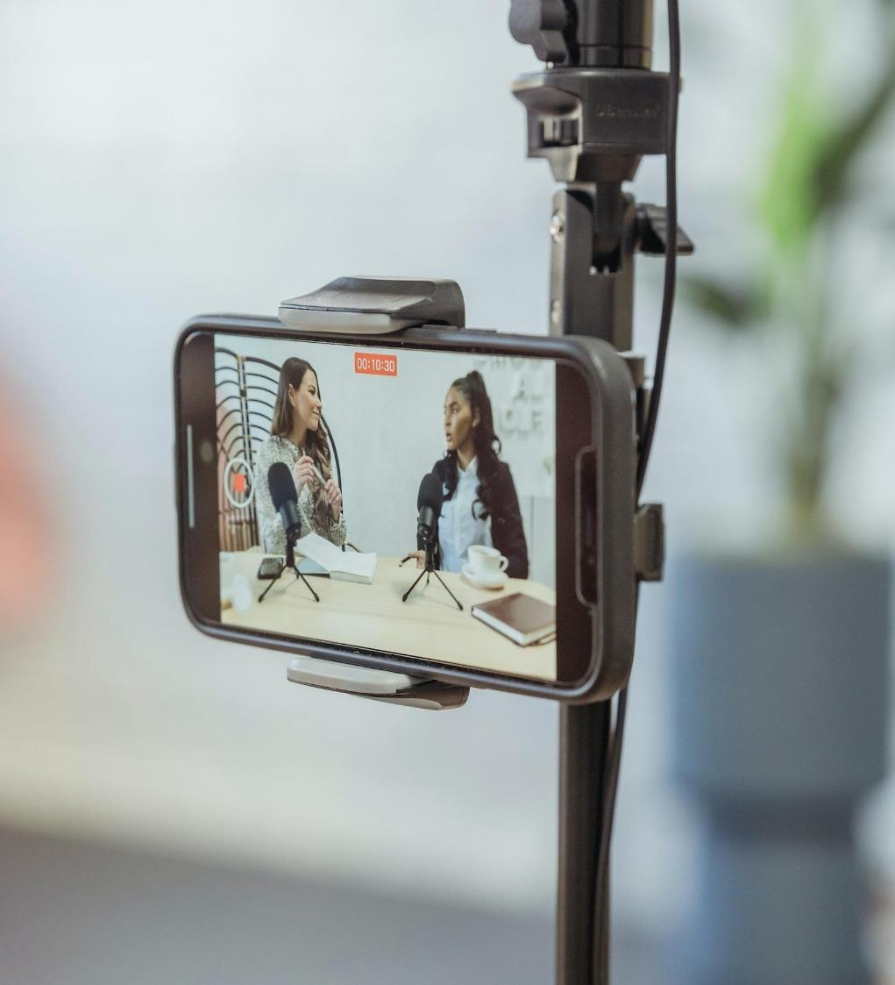
What is Digital Empathy?
With empathy representing an important part of health profession roles in general, it is critical that curricula be integrated with the concept of digital empathy, or those "traditional empathic characteristics, such as concern and care for others, expressed through computer-mediated communications.“
Digital Empathy then explores precisely the impact of these altered communications and "new" social behaviours.

Slide 41
Reasons for poor empathy…
The research "The emerging issue of Digital Empathy" (Terry & Cain, 2016) found that empathy, in digital conversations, is mainly threatened by psychological disinhibition.
This concept seeks to explain the reasons for the reduction of empathy in online communications, among which we find anonymity, dissociation from the self in offline reality, alternative identities, etc.
In particular, it has been shown that younger generations who have grown up with technology are losing some social-emotional skills, thus becoming less empathetic.
In psychology, disinhibition is a lack of restraint manifested in a disregard for social conventions, impulsivity, and poor risk assessment.

Slide 42
3 key areas of Digital Empathy
The DQ Institute's 2019 DQ Global Standard Report defines 3 key areas of Digital Empathy that individuals can act on to properly develop it:
Knowledge: The ability of individuals to understand how their online interactions can affect the feelings of others, and how those feelings are affected by digital communication
Skills: The ability of individuals to develop, through online interactions, social-emotional skills, becoming more sensitive to others' perspectives and emotions to provide more contextually appropriate responses
Attitudes and Values: Development of greater awareness and understanding of users' feelings and needs.

Slide 43
It is possible & important to identify aspects that CAN be taken into consideration to ensure that digital communication is empathetic, safe, and comfortable…

Slide 44
Aversion to digital communication
Especially senior clients may exhibit a natural aversion to communicating using digital tools. This can lead to behaviour termed as"digital ghosting“. This is basically the tendency to avoid virtual interaction, for example by not responding to an email or chat question.
This behaviour can be due to:
frustration,
a lack of skills or motivation,
anger or disappointment.

Slide 45
There are rules to avoid this, which apply both to you and to your clients/patients:
If you are waiting for a response and it is not urgent, do not solicit or mull it over. Wait a few days, then try again. If again you get silence, change the medium of communication (from e-mail to text or chat or, to a phone call)
If you must respond, do so immediately if it is urgent or at least inform the client when you will respond.

Slide 46
Making digital communications more like face-to-face communications can be a good way to overcome this problem.
The use of video calling instead of audio-only calling and messaging is therefore preferable.
Through video, emotional signals and vocal inflections are easier to recognise and help to establish more complete virtual relationships.
Therefore, during video communications, we recommend framing the entire torso, hands, and surroundings.

Slide 47
Communication via Messaging…(Text or Email)
When video calling is not possible, but it is necessary to communicate via messaging, it is advisable to be clear and authentic, avoiding misunderstandings and ambiguity even if this means longer messages.
Practice active listening, encourage dialogue, and make sure that both you and your client understand each other correctly.
In this regard, one method of trying to avoid ambiguity is the "Teach-Back Method": if you have the feeling that your client is not interpreting the conversation correctly, ask or prompt them to repeat what you have said.

Slide 48
Communication via Messaging…
Often, in order to more accurately communicate our moods and feelings, it can be useful to use an emoji.
These are nothing more than small images designed to replicate our facial expressions and emotions, providing an indication of feelings and context to digital communications.
Be careful, however, DO NOT go overboard!

Slide 49
Communication via Visuals
Another way to reduce misunderstandings, especially in the case of more complex concepts, is to support your speech with visual material (e.g., slides, handouts, diagrams, charts, etc.).

Slide 50
Active listening
An indispensable characteristic of empathy is the ability to pay interested and intentional attention to communication with another person.
Active listening implies the complete involvement of the listener, who encourages their communicating partner to express his or her thoughts, without interrupting and judging them. It is a fundamental feature of a relationship with the client/patient, who then feels welcome and understood.

Slide 51
What is effective Digital Communication?
reading e-mails/messages carefully, identifying the needs of others, learning to give importance to their problems, without feeling the need to solve them
responding quickly to a request
taking notes and/or ensuring that the notes are sent to the required person after the session

Slide 52
What is effective Digital Communication?
showing care and empathy through precise questions
arranging a face-to-face meeting for more complex issues
not interrupting and using verbal cues such as "Go ahead" or "I'm listening" to encourage clients to share their thoughts or feelings

Slide 53
What NOT to do during Digital Communication?
do not use the "mute" button or turn off the video function, as it shows disinterest
no multitasking: there is nothing more irritating than talking in front of a video and seeing participants hunched over chatting on their phones or performing other tasks. It shows disrespect.

Slide 54
Do not make assumptions
The use of technology can lead us to draw hasty conclusions too quickly about our clients, and thus not empathise as we should.
When we make assumptions about another person's situation, we insert our own biases and opinions into the narrative. Such behaviour, in fact, can affect our perception of the person and thus fail to interpret their story and state of mind correctly.

Slide 55
Managing Empathy
As mentioned already, empathy allows us to make deep connections and understand others and their state of mind.
However, an empathetic outlook can be considered painful when it generates stress and sadness, as it can become difficult to actively witness others' suffering. This often happens in the health professions, where constant contact with painful situations can lead to burnout and interfere with the proper performance of one's job.

Slide 56
Managing Empathy
Avoiding empathy is NOT the solution to the problem.
Instead, YOU must learn & practice that it should not be understood as continuous exposure to suffering, but rather as a fundamental requirement for creating a trusting relationship with the patient/client and ensuring therapeutic and effective care.
It can then be viewed as a positive and lead to effective performance and job satisfaction.

Slide 57
Exercises - Recognise communication styles
Each of us communicates differently: there are, in fact, 7 different types of communication, with some of which a specific strategy of approach is required. The types are 7, but here are the 3 most common:
Passive communication: it is characterized by the tendency of the interlocutor not to take the floor, and to limit him/herself to listening, without sharing or openly manifesting his/her thoughts.
Aggressive communication: the interlocutor tends to prevaricate, not paying attention to the ideas and opinions of others, and also using inappropriate tones.
Assertive communication: it is the one to which everyone must aspire, that is a way of communicating that takes into account their emotions, ideas and needs and those of the interlocutor. In assertive communication, one is open to dialogue, to confrontation and one arrives at an agreement or compromise.

Slide 58
Analyse your communication (30 min)
Recall three moments when you believe you have used a passive, aggressive and assertive communication style. Think carefully back to the things said, to those not said, the feelings evoked and thoughts of that moment. Then answer the questions on the next slide. The exercise must be carried out in solitude in a moment of tranquility and serves to focus on how we can improve our way of communicating and understanding the importance of active listening. This exercise is useful for both analysing relationships with patients and colleagues.

Slide 59
The questions
Answer the following questions for each situation:
How did I feel at the end of that conversation?
Have I managed to bring out my ideas/opinions?
How did I handle the conversation?
Have I communicated effectively with my interlocutor?
Did I understand the ideas and feelings of my interlocutor?
Did I act with prejudice during the conversation?
Have I achieved the goal set through dialogue?
What would you change about that conversation?
What wouldn't you change in that conversation?

Slide 60
EXCELLENT!
You have reached the end of the longest and most complex topic in this module, so continuing will be a breeze.

Slide 61
03
Teaching technology to Elderly people

Slide 62
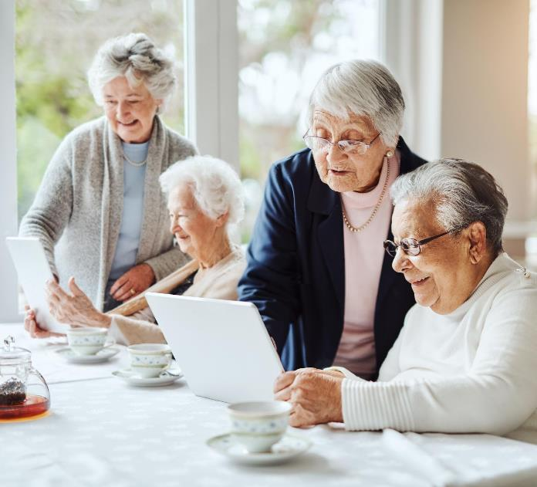
Seniors and technology
Technology has now entered the everyday life of the elderly, as confirmed by Istat: from 2005-2015, the number of people aged 65-74 who use PCs increased by 343.6 % and those who use the Internet, in the same age group, by as much as 556.4 %.
The isolation caused by Covid has favoured this process, so much so that in 2021, the elderly (65-74 years old) who use PCs account for 36.4 %, up from 31.6 % in the previous year as reported by Istat.
Digital tools can improve everyone's quality of life, especially that of the elderly. Thanks to the Internet, various benefits can be enjoyed…see Module 3 for more details!

Slide 63
How Digital Technologies can be helpful to Seniors
The use of messaging apps (e.g., Whatsapp) and social networks (e.g., Facebook, Twitter), in fact, can help one stay in touch with friends and family even when away
The possibility to stay connected
The performance of banking and bureaucratic transactions
Very functional for people such as the elderly, who may have mobility or other problems that hinder their use
Taking care of one's health
As we age, health needs often become predominant, but some of these can now also be met online

Slide 64
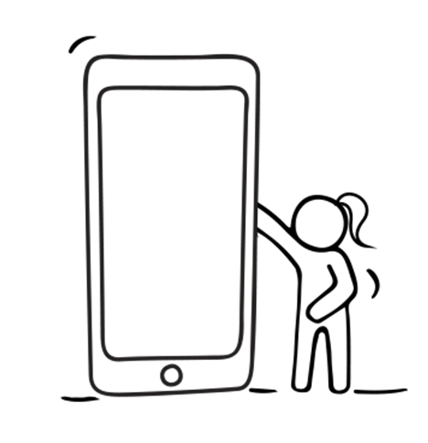
The benefits also relate to health in the narrower sense, in that, the use of technology enables:
- Improve cognitive abilities and keep the mind active;
- Slow down the onset of cognitive decline;
- Develop new skills, introduce new interests, entertain;
- Reduce feelings of isolation and promote socialisation;
- Increase one's sense of autonomy and independence.

Slide 65
In order to gain such benefits from using digital technologies, it is essential that seniors can and know how to use Digital Tools & Technologies.

Slide 66
However, teaching digital skills to seniors can be difficult…
as the older person might:
- Disqualify your if you seem ill-mannered to him or her. It is important not to expect to get on the senior client's good side right away (avoid using overly technical language), but gradually establish a relationship of trust and mutual respect
- Resent you if you correct them too abruptly. Remember, that you are teaching an older person, who may expect a certain kind of respect and approach from you
- Get irritated if you perform tasks for them, not allowing them the time they need to learn. Older people, in fact, need to repeat steps several times and to slowly learn how digital tools work
- Have difficulty understanding explanations, even simple ones, as they do not know the digital language (e.g., "click," "chat")
- Get distracted easily, as they may be disinterested in what you are teaching them.

Slide 67
The following is a series of useful tips to aid when TEACHING SENIOR CLIENTS and in addressing problems that may occur

Slide 68
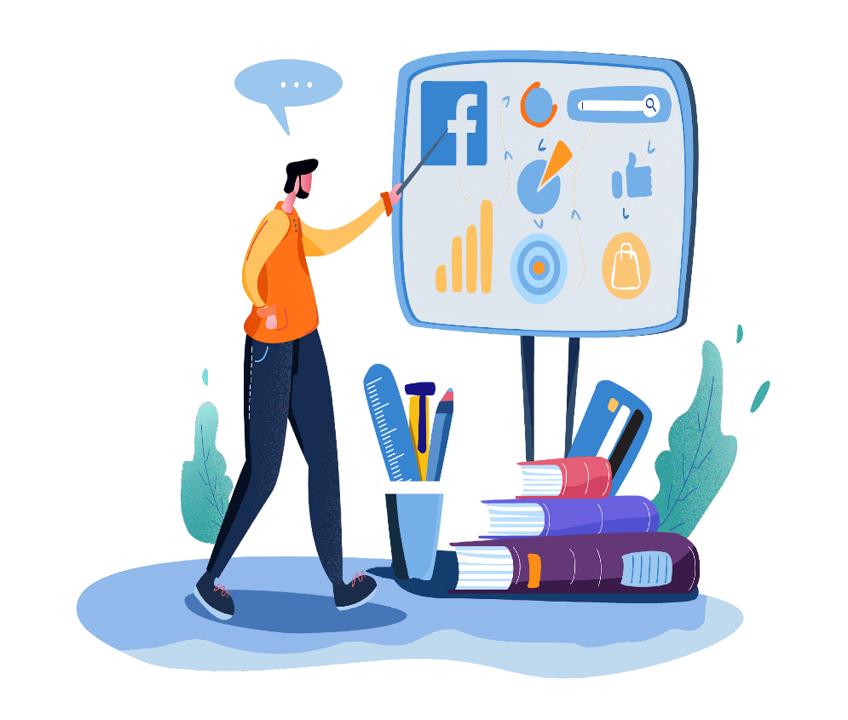
1. Have (a lot of) patience
Your clients are no longer used to being in school, and they have little or no familiarity with digital tools. Therefore, it is important not to take anything for granted, but to start with what they know and can do.
Try to understand their difficulties and find the right solution to address and overcome them. One of these might be to repeat key concepts until you see that they have understood and are able to act on their own.

Slide 69
Build a relationship of trust with your Learners
The learner needs to know that he or she can always ask for help; therefore, it is important to show kindness and politeness especially when some situations might irritate you.
Do not substitute yourself for the client, as it is they who must learn, even by making mistakes
If you see that they can't get ahead, help them by giving some suggestions, or push them to ask you for help or ask you questions, to determine why they are struggling.

Slide 70
Use simple terms
IT language can be difficult to understand for those unfamiliar with it, especially if some terms are expressed in English (e.g., web, app, shop, home). Therefore, try to use simple language, and translate it into your respective language.
Ignite their interest by emphasising the benefits of technology
Learning will be easier if your senior learners are motivated; so, try starting with their personal interests (e.g., music, movies, books), you can push them to discover new possibilities inherent to them.

Slide 71
Show the human element associated with technology
Try to make your senior learner understand that even though the digital tool may appear cold and impersonal, it is still a useful means of establishing and cultivating relationships.
Match theory with practice
To promote understanding, it is essential to convey as much practical information as possible and to give specific examples. Games are an excellent learning aid, since whether you are young or old, they still allow you to stimulate interest in practicing and learning.

Slide 72
Organise short, slow-paced classes or lectures
It is important not to overload your learners with information, so it is better to hold short sessions, adopt a slower pace and take breaks so they have a chance to process what is being explained.
9. Invite the use of pen and paper
In some cases, it may be useful to have the senior learner jot down some notes that will be useful to them while surfing the web (e.g., username, password, keywords, names of sites of interest...) which they might easily forget. However, for learning the procedures of using digital, it is always better to have them practice directly with the tool, rather than writing down every single step to be performed.

Slide 73
Adapt devices to physical needs
The use of technology can often be hindered by difficulties of various kinds, such as problems with vision, hearing, etc... for that reason, you can change the graphics of your device to make its user accessible to everyone (e.g., increase/decrease the zoom), or resort to a physical keyboard rather than the touchscreen if it is easier to type on, or even activate text-to-speech to hear and understand what is written and cannot be read.
However, in order to fully enjoy the benefits that technology offers, it is good to be educated about its responsible use and to know what negative effects it can bring about if one does not use it properly.
Such effects can affect even the most digitally confident users.

Slide 74
A few side-effects of digital use or over-use to be aware of.

Slide 75
The risk of alienation
The use of computers, smartphones, tablets, televisions and video games is now a constant feature of our lives. Their excessive use, however, can lead to a detachment from reality (offline), and an addiction to the world (online), resulting in reduced interest in non-digital activities and interactions. This is the phenomenon of alienation, from which we can protect ourselves, for example, by reducing the amount of time spent online

Slide 76
Cognitive laziness
Constant reliance on technological support in carrying out even the most mundane activities of daily living may have an opposite effect on cognitive abilities. Instead of stimulating them, it may generate their decay
The alteration of sleep-wake rhythm
Artificial light from devices can negatively affect our circadian rhythms, worsening the quality of rest. It is best to avoid using smartphones and tablets before going to sleep, or at least activate the "night" function on the screen that will attenuate blue radiation

Slide 77
The LAST EFFORT!
You are doing AMAZING…and only have one more Topic to cover and then you will have completed the entire Module…
Keep your concentration high!

Slide 78
04
Work Environment and Cooperation

Slide 79
COMMUNICATION AND COOPERATION among colleagues are two key elements in achieving excellent work results, both in terms of performance and personal satisfaction. When you work cooperatively, you become better able to deal with difficult situations and solve problems.

Slide 80
The benefits you can get from cooperation at work:
Improved sense of belonging to the company
Increased motivation and a sense of togetherness among colleagues
Reduced conflict
Higher levels of productive efficiency and effectiveness
Achievement of company goals with greater ease.
We suggest some strategies for improving communication among colleagues

Slide 81
1. Identify the communication channel and topic
You can communicate in different ways: in person, by e-mail, via chat, or on online platforms.
The choice of the channel may depend both on the topic at hand and on various kinds of needs, whether technical, economic, or personal. In any case, it is good to be clear about the tool you want to adopt and make sure that everyone knows how to use it.
To make communication effective, it is essential that everyone is on the same wavelength.
For rapid communication use instant messaging apps like WhatsApp, for not urgent modes use email

Slide 82
2. Prioritise two-way communication
To make your communication truly cooperative, you need to listen and give space to others' ideas as well, and not focus only on your own.
Communication means exchanging information, including nonverbal information. Therefore, if you are unable to listen and observe, you are unlikely to understand what is required of you, and it will be even more complex to achieve the results you want to achieve.
Groups on instant messaging Apps are frequently used. Probably you have one with your colleagues, but chatting massively on it creates confusion and misunderstanding.
At times a private chat where you can talk with one person at a time is more useful.

Slide 83
3. Stick to facts and not stories
During communication it is important to stick to what happened and can be confirmed, and not to interpretations that can be made of a situation. Creating stories is inevitable, but you must try to separate them from the facts
4. Be confident
To be credible when communicating with your colleagues, it is important to show confidence in what you are saying. To do this, maintain eye contact, and do not use an authoritative or arrogant tone with those in front of you, but always try to be empathetic. Even when you are having an online meeting, remember to keep the audio and the camera on and look at the camera while you are talking. Most of the meeting platforms allow you to “raise the hand” to ask to speak then just wait your turn.

Slide 84
5. Be clear and concise
To make your communication effective, express concepts directly and concisely, regardless of the tool you use. This applies to both verbal and written online communication. When you write an email, be sure to make immediately clear why you writing it, outlining a clear objective. If you are in an online meeting, don't be long-winded because when online we are more easily distracted and your colleagues won’t listen for a long time.
6. Respect others
To foster more productive communication, it is important to listen to and respect the ideas and opinions of others, without being influenced by any prejudices. Be open to discussion, try to pay attention to everyone's words. Some small tricks, such as maintaining eye contact, calling a person by name, or not looking at your phone while someone is talking, can help you appreciate your colleagues' opinions more, and make them appreciate your efforts.

Slide 85
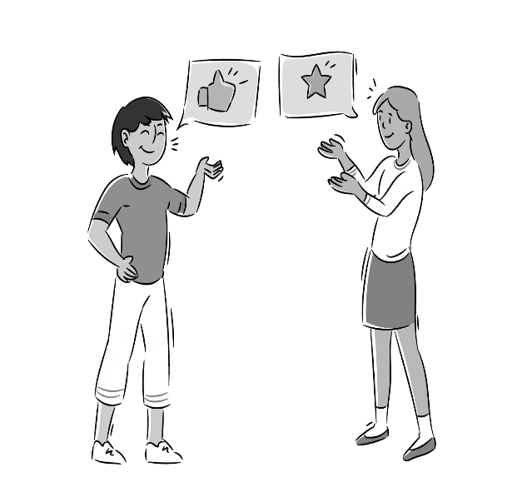
7. Give and ask for feedback
Feedback is critical to improving your own work and that of your colleagues; therefore, ask for responses and express your opinion about ideas or problems you may be experiencing.
Feedback is important for growth, both in terms of job performance and personal satisfaction. It is a great way to cooperate constructively and increase your motivation to work.
Use a management tool, such as Google tasks, Sharepoint, and Trello to share the tasks with your colleagues and exchange feedback about what’s going on.

Slide 86
In order to work calmly and at the same time productively, it is necessary for the work environment to be purposeful and motivating. Situations of conflict may sometimes arise because everyone has their own ideas and different opinions and approaches to work.
Although they are not always avoidable, it is advisable to know how to handle them.
Dealing with Conflict…

Slide 87
The four main steps in avoiding workplace conflict…
1
2
3
4
Be available to listen
Don't lose control
Come to an agreement
Try to be objective
Try to understand the ideas of others, and the reasons behind the conflict or why the situation escalated
Getting caught up in anger is never good or constructive. Therefore, try to remain calm
Finding a compromise is the wisest thing to do in certain situations
Acknowledge your own mistakes and try to understand those of others

Slide 88
Here are some digital tools that will help you manage communication and cooperation among colleagues
Shared calendar management. Google Calendar allows you to create several agendas in which to set appointments and remember commitments, which can be shared among colleagues;
Fast communication. For quick and urgent information, you can use work groups on messaging apps such as Telegram or WhatsApp;
Virtual meetings. Digital platforms are very useful and are now used daily, as they facilitate everyone's participation. Some examples are Skype, Zoom and Google Meet;
Document sharing. To share folders of documents and information with your colleagues, we suggest Dropbox, Microsoft Teams, and Monday.com.

Slide 89
Congratulations You have just completed Module 2 of our Online Course.
WELL DONE!!
Please keep going on this learning journey.
In the next and final module we discuss…Digital Technologies in the Healthcare Field

Slide 90
In Module 3 we will discuss the opportunities and benefits that lie with various Digital Technologies and Apps to help you support your clients.
﻿www.housingcare.net

