Slide 1
MODULE 3 –
Digital technologies for the healthcare field
﻿www.housingcare.net
The European Commission support for the production of this publication does not constitute an endorsement of the contents which reflects the views only of the authors, and the Commission cannot be held responsi­ble for any use which may be made of the information contained therein

Slide 2
Module 3
The Module is made up of 3 components. By the end of this module, we aim for you as Carers to be able to understand and realise the benefits and opportunities that lie within Technologies and Digital Apps for both you and those that you care for in terms of work and personal life.
You will be given real-life examples and the confidence to explore and experiment with the array of digital apps available as aids.

Slide 3
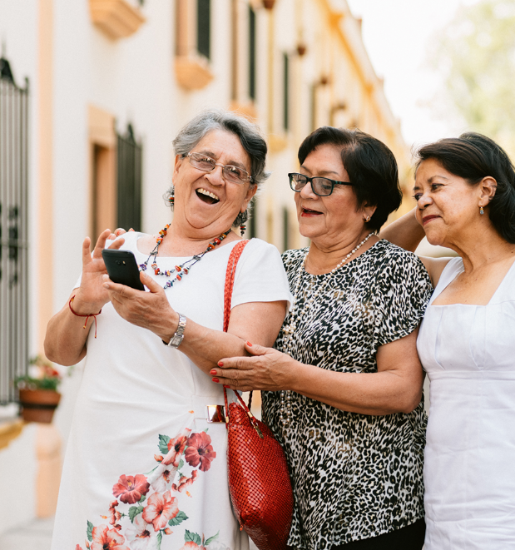
contents
TIP: TAP ON THE TOPIC TO BRING YOU TO IT DIRECTLY
01
Digital Apps for Healthcare Management
02
Technology applied to physical activity, healthy lifestyles and preventing cognitive decline
03
Social Activities Apps

Slide 4
Topic
1
Digital Apps for Healthcare Management

Slide 5
contents
(a)
What is Personal Autonomy?
(b)
Managing Health Conditions
(c)
Selecting an App to manage Health
TIP: TAP ON THE TOPIC TO BRING YOU TO IT DIRECTLY

Slide 6
(a)
Personal Autonomy

Slide 7
What is Autonomy?
Autonomy is about having control and choice over one's life. Being supported to continue with routine daily tasks such as shopping, walking a dog or going to a social-club can be instrumental in maintaining a person's autonomy.
Autonomy is particularly at risk when a person needs help with their most basic and private needs, as may happen in a hospital or residential care, or when impairment affects their ability to communicate.
Staff providing care should never make the mistake of assuming that because they know the individual well, they always know what their preferences will be. Choosing what to wear, what to eat or drink or where to spend their time in a residential home are all examples of how people can retain autonomy over key aspects of their daily lives, even when they have complex needs and require a high level of support.

Slide 8
Housing Care & the right to live Autonomously at all ages
From the caregiver's point of view, the perception of autonomy of the dependent older person should be preserved as long as possible. This is one of the best ways to protect their dignity.
As professionals who always seek to improve the needs of our clients, we must find ways to assist them in the best possible way.
In this sense, the physical capabilities of many older people prevent them from being active in their own health care management, this is where technology can play a very relevant role.

Slide 9
The importance and power of Autonomy & Independence
Older people tell us what the right to autonomy and independence means to them - YouTube

Slide 10
How can we improve the independence of seniors?
Improving self-acceptance skills: We must show them respect for themselves, accepting their strengths and the areas in which they can improve, because age is not a condition to stop learning.
Motivate them: Care is not only direct, but often the best care is the care that makes the client feel better. Therefore, the caregiver must motivate the person to do things adapted to their likes and needs.
Work on the organisation of time: The vast majority of elderly people have many problems in organising their time, so we must provide them with the appropriate tools to make it much easier for them.
Work on decision-making: it is important that they know how to prioritise between their preferences and their obligations. Understanding that throughout the day there is time for lots and that they must reserve some time for their interests.
Recognition of emotions: Being independent means being able to do what you want to do without considering the opinion of others. This will make them feel one way or another, an aspect we can work on in order to acknowledge their state is to understand that emotions are a key aspect in their decisions.
Teach them self-motivation: It is essential to teach them to be curious in their daily lives, and to show them the way so that they are able to motivate themselves. This will improve their self-concept and therefore their self-esteem.

Slide 11
Simple Tips on how to Promote Independence…
This short video gives some simple tips on how to promote the Independence of seniors as a caregiver. This includes allowing them to operate the controls for TVs, and digital technologies. Thus, giving them greater control and making your role a supportive one rather than doing tasks they can manage or learn.
How to Promote Independence - YouTube

Slide 12
A Quick Learner Exercise
Grab a pen and paper OR your tablet/phone:
List 5 practical tasks or things that you could improve in your daily working life with Seniors that would give them greater autonomy & independence ultimately
REMEMBER TO THINK OF ACTIONS OF SUPPORT RATHER THAN DOING AND DECIDING ON EVERYTHING FOR THEM!

Slide 13
(b)
Managing Health Conditions?

Slide 14
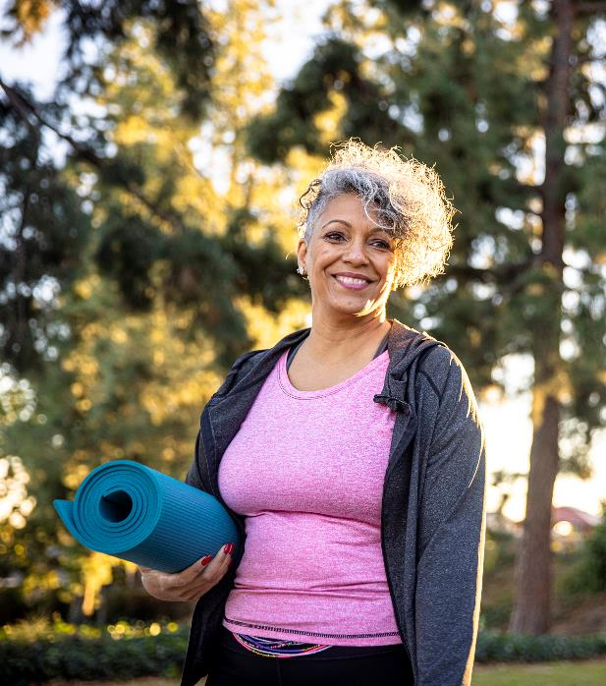
Using Digital technology to manage Health
In this section, we discuss how Digital technology…specifically Apps can be extremely useful in Health, and medical condition management on seniors.
"Medical condition" is a very broad term. It can refer to any kind of disease, disorder, injury, or illness. The older we get, the more likely we are to suffer from at least one medical condition. Some medical conditions are quite mild and may not make much difference to one’s day-to-day life, while other medical conditions require intensive treatment.
In the following slides, we will show you how Apps can assist both you in your role as a care worker and your clients in living more independently no matter what their Health Condition is…SO PLEASE STAY WITH US!!!!

Slide 15
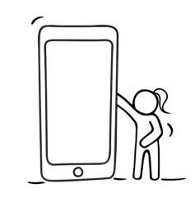
Do Seniors Use Apps?
Indeed, they do, and their numbers are growing. Pew Research Center data from 2017 reported that, “the share of adults ages 65 and up who own smartphones has risen 24 percentage points (from 18% to 42%) since 2013. Today, roughly half of older adults who own cellphones have some type of smartphone; in 2013, that share was just 23%.“
Age plays a factor in smartphone ownership, according to the Pew Research Center.
59%
49%
31%
17%
of 65-69 year-olds
of 70-74 year-olds
of 75-79 year-olds
of >80 year-olds
SMARTPHONE USER NUMBERS ARE GROWING YEAR ON YEAR…
Therefore, seniors’ digital skills will also improve year on year !!!

Slide 16
For Learning Purposes…
To demonstrate the benefit of Digital technologies/Apps we have selected just ONE condition to show the OPTIONS and OPPORTUNITIES available to you and your clients in managing their health .
This condition is DIABETES

Slide 17
Why we chose the condition/illness Diabetes to spotlight the benefit of using Apps
The International Diabetes Federation (IDF) released new figures in December 2021 showing that more than half a billion adults are now living with diabetes worldwide — an alarming rise of 16% (74 million) since the previous IDF estimates in 2019.
Diabetes around the world in 2021:
537 million adults (20-79 years) are living with diabetes.
541 million adults have pre-diabetes, which places them at high risk of type 2 diabetes.
The prevalence of diabetes worldwide is predicted to rise to 643 million by 2030 and 784 million by 2045. Source
In other words…in your professional career, the chances of caring for someone with Diabetes are HIGH!

Slide 18
A brief outline of what Diabetes is?
Watch this short video to gain a better understanding of what diabetes is.
There are 2 main types of diabetes both of which lead to too much glucose in your blood which can lead to complications if untreated
What Is Diabetes? | 2 Minute Guide | Diabetes UK - YouTube

Slide 19
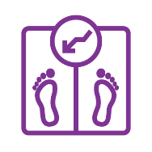
Complications of diabetes
Diabetes, if not controlled, can lead to a range of health issues.
Minor symptoms include:
Weight loss or gain
Chronic fatigue
Blurred Vision
Slow healing sores
Easily Acquired infections

Slide 20
Complications of diabetes
Diabetes, if not controlled, can lead to a range of health issues.
More serious symptoms include:
Heart disease
Nerve Damage
Issues with mouth, eyes & ears
Problems with the feet
Mental Health Issues
As you can see…several of these symptoms are common to other health conditions too…PLEASE KEEP READING AND LEARNING how Apps and digital technologies can assist your clients and their needs!!

Slide 21
Managing Diabetes…
It is possible to manage Diabetes, but it means making adaptations to one’s daily routine. Sometimes for senior clients, it can be useful to have digital aids to assist them in managing and maintaining a few changes. For example, it is often advised to:
Fix Meal-times & maintain a gap between meals to regulate the sugar level
Take small portions of food frequently to maintain a stable blood sugar level
Fitting in regular physical activity to regulate weight & improve the body’s response to insulin
Take the prescribed dosage of medication at the correct times
Monitor blood glucose levels as required and cholesterol regularly

Slide 22
Using Digital Tools to manage Diabetes (health conditions)
A mobile phone can be one of the best tools for managing diabetes and maintaining good health.
Both iPhone and Android phones offer access to Apps that can help with diabetes management. See Module 1: What are APPs
Like all apps, Diabetes apps typically range in price from absolutely free to subscription account and can be selected according to your client’s needs and budget.
Finding the ideal app for your client that will address their issues and make controlling their condition is key.
Most Apps record blood glucose readings, while some also let you record diet, medicine, weight etc.

Slide 23
Reminder we are using Diabetes as a Case study…
the following approach can be used when managing most Health Conditions, the options of Apps available are endless and therefore so are the opportunities.

Slide 24
(c)
Selecting an App to manage Health

Slide 25
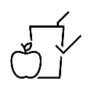
Using Digital tools to Aid Health Management
Apps are available to download from the internet, providing information, advice, and guidance on a myriad of health conditions. (See Module 1 on how to download Apps)
This information is available at our fingertips and on multiple types of devices. (phones, tablets, laptops)
In this case, we are using the example of Diabetes, however, other conditions can be researched, and useful applications downloaded in a similar way which can be beneficial in the Housing Care environment.

Slide 26
What do you need to know?
Understanding how food, exercise, and blood sugar levels interact is crucial for controlling diabetes, whether your client has type 1, type 2, or gestational diabetes.
There is an app for practically all issues, including carb counts, insulin dosages, timers, meal planning, exercise planners, glucose, glycemic index, blood pressure, and weight management.
Some apps make it convenient for your client to communicate their health information with you as their carer and/or their medical team.

Slide 27
Selecting the correct App may seem daunting but remember everything you are doing is to help or assist your client and that is POSITIVE!
To help you we have selected a few relevant apps to get you started…

Slide 28
1. – Informative Apps
Informative Apps help users to keep up with the latest medical therapy options and become knowledgeable about their condition, management tips and potential risks.
Beat Diabetes is a user-friendly Android app designed to help those who have just been diagnosed with diabetes to learn more about their condition. It provides a wealth of knowledge on diabetes ranging from the foods to avoid, to easy techniques to enhance physical activity.

Slide 29
Beat Diabetes
This app is compiled by a team of Medical Doctors specifically for Diabetic individuals. It includes:
A list of Best and Worst foods for Diabetes,
List of 10 Fruits and Vegetables to be avoided
Expert Tips on Controlling Blood Sugar levels in Diabetes
9 Strategies to improve physical activity
A description of complications of Diabetes & a timeline of their appearance
Click on the tab to download this App

Slide 30
2. – Device & Data Integration Apps
Device Integration apps can store all important medical data from connected devices, integrations, and manual entries, in one convenient place and are extremely useful for users and their carers especially if there is a care team.
mySugr is made by people with diabetes, for people with diabetes. When it comes to controlling diabetes, this app wants to be your partner in crime! The mySugr app will be right by one’s side throughout their diabetes journey, helping them stay motivated, confident, and ready to control the effects!

Slide 31
MySugr App
In the mySugr app, you can log data such as blood sugar level, activities, food, insulin etc. With the help of convenient features like the Photo Function and entry customisation, therefore you can embrace the world of data logging and do away with traditional logbooks.
Click on the relevant tab to download this App

Slide 32
3. – Monitoring Apps
Monitoring Apps help users to easily spot patterns (in this case blood sugar) & connect blood sugar with food, insulin and activity. This makes condition management a safer task and removes the guesswork.
The OneTouch Reveal® app works seamlessly with the same brand, Glucose measuring meters/devices and aims to change the way a user sees their blood sugar. The OneTouch Reveal app can be used to manage type 1, type 2 & gestational diabetes.

Slide 33
OneTouch Reveal
This App allows users to receive automatic notifications on their smartphone when a high or low blood glucose pattern is detected.
It sets personalised reminders to stay on top of patterns, meds, food, exercise—whatever your client needs to manage their condition (in this case diabetes).
And they can share progress with you or their care team between visits
Click on the relevant tab to download this App

Slide 34
4. – Meal Plan Apps
Meal Plan Apps help users to discover delicious, healthy recipes that fit into condition-required diets. They can offer variation and mental stimulation too as often senior clients’ lives revolve around mealtimes and so it is positive for them to have something to look forward to preparing and eating.
The Diabetic Recipes App gives a range of recipes that make it easy to whip up delicious, healthy, diabetic-friendly meals. For people with diabetes, healthy eating is not simply a matter of what one eats, but also when one eats.

Slide 35
Diabetic Recipes: Healthy Food
This App is simple to navigate and also has multiple tutorials available on how to use the app.
As the recipe is a set of instructions for cooking, the app also provides nutritional information, servings, total time for preparation and recommendations so that nothing can go wrong when one is cooking.
The app also offers a shopping list creation function and allows users to create a book of favourite recipes
Click on the relevant tab to download this App

Slide 36
5. – Social Apps
As humans, we’re hardwired for connection. Belonging to a community makes us feel safe and helps us thrive.
But so often, living with type 2 diabetes (T2D) or other conditions can make one feel physically and emotionally isolated. Not only can it be hard to do things one loved before their diagnosis, but it can also feel like no one understands what it’s like.
Condition-specific social Apps allow those with the condition connect via live chats, forums, 1:1 messaging and to discover relevant articles and stories.

Slide 37
Bezzy T2D
Mental health is also very important, and this app equips users with the means to connect with others in an online community to talk about anything and everything connected to diabetes. There are secure forums where people may discuss topics including daily living, diet and nutrition, relationships, recently diagnosed conditions, mental health, and more
Click on the relevant tab to download this App

Slide 38
Medications
As with many conditions, there are often a variety of medications one can take to manage symptoms and complications.
In terms of Care for Seniors, it is critical to their health management that their medication regime is established, maintained, and monitored – this action may need your support as a care worker.
We think this is where the use of Technology can assist both you and your client in their illness management.
KEEP READING!!!

Slide 39
6. – Medication Adherence Apps
Medication Adherence Apps ensure that users get the correct medication at the correct times, but often require the follow-up or assistance of other people such as family members or caregivers. There are endless applications for reminders, scheduling, tracking dates or relevant events.
The Medisafe App reminds users to take each of their medications. It also allows connecting more than one person to the same account, so they can see if the person has taken their medication, download their prescription, etc.

Slide 40
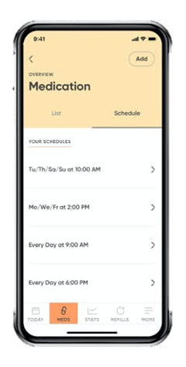
7. – Medication Adherence Technology
Medication Adherence ‘Robots’ or dispensers are extremely useful as they do the work of organising all one’s pills into different dose groupings for easy administration. They are generally controlled via an App hence why they are mentioned here.
The Hero Pill Dispenser is designed to help users/seniors improve their adherence to their prescribed medication regimen. It reminds one which pills to take and when to take them; and helps to refill prescriptions when needed.

Slide 41
8. – Exercise & Fitness Apps
Exercise is important for all ages, but as your clients age, they tend to become more sedentary. Health and exercise go hand in hand though no matter what the condition and having an App instruct and motivate you is very useful.
My Fitness Pal App allows one to track progress toward nutrition, water, fitness, and weight loss goals, all factors that influence health. This app is like having a nutrition coach, intermittent fasting tracker, meal planner, and food diary with you at all times.

Slide 42
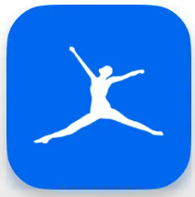
My Fitness Pal
My Fitness Pal is a good App for seniors to help them maintain a healthy lifestyle. Track the food they eat, count their steps, and what forms of exercise they’ve done during the day. One can also connect with a community of users and share tips and techniques thus supporting each other with fitness and health goals.
Click on the relevant tab to download this App

Slide 43
9. – Blood Pressure Monitoring Apps
Blood pressure (BP) monitoring/tracking and heart rate are very important for health. Blood pressure tests can be carried out at several places, including at home – Home blood pressure monitoring enables patients with hypertension to measure and share their blood pressure readings with their care team from their home.
There are a variety of low-cost blood pressure monitors available that patients can buy to use at home that can be linked to Apps directly or the data can be input for sharing purposes.

Slide 44
Blood Pressure Diary
This app helps you to record your blood pressure readings after measuring it using an external device, generate charts and set reminders for future readings. This app doesn't measure your blood pressure, (systolic or high pressure, diastolic or low pressure), but it helps you to track, log & monitor your blood pressure heartbeat (pulse) and more. You can even write a note for each log.
Click on the relevant tab to download this App

Slide 45
Using this example as inspiration to further your and your client’s use of technology
As mentioned earlier in this section, Diabetes is only being used as an example of one illness where Apps and digital technologies are very useful in condition management. However, the use of technology can be applied to several medical conditions. For monitoring purposes, exercise motivation, social connection, diet management, etc…

Slide 46
Keep Going!!!
You have just completed TOPIC 1 …we continue the conversation of Apps and Technologies in the next section but focus on those that support seniors in creating some good habits and ultimately improving their lifestyles. Let us guide you through it…
TOGETHER WE WILL GET THERE!!!

Slide 47
Topic
2
Technology applied to physical activity, healthy lifestyles and preventing cognitive

Slide 48
Topic 2
This section is made up of four elements each of which is important and relevant to the well-being of seniors but which are all focussing on the technologies available to assist seniors on the journey to maintaining good health, autonomy and independence.
Technologies to support physical activities
(a)
(b)
Fluid Balance Technology for Seniors
(c)
A Healthy Lifestyle & Technologies to support it.
(d)
Preventing Cognitive decline using Technology
TIP: TAP ON THE TOPIC TO BRING YOU TO IT DIRECTLY

Slide 49
02
(a)
Technologies to support physical activities

Slide 50
Introduction
One of the tasks of carers is to try to promote a healthy lifestyle in their clients through moderate physical exercise, good habits, and trying to maintain an adequate balance in order to ultimately promote the autonomy of these seniors.
As professionals who always seek to improve the needs of our clients, we must find ways to access and assist them in the best possible way.
In this sense, the physical capabilities of many older people prevent them from exercising regularly, which is where technology can play a very relevant role.

Slide 51
The value of physical exercise
Without Physical activity → Signs of physical deterioration appear
Staying active is essential for good health at any age.
It is important to engage in some form of physical activity to promote mobility and prevent diseases that are accelerated or caused by a sedentary lifestyle. However, physical activity is much more important for older people, as their autonomy and independence depend to a large extent on it.
With age, older people often become more dependent, as many limitations caused by the passage of time appear.
Physical exercise for seniors has many advantages, not only on a physical level but also mentally and emotionally.
Studies have shown that exercise has the ability to delay brain ageing and may prevent neurodegenerative diseases of old age, such as Alzheimer's or other types of senile dementia.

Slide 52
Exercise should be understood as an attribute of the heart.
Gene Tunney
The benefits of physical exercise are...
Positive effects on reaction capacity and memory
Lowers blood pressure by improving the blood system
Improves visceral activity with consequent improvement of intestinal transit.
Helps to lubricate joints

Slide 53
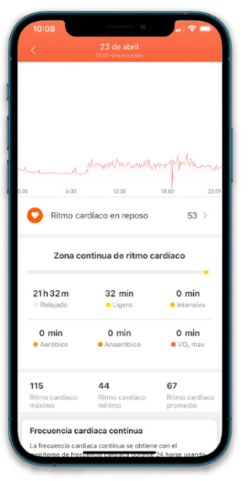
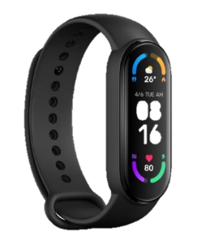
Bracelets or wearables
It has a very intuitive and user-friendly design, making it accessible to seniors.
It also has the possibility of connecting it to a mobile app, so it allows you to observe all the activity, including heart rate graphs, so you can adapt the activities to those that the users does.
Xiaomi Mi Smart Band 6, is an activity tracker, which comes with more than 30 training modes for every kind of user.
With this activity tracker, you can monitor your steps taken, calories burned, distance travelled, rest and active heart rate, and sleep throughout the day.
It is able to measure stress through heart rhythms and offers a series of relaxation guidelines and programmes.
Dance, gym, walk, stretching and training for specific parts of the body, are some examples of the programs that Miband offers to do.

Slide 54
Phone Apps:
For Exercising
Rosita is an App aimed at people over 60 years of age that proposes personalised exercises, physical activities or nutrition classes among other activities, with the aim that people over that age can lead an active, healthy and healthy life.
This App aims to help the seniors to increase their physical, mental and social activity through activities of healthy habits.
Rosita allows one to carry out activities adapted to the age and physical capacity of each user such as yoga, dance, karate or even CrossFit.
Click here

Slide 55
Phone Apps:
For Exercising
Yoga is a lovely way to exercise without doing anything too extreme. However, for seniors, yoga can have plenty of major health benefits, like improved mental health, better sleep, and reduced stress.
Down Dog is the perfect yoga App for seniors. It allows one to choose a level of experience, their favourite voice narrator, music style, pace, and if they want to focus on a specific body part. The styles of yoga vary from fast-moving cardio flow to gentle chair yoga, which is a lot more suited for older adults
Click here

Slide 56
Phone Apps:
For Exercising
Senior Fitness is a free, easy-to-navigate mobile App with simple and low-impact exercises. A few of the exercises include head tilts, shoulder stretches, and heel raises.
The best part is that about 99% of the exercises can be done while seated in a chair, which is perfect for those who find it hard to stand or have medical issues. Be sure to read the instructions or watch the demonstration videos if you're not sure how to do a specific exercise.
Click here

Slide 57
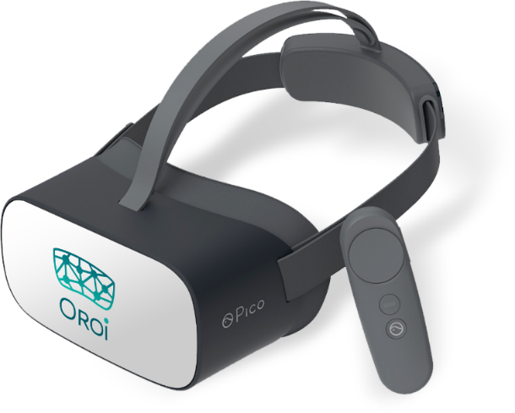
Technological Devices:
OROI forms a virtual reality solution that offers a means of awakening emotions, cognitive stimulation and physical stimulation in order to achieve well-being in these aspects of the lives of seniors.
It has 3 applications that seek to satisfy the aforementioned
Design and manufacturing
Wellbeing
Cognitive
Fit
Consists of a series of immersive entertainment-oriented videos, through which users visit different areas abroad, being able to avoid problems, such as loneliness or boredom, and even being able to recall some anecdotes in case they have ever been in those areas
Set of interactive exercises, through which their cognitive functions are worked through friendly and dynamic environments. It has some puzzles, memory games and exercises that simulate actions of everyday life
It is a collection of interactive videos through which users can enjoy bicycle rides through different environments, whether real or in 3D. It consists of a system that combines the use of pedals with virtual reality glasses, in a way that favours physical exercise.

Slide 58
02
(b)
Fluid Balance Technology for Seniors

Slide 59
Remember, if one exercises, they must stay hydrated.
Data tells us that Dehydration …
1
Increases the risk of morbidity and mortality.
Dehydration refers to a decreased amount of water in the body as a result of inadequate fluid intake. It occurs when there is an excessive loss of fluids that are not replenished. If not treated in time, it can become very dangerous for the health of seniors, as the bodies would not function properly.
2
Is associated with more probability to suffer mental illness or stroke.
3
Is correlated to longer hospital stays.
4
Leads to high costs for the health system, more than lung and skin cancer together!
Source: Bruno, C., Collier, A., Holyday, M., & Lambert, K. (2021)

Slide 60
Let's do a practical exercise....
Developing a healthy hydration plan
One of the first steps towards proper hydration is to start healthy habits. Therefore, the best thing you can do is to create your own daily diary in which you specify:
The number of glasses of fluids you drink every hour. This will also depend on the amount of exercise and the temperature.
Type of drink (water, juices, tea...)
Take into account the food of the day and the amount of fluids they provide.
In this diary, we should also have the option of being able to put at the end of the day whether or not we have achieved the proposed objectives. This will also help us to improve our day-to-day work.

Slide 61
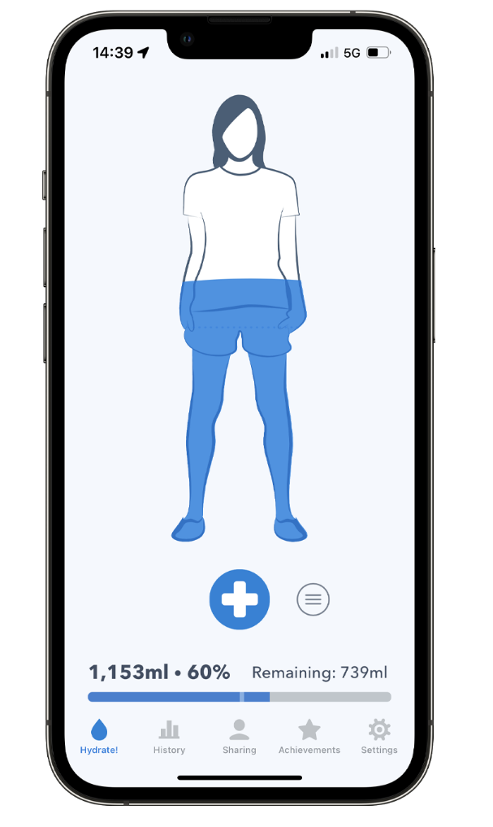
Phone Apps:
For Fluid Balance
WaterMinder is an easy-to-use App that allows you to monitor your daily water consumption. Based on your weight or personal goals, this App reminds you when to drink water to reach your daily target.
WaterMinder also integrates with HealthKit to get our weight, gender and date of birth to calculate our recommended daily water intake.
It is compatible with iPhone, iPad, iPod touch and Apple Watch.
Click here

Slide 62
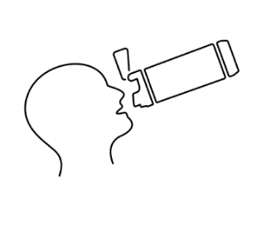
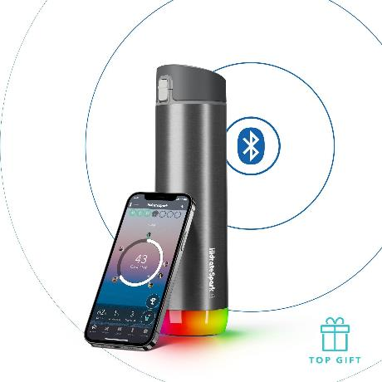
HidrateSpark
HidrateSpark PRO
HidrateSpark is another company pursuing water bottle innovation through technology with the goal of empowering people to lead healthier lives through hydration.
All its products are equipped with:
HidrateSpark PRO is their flagship product.
Composed of a stainless-steel insulating material, it can maintain the temperature of beverages for up to 24 hours.
It has a bluetooth device that connects to your mobile phone to remind you when to drink.
Glowing/indicator lights to act as reminders to drink throughout the day
The bottles have technology that can track every sip or bottle that is drank.
The bottles can be connected to an App that syncs with each other to show progress.

Slide 63
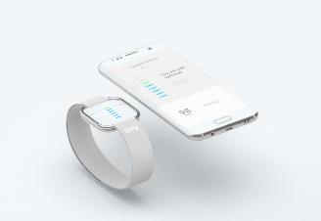
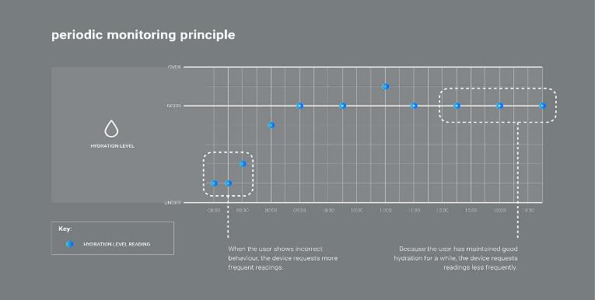
Sixty: Hydration monitor
Click here
Sixty measures hydration level, heart rate, activity levels & calories burnt as well as sleep tracking.
With all the data collected it gives one feedback on their progress and the next steps one should take to improve their health and well-being.
As advertised on their website: Sixty is more than a bracelet.
Sixty measures hydration and heart rate through the principle of optical spectrometry. Three LEDs shine green, red and infrared light onto the skin while photodiodes measure the amount of light reflected back.
The device can be detached from the strap, allowing it to be used in more scenarios and for more users.

Slide 64
02
(c)
A Healthy Lifestyle & Technologies to support it.

Slide 65
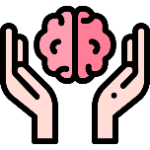
What is a healthy lifestyle in Seniors?
Closely related to physical exercise, leading a healthy lifestyle means taking care of yourself inside and out, so when we talk about leading a healthy lifestyle, we are not only talking about physical activity but also about the food we eat but also how we spend our free time and the activities we take part in.
we can distinguish four very important blocks in a healthy lifestyle
Physical Exercise
Nutrition
Mental health
Socialising
Experts recommend that seniors get a minimum of 30 minutes of exercise, 3-5 times a week.
Choosing nutritious foods keeps energy levels up and can lower the risk of chronic conditions, like heart disease, hypertension & diabetes.
Stimulating the mind and engaging with the world around you can help delay or avoid dementia and Alzheimer’s.
There are many benefits to socialising, including a more positive mood and increased physical activity.

Slide 66
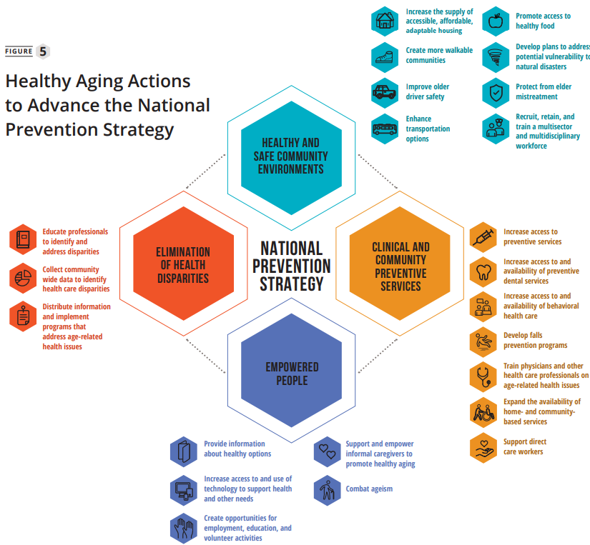
Increase the supply of accessible, affordable, adaptable housing
Create more walkable communities
Improve older driver safety
Enhance transportation options
Promote access to healthy food
Develop plans to address potential vulnerability to natural disasters
Protect from elder mistreatment
Recruit, retain, and train a multisector and multidisciplinary workforce
Healthy Ageing Actions
HEALTHY & SAFE COMMUNITY ENVIRONMENTS
Educate professionals to identify and address disparities
Collect community wide data to identify healthcare disparities
Distribute information and implement programs that address age-related health issues
CLINICAL AND COMMUNITY PREVENTIVE SERVICES
Increase access to preventive services
Increase access to and availability of preventive dental services
Increase access to and availability of behavioral health care
Develop fall prevention programs
Train physicians and other health care professionals on age-related health issues
Expand the availability of home- and community-based services
Support direct care workers
ELIMINATION OF HEALTH DISPARITIES
HEALTHY AGEING ACTIONS
EMPOWERED PEOPLE
Click here
Provide information about healthy options
Increase access to and use of technology to support health and other needs
Create opportunities for employment, education, and volunteer activities
Support and empower informal caregivers to promote healthy aging
Combat ageism

Slide 67
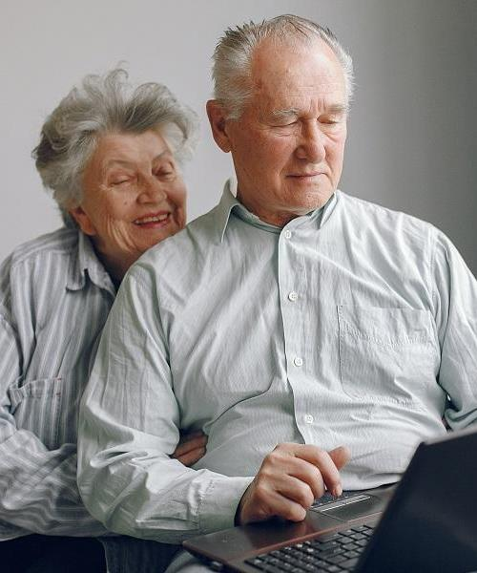
The role of Caregivers in the lifestyle of clients
Far from what it may seem, carers play a very important role in people's lives, especially in their lifestyle.
YOU are often the main contact with the outside world and therefore a great source of information that can help people learn about things they did not know about before.
This is where technology comes in and can facilitate the task of you and family members as caregivers.

Slide 68
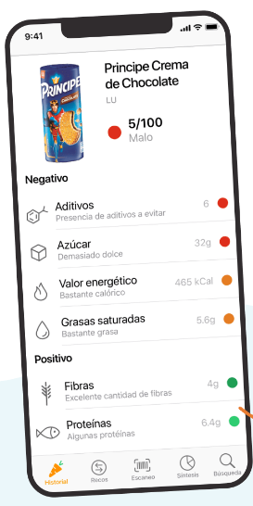
Phone App:
For Nutrition
Yuka is an application for smartphones that scans food and cosmetic products and offers information on their composition and evaluates their effects on health.
This application allows one to evaluate the shelf life of food products. All one has to do is scan the barcode of the product they are interested in with the mobile-phone camera, and the application will return the information and classification of the product in question.
Click here

Slide 69
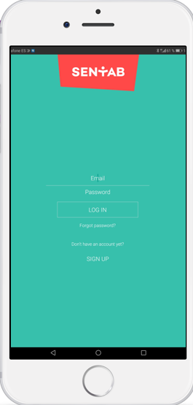
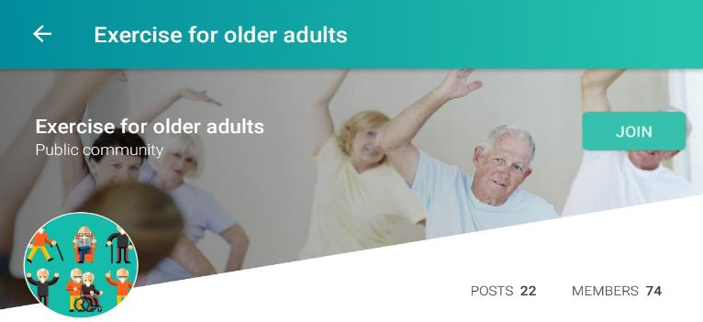
Phone App:
For Social Networking
Sentab is one of the most useful mobile Apps related to Facebook-type social networks for older people because all its features and functionalities are adapted for the senior user. For example, the letters are adapted to the visual difficulties of the age group, the information is simple and always accompanied by pictograms so that its function is better understood.
In addition, you can create activities, discussion groups, upload posts, make video calls and connect with people close to you.
Click here

Slide 70
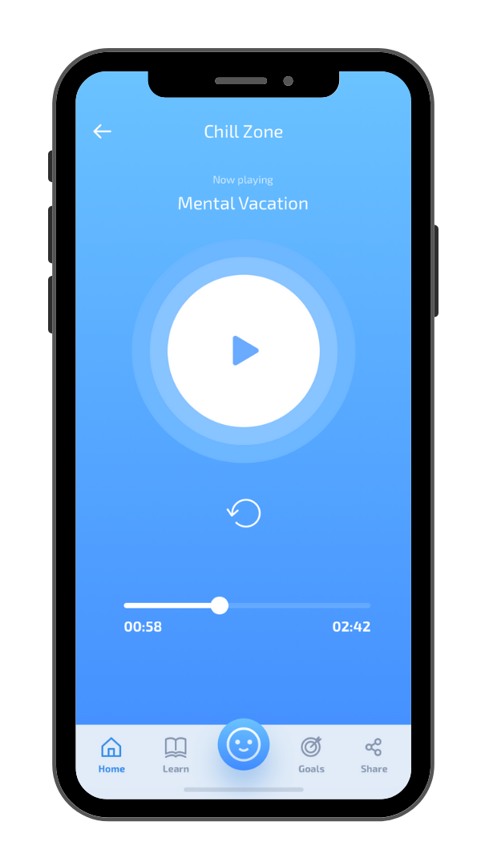
Phone App:
For Mental Health
Mindshift is an App that was developed by the Canadian government to help people treat their anxiety. Think of this as a mental health Swiss Army Knife, because it has many mental health tools: you can track mood, develop a list of coping skills, and learn more about mindfulness.
In addition, it is derived from evidence-based principles of Cognitive Behavioral Therapy
Click here

Slide 71
Technology for Personal Management
For a good family and household organisation, an App like Dommuss is needed, giving a private space which, the whole family will have access and where they can edit the calendar, the shopping list or the weekly menu. There is also a telephone book, another to share photos or another to add notes
Help your senior clients see and feel that they are in control of their lives. They must be the person to decide what they want to do with their life. To do this we must offer them the right tools, to make it easier for them to manage the things in their day to day.
Several studies have shown that the involvement of seniors in decision-making processes has had positive effects on their emotional well-being, it improves their self-esteem and their own self-perception.
With dommuss, you will can:
Make a weekly schedule of tasks to be done. Family & caregivers can review and comment
Anyone in the house can add or remove what is needed on a shopping list.
Having a family menu will help you eat healthy, plan the purchase and anyone can prepare dinner
Save and share relevant contacts so that all the members of your Dommuss have them
Share information you need everyone in your family to know.
Share family photos or photos of important things that you all want to have access to

Slide 72
Let's do a practical exercise....
Learn about this Management App
Before we can help clients with Apps, we must first learn how they work. For this reason, we want you to practice & we ask you to try a few things:
Download the Dommus App
Try to share this app with all your family or people living with you
Try to use all the options that Dommus offer for one week.
After the week, investigate if this app has improved the management of all the things in your day-to-day life or in contrast has been an impediment to carrying out the tasks as usual. If this is the case…What was the problem? Can it be improved?

Slide 73
02
(d)
Preventing Cognitive decline using Technology

Slide 74
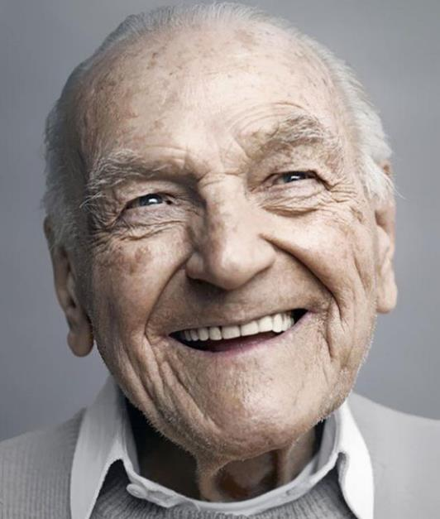
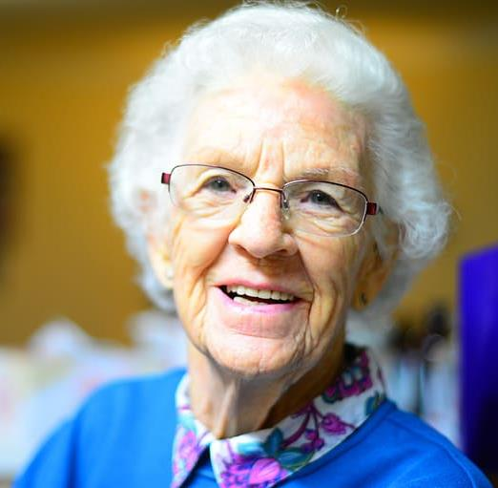
The best memory is the one that brings a smile along with it,
Let's make the journey much easier

Slide 75
What is cognitive decline?
Cognitive decline is when a person’s ability to think, learn, remember, use their judgement, and make decisions is altered.
Signs of cognitive decline include memory loss, trouble concentrating or completing tasks, understanding, remembering, following instructions, and solving problems.
Other common signs may include changes in mood or behaviour, loss of motivation, and being unaware of surroundings.
There are many causes of cognitive impairment.

Slide 76
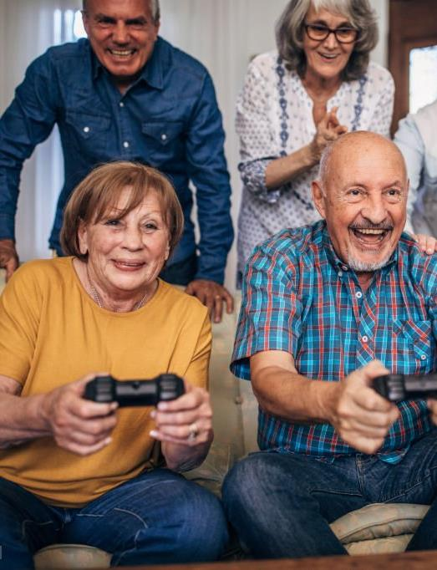
Improving the Memory via Games or Play
Play is the best way to improve the memory.
Games can allow significant learning, stimulating neuropsychological skills such as attention, memory, executive functions and language.
Many journals have proven that video games have positive effects on the memory. Playing video games may also improve problem-solving skills

Slide 77
Technology for Seniors: The Benefits of Video Games
Playing video games exercises a gamer’s memory, especially short-term memory. Playing even occasionally can help seniors remember things like names, addresses, phone numbers, date, and times better
They also force players to switch quickly between different tasks, which can lead to increased mental flexibility and multi-tasking ability for seniors.
Playing video games helped seniors exercise their brains and decrease their Alzheimer's risk factors.
It becomes an ideal space to play with the family and promote interpersonal and intergenerational relationships.

Slide 78
Devices for Playing/ Gaming
In the last years, some videogames brands such as PlayStation, Xbox or Nintendo have developed games whose main objective is to improve memory and cognitive abilities. These games usually have very visual graphics and are very easy to use.
However, smartphones are an amazing tool to use as via Apps, games, video games, specific webpages the options are endless for seniors looking to improve cognitive function

Slide 79
Working Cognitive Abilities via Virtual Reality Games…some examples
In Escape Academy seniors will have to find a way to get out of the different rooms. For that, they will need to fight their way through a variety of team-based, exploration, and limited-time challenges. A constant training space through clues, keys, locks, safes and secret codes. Everything is as if it were a real Escape Room.
Ever Forward, is an adventure and puzzle game that tells the story of Maya, who has been suddenly lost in a strange world halfway between reality and imagination.
Players must observe and use their intelligence to solve multiple puzzles that will help uncover the dark secrets of Maya's past that her mind has preferred to forget.
In We Were Here Together we play two explorers who set out from a polar base to rescue other lost explorers. To find them the gamers will have to solve puzzles together, the communication between them is so important.
This game becomes an essential tool to improve communications skills and a channel for seniors to keep in contact with their family.
Maquette is a beautiful and colourful first-person puzzle game that transports the player to a magical world, where every building and object is tiny and amazingly big at the same time.
With each puzzle that is solved, more is learned about what has happened to the protagonist.

Slide 80
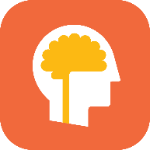
Phone Apps:
Working the Memory
Lumosity is one of the most popular brain training Apps on both Android and iOS, with more than 100 million users worldwide.
Lumosity develops cognitive skills such as memory, processing speed, problem-solving, and many more.
Lumosity turns lab tasks into fun games. Then interpret the results to provide each senior with relevant reports and a detailed analysis of their cognition.
Click here

Slide 81
Phone Apps:
Working the Memory
The Peak App was designed as a mobile gym for the brain of seniors. Peak has developed an individual training plan, which is designed to help seniors improve their health every day.
To help keep seniors motivated to train their brains each day, Peak encourages them to set up daily reminders that can be tailored to notify them that it’s time to train their brains at a specific time each day.
Click here

Slide 82
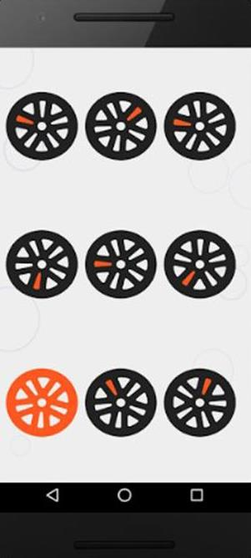
Phone Apps:
Logic games
One of the methods most used by experts to improve memory is logic, with which we can obtain many benefits. A theory on which the Skillz - Logic Brain Games App that we can download to our mobile is based.
The intelligence tests themselves are based on logic to score results, something that we can train and practice with the different levels of Skillz.
Click here

Slide 83
You are almost at the FINISH Line…one more topic to go and the course is DONE!!!

Slide 84
Topic
3
Social Activities Apps

Slide 85
contents
(a)
Social Activities
(b)
Social/interaction Apps
(c)
Entertainment Apps
(d)
Cultural Apps
TIP: TAP ON THE TOPIC TO BRING YOU TO IT DIRECTLY

Slide 86
(a)
Social activities

Slide 87
Nowadays, those who manage or work in care facilities know that taking care of the body is only half the job. It is equally crucial, to provide opportunities for intellectual stimulation, socialisation, and maintaining a good mood.
This is essential to safeguard the mental and physical health of clients and prevent them from losing their autonomy.

Slide 88
To promote active aging, it is necessary to promote a range of recreational activities that enable clients to continue to feel an integral part of society and improve their quality of life.
Digital tools, constitute as an excellent resource for this!

Slide 89
(b)
Social/interaction Apps

Slide 90
Making connections with other people is important for each of us. Digital tools play a key role in this regard, because they allow us to shorten physical distances, and reduce social isolation.
Social networks and virtual communities are digital and virtual spaces available on the internet, through which people, in different ways, can stay connected with loved ones, and/or establish new interpersonal relationships. Each of these virtual spaces has its own characteristics but all of them are aimed at fostering connection among people and also among strangers.

Slide 91
Facebook
It is the first social media platform by number of active users. It started in 2004 as a free university service but was later extended to everyone. It is available in a free form in 111 languages, for IOS, Android, and Microsoft Windows operating systems. It is the social network that has infinite possibilities of use and type of content. It is also, however, the social network where it is easier to spread fake news because not all content can be controlled.
If the video doesn’t work here, click on this link:
https://www.youtube.com/watch?v=KYKh2SFQtEA

Slide 92
Twitter
It is a free information and news sharing platform, started in 2007 and available in several languages. It allows people to post short text messages ("tweets") to which other users can subscribe and follow. It is a social network where everyone can express their idea on any topic: the most debated ones become trends. Trends are a useful tool to understand how our society moves.
If the video doesn’t work here, click on this link:
https://www.youtube.com/watch?v=dZ8jykKJ5mU

Slide 93
Community blogs
These are virtual communities that arise from the sharing of hobbies and passions (e.g., gardening, DIY, etc.) and allow people to expand their circle of relationships.
They were the first forms of online relationship, at the dawn of the internet and where young people met to exchange ideas or to share common passions. These included blogs intended as personal diaries; others as active communities engaged in online role-playing games. Today some social networks, first of all Facebook, has recreated communities with the groups function. Just type the keyword on the search bar and the related results will appear.

Slide 94
Groups or online Communities can be organised in different ways and generally have a policy to accept and are managed by users identified as moderators and administrators. The regulation serves to ensure the correct use of the virtual space, allowing all users to use it appropriately. The communities or blogs of the sector are often the best spaces to approach a new hobby, an activity or a specific topic because in them there are both contents made specifically for newcomers, but above all, there will be people willing to help just in the spirit of sharing.

Slide 95
Facebook groups
To access and explore groups on Facebook, just click on the menu and then on the groups panel. You can then explore the various content or check the groups suggested by Facebook based on what you like and your profile. In each group you can post content, read other posts, comment to exchange ideas and opinions with other users. If you do not find what satisfies you, you can create your own group in which to invite friends and other users who have the same passion as you

Slide 96
Warning!
The information you find on apps, however, is constructed by their managers based on what they believe are your (and their) interests, through the study of reading times, reactions, likes, and comments.
The result is that an information bubble is created that could create alienation and isolation, as well as lead to a radicalisation of one's own ideas and positions, and to a "myopia" toward everything we do not see or read directly.

Slide 97
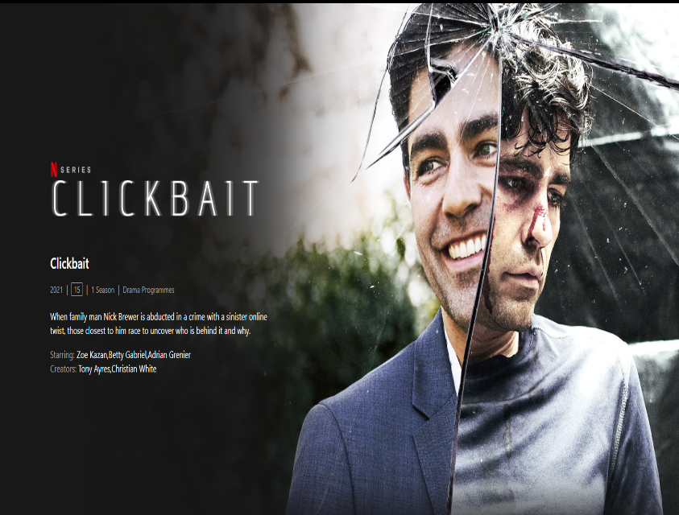
What fake news is?
For your own entertainment why don’t you watch this Netflix series…it will help you understand fake news and its effects!
As we said, on social media, it is very easy for false news to be circulated and created ad hoc to manipulate users or leverage the low level of protection of some users while browsing a recreational platform. Fake news constitutes a danger to correct information because it can significantly alter the perception of reality and instigate incorrect attitudes at the limit of legality (defamation, slander and violation of privacy are now recognised as crimes, in many countries, even if committed on social networks). But how do you recognise Fake news? It can be a complicated process since sometimes even newspapers fall into the traps while exploiting clickbait (increasing the number of clicks to get more advertising or for-profit viewing).

Slide 98
01
Check the source
Where does the information come from? Are the sources cited? Is there an author's signature and the feedback of other resources?
02
Check the facts
Is the news reported elsewhere and how is it presented? Is there correspondence between the various sources?
03
How the content is presented
In what format is the information conveyed? Does it have a sensationalist title? Is it grammatically correct? Are the tones of the article being neutral?

Slide 99
La Netiquette
Virtual space, like real space, has rules that must be respected to ensure its proper use. The extreme speed with which the Internet has spread and the access to virtual space even by users who are not ready to use it, has led to the diffusion of inappropriate practices regarding respect for other users and the space used. We are all familiar with the phenomenon of keyboard lions, just as we are well aware of the repercussions that can be caused by the improper use of information and content and by the sharing of the same, even violating the privacy of others, hence the need to create a regulation for the use of Internet spaces; just as a sector of jurisprudence is developing that intervenes and regulates virtual spaces through the law…Thus Netiquette was born.

Slide 100
Netiquette rules
Do not use capital letters: they stand for yelling.
Use emoticons (the small yellow faces with expression such as smile or crying) that will help create a better understand in your message.
Always ask for consent before tagging other people on photos or videos.
Respect the privacy of other users by avoiding publishing personal information and sensitive data.
Cite the sources and, if possible, link them, in the case of publications of texts, photos or videos.
Questa foto di Autore sconosciuto è concesso in licenza da CC BY-NC-ND

Slide 101
Netiquette rules…Continued
Do not become a part of cyberbullying (which means write unpolite comments and reactions online) by publishing posts praising hatred, and racial, sexual or religious discrimination.
Express your position in a respectful way and without personally attacking those who think differently.
Don't be hard on those who make mistakes.
Do not offend others by using profane, rude, inappropriate or derogatory language.
Use hashtags correctly and without exaggerating. Hashtags are words used to label the contents to let them be found faster by other users interested in the same topic

Slide 102
Social Community Platforms
Televeda is just one platform available and it’s mostly recommended for English speaking users, nevertheless, there are some similar applications also in other countries.
In Italy there is the Gioia+ app that works pretty the same as Televeda. The senior can download the App and once they are logged-in, they can join virtual classes in which they can do different things, such as reading a book together or physical activities.
In Spain Familyar is available which is an app that requires a subscription, to create a group of people around the seniors. This group can be made by family, care workers, friends and neighbours to keep the interaction constant.

Slide 103
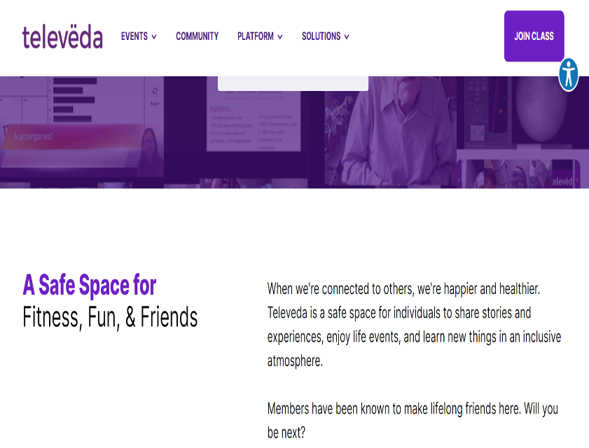
Televeda virtual community
Televeda is a social live streaming platform specifically thought for seniors who can find different activities to do while they are connected with other users from all over the world. A platform is a website with different sections where the user can interact with different content.
Joining is really easy, an email account is all you need to subscribe.
It’s possible to join multiple kinds of classes such as fitness, drawing, painting or just playing games with other users.
Virtual events, such as Bingo night, are organised to have fun together.

Slide 104
Be Inspired…suitable Apps
Word with friend app
Word with friend is a game similar to Scrabble, in which the player can interact and play in multiplayer mode with friends, challenging each other in games with different game options.
It, therefore, allows players to interact with friends but also get to know other players, positively impacting cognitive functions as well. It helps, in fact, to train thinking in searching for the right words.
It is available in iOS, Android and on the web, but not in all languages, but don’t worry about this because you can find a lot of similar app in your language.

Slide 105
(c)
Entertainment Apps

Slide 106
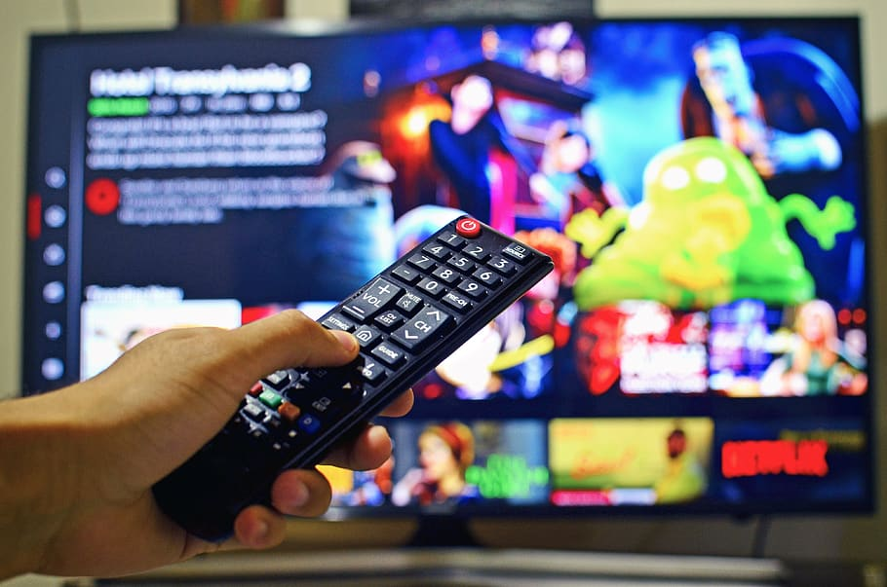
Entertainment Apps
Today, entertainment is made more accessible through streaming. This is a system for transmitting audio and video over the Internet, allowing people to listen to or watch the content they want without having to wait until it has been fully downloaded.
Major legal streaming platforms include Netflix, Amazon Prime, NowTV, Disney, Spotify, Pluto TV, YouTube. Continue reading to learn more about each →→→

Slide 107
This is a subscription streaming service that hosts a considerable number of movies, series and documentaries, offering subscription plans usable by one, two or four users at the same time. The contents are in high-definition resolution so you can watch movies with clear colours and frames. If you want, you can also download the content and watch them when your internet connection is off.
If the video doesn’t work here, click on this link: https://www.youtube.com/watch?v=o5RxOCCHNGM

Slide 108
Amazon Prime Video
Once you subscribe to Amazon Prime, the service automatically activates, supporting high quality definition. The contents are divided in categories, so you can choose among movies, cartoons or series and once you decided what to watch you can surf among the contents according to the genre. If you have a smart TV or the Amazon Firestick you can also use the microphone in the remote control and just say the title, then the App will open the movie automatically.
If the video doesn’t work here, click on this link:
https://www.youtube.com/watch?v=7G7RyXzHMSM

Slide 109
Spotify
It is a music streaming service that gives access to millions of songs and podcasts. Podcasts are really popular right now. These are audio recordings in which people can tell stories, comment on news or read books. There are several genre of podcasts: crime, comedy, politics and historical ones etc. It’s just up to you to choose the best. Free versions can be accessed via PCs, laptops and smartphones. The free version has some functions locked, to unlock them just subscribe to Spotify Premium, which means paying a monthly fee.
If the video doesn’t work here, click on this link: https://www.youtube.com/watch?v=PxpNtOIFRm4

Slide 110
Pluto TV
Viewing content is free, and can be accessed either through a Browser, or from the App available on both GooglePlay and AppleStore. Pluto offers a Live TV section and an On Demand section. In the “on-demand section” the user can choose the show he/she wants to watch just by typing the title of it and letting it play.
If the video doesn’t work here, click on this link: https://www.youtube.com/watch?v=XnAvz8J6Nq0

Slide 111
(d)
Cultural apps

Slide 112
Cultural apps
Technological tools, especially smartphones, through the multiple recreational Apps they offer, are thought to be negatively impacting users' interest in culture. However, theses digital tools on the other hand, are very valid allies to cultivate their passions, to continue to document, inform and feed our curiosity. The power of technology means that we have had the doors of the world opened to us, allowing us to see or visit things and places that perhaps we would never have been able to see otherwise. During the pandemic, this need became even more urgent, since having to spend a lot of time at home, the only way for culture enthusiasts was to travel through the internet or visit places virtually. Many museums, places of interest, have taken up this challenge and have opened their doors for free to millions of virtual visitors.

Slide 113
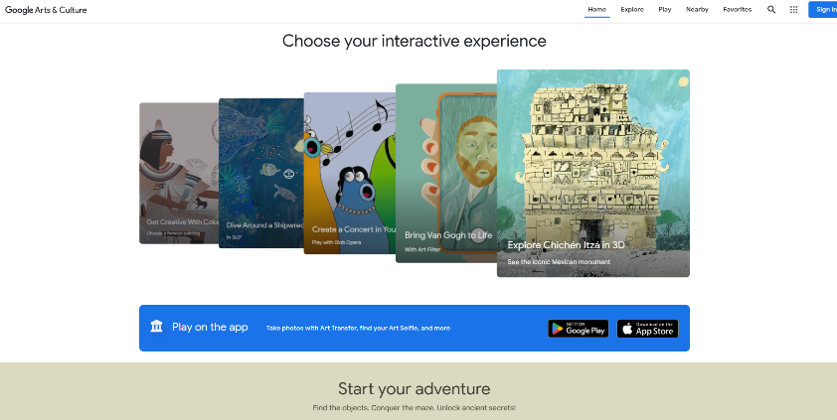
Google Arts & Culture
Among the easiest tools to use, the most solid and of course gratuitous is Google Arts & Culture. The platform was born from the famous search engine and has been active since well before the pandemic forced us to have to travel online.
What can you do with Google Art & Culture? You can browse through thousands of contents: art collections, visits to museums, exploration of video content and photos on historical periods and characters. All just a click away. Among the supported functions, there is also the "Nearby" function, thanks to which you can discover all the museums, places of interest and historians near you. By clicking on the name, a drop-down menu will open with other brief information.
But how else can Google Art & Culture help us?

Slide 114
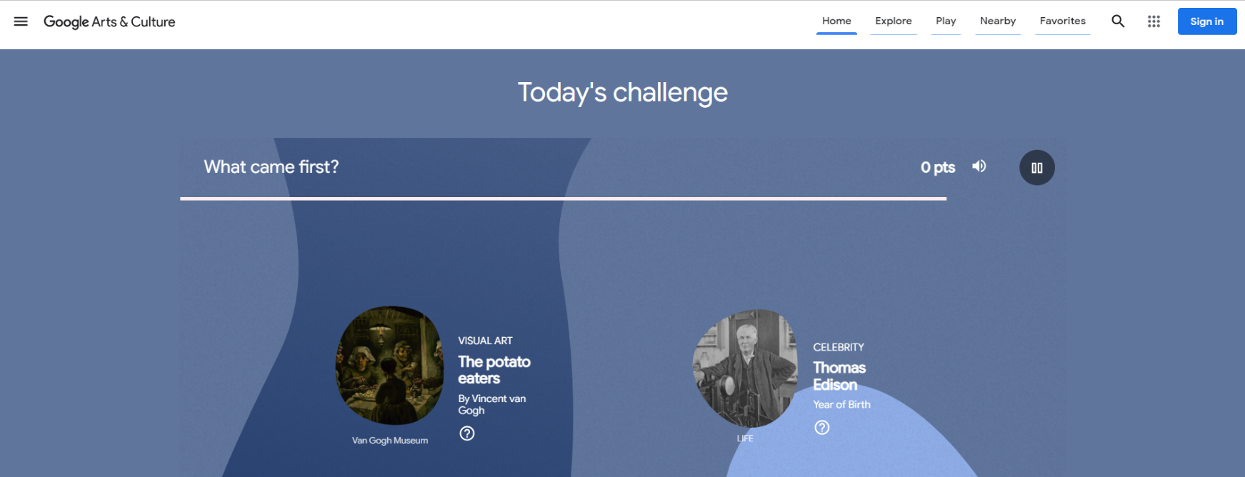
With daily challenges, the user can test his memory, knowledge and cognitive abilities. Constant mental training has been shown to prevent the development of neurodegenerative diseases and help maintain lucidity over time.

Slide 115
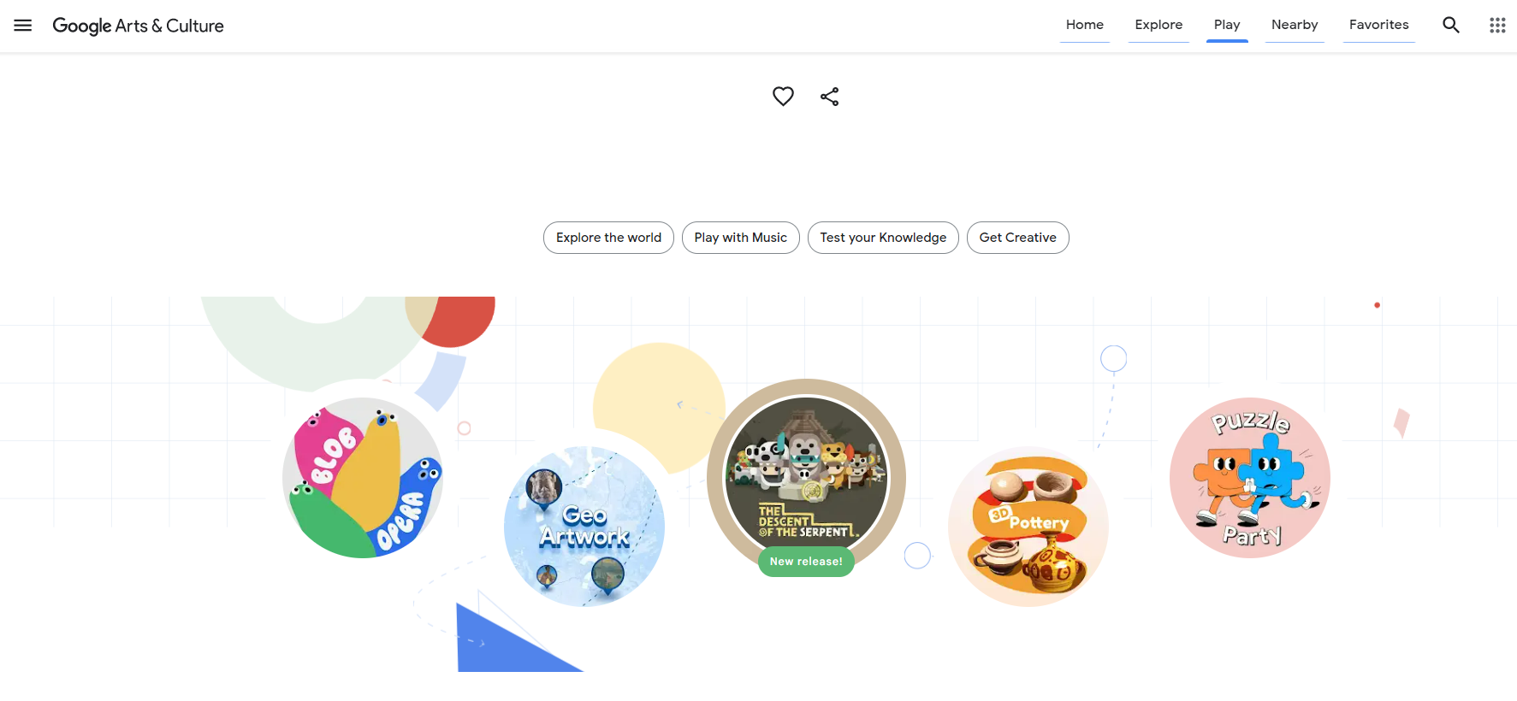
In the Play section, which can be selected in the bar menu at the top right, you can access many game categories divided by objective and topic. In the "Get Creative" section you can draw, colour, create your own 3D ceramics and also interact with artificial intelligence.

Slide 116
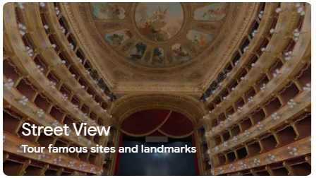
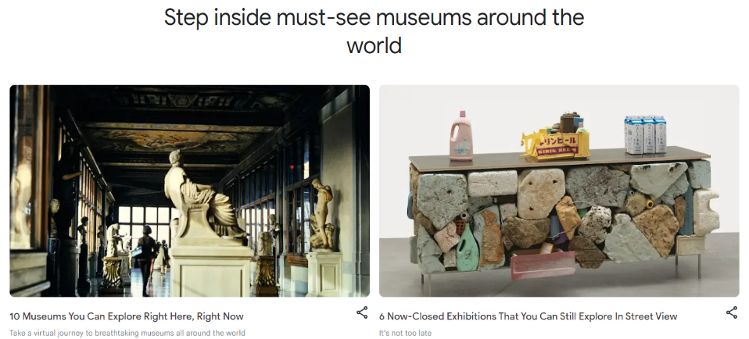
In the Explore Section, through the tool Street View you can visit a Museum. Street View is a function supported by Google Maps which allows the user to visit a place as they would if actually there. It gives the perception of being in that place, walking and looking around.
2) Google Arts and Culture exploit this Street View functions and let the users enter and visit a Museum or a place of interest. Just clicking on the name of the Museum the users can visit it like they would do in presence.

Slide 117
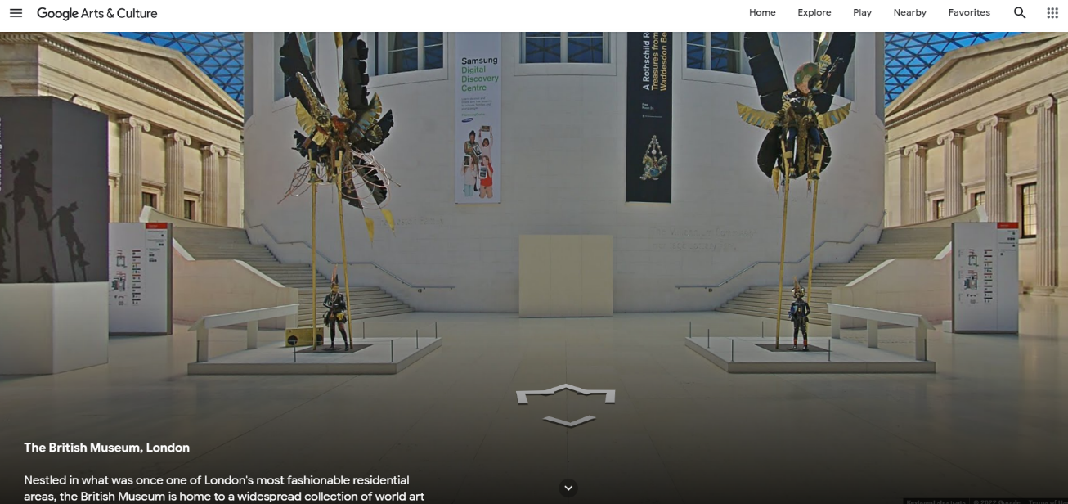
3) This is an example of what the Google Arts and Culture Street view looks like. Here we show the entrance of the British Museum in London.
Using the arrows appearing on the screen the users can decide in which direction they want to proceed with the visit. Then clicking on the art, the users can look at them as they would when visiting the Museum for real.

Slide 118
Google Arts & Culture is usable on every search engine and is also available on smartphones and tablets, it’s possible to download the App from the App stores.
The benefit of using this platform are several:
As we mentioned, it helps the user to stay active, nurturing curiosity and the willingness to learn new things.
Through an innovative approach it allows the users to live a full experience, allowing those who cannot travel to visit and see the amazing things that exist around the world.
The play sections give the opportunity to learn while having fun, keeping the mind active and trained.
It’s really easy to use and can be taught also to elderly people who want to learn and explore new things and places.

Slide 119
Learner Exercise:
Would you like to visit a museum you've never seen or visit the Orion Nebula?
As an exercise: open Google Art & Culture, and explore all the functions and visit somewhere new.

Slide 120
Congratulations…You have just completed the Entire Housing Care MOOC
Please feel free to come back to this course at any time to refresh or remind yourself
www.housingcare.net

