Slide 1
Introduction
Reframing Skills for Senior Carers
﻿www.housingcare.net

Slide 2
Contents
01
The Housing Care Project
02
Caring through technology: Is it possible?
03
Care Workers and Technology
04
Is not just a theory, it is a reality. Examples.
05
About this Massive Open Online Course (MOOC)

Slide 3
01
The Housing Care Project

Slide 4
Too often we underestimate the power of a touch, a smile, a kind word, a listening ear, an honest compliment, or the smallest act of caring, all of which have the potential to turn a life around
LEO BUSCAGLIA

Slide 5
The Project
Housing Care: Using Reframed Skills for Senior Carers, arises with the intention of improving the quality of life of dependent seniors through the upskilling and training in new technologies for their care workers.
The care sector, as the years go by, will become larger and more important since as the data shows, the population over 65 years of age is going to increase dramatically. Therefore, the percentage of people in need of specialised personal care, adapted to the current social situation will also increase.
The Housing Care Project aims to offer a new perspective on care, adapted to the present day and whose main driver for change is the adoptation of new technologies both inside and outside the home of seniors.

Slide 6
The Care Workers, at the end of the MOOC will be equipped to:
Project Objectives
Through this MOOC, we want to give care workers the updated tools and adequate skills to equip them to perform their roles effectively and efficiently, with the sole intention of improving their overall well-being, as well as that of their clients or patients.
We do this by showcasing the latest education techniques, offering a variety of tools and platform content and by providing resources that can be used on a day-to-day basis.
Test Ambient Assisting Living & E-Health devices to assist and take care of seniors
Practice assistance and care interventions using these technologies, integrated with a strong humanised component
Manage the multi-functionality of devices at a basic level
Understand and use some of the data produced by the technologies.

Slide 7
We need act as soon as possible
The population is ageing, and unlike in previous decades, this is the first time that we don’t have one generational replacement. As a result, the demographic pyramid is inverting faster and faster.
In 2022, there were 771 million people aged 65 years or over globally, 3 times more than the size in 1980 (258 million). The older population is projected to reach 994 million by 2030 and 1.6 billion by 2050.
Population growth is caused in part by declining levels of mortality. Globally, life expectancy reached 72.8 years in 2019, an increase of almost 9 years since 1990. Further reductions in mortality are projected to result in an average longevity of around 77.2 years globally in 2050.
A silver economic future, which will require a change in the model as we currently conceive it, especially in the care model. A person-centred care model adapted to a technological society.
Source: United Nations

Slide 8
The project: Care Workers
Within this economic future, one of the most important roles is that of Care Workers.
Indispensable in the care of people, whether dependent or not, they carry out a challenging role, with a lot of physical and emotional effort, which is often not recognised or financially rewarded.
Characterised as an outdated sector, some studies indicate that training in new technologies would improve the quality of life of Care Workers and therefore the care received by older people.

Slide 9
We Owe Them a Lot!!
An example of perseverance, strength and self-improvement.
There are many categories within the care sector, but regardless of whether they worked in a hospital, in a health center, in a nursing home or in an individual’s home, their efforts during Covid-19 were immeasurable.
That is why we now have an obligation to take care of them. Improving their working conditions and giving them the professional tools that they need in their daily work.
Perhaps, this is our small contribution!
International Year of Health and Care Workers - YouTube

Slide 10
02
Caring through Technology:
Is it Possible?

Slide 11
The best way to grow an idea is by asking ourselves…
We have two questions for the two types of Care Workers according to their experience…
Those with more than 15-20 years of experience…
How has the way of working changed since you started?
Does technology make it simpler?
2) Those with less than 10-15 years of experience…
Do you believe that technology is necessary to carry out your work?
What kind of technology are you lacking in your work?

Slide 12
Challenges Care workers face…
In recent years there has been a major leap in the quality of technology dedicated to the care of dependent persons.
For many workers, dealing with technology in the workplace can be a real headache, and many times is considered a barrier to developing their work efficiently (Andersson et al., 2016), and one of the main causes of stress.
A core problem is that care workers are often poorly trained regarding new technology and the opportunities that lie within it’s use.

Slide 13
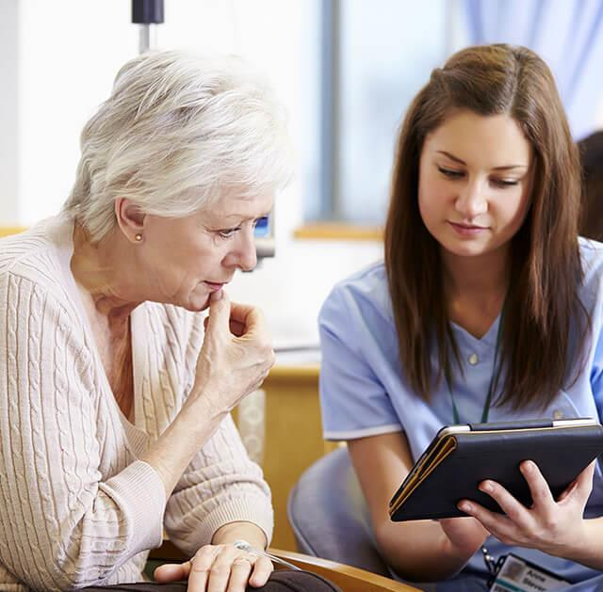
The possibility to care through technology
If you are one of those people who thinks that technology is a setback when it comes to caring for dependent people or seniors, you should know that there are many ways of caring and not all of them require presence or physical care. An important element of the role is connection, monitoring and communication and taking into account the emotional state of the person.

Slide 14
Is it possible to care through technology?
Therefore, the answer to this question is .... YES!
For example, some studies have found that simple positive monitoring via technology at home would result in fewer trips to check on seniors, saving time and allowing for more practical tasks to be carried out.
Additionally, home care workers have the possibility to reduce the time spent on the daily completion of user-related paperwork and devote it to paying more attention to the older person.
Other studies have shown that the use of technology increases the user's responsibility for their health, reduces their anxiety and improves their overall physical and emotional state. It also improves communication between the care worker and the user.

Slide 15
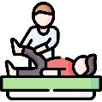
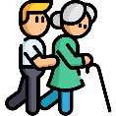
Caring for others... a journey of many possible paths
In this MOOC that we have created, you will learn that there are many aspects to caring and that each one can be performed in a myriad of different ways.
Dependent people, especially seniors require that we work with them on aspects such as memory, and executive functions.
It can be one of the simplest interventions and one of the most effective, we just need to work on active listening.
Cognitive Care
Companionship
Physical Care
Emotional Care
Learning Support
Understood as the traditional form of basic care, such as wound care.
Dependent people can suffer from many emotional problems, and if this aspect is not taken care of, it can lead to more serious problems such as depression.
The fact that the people we care for are dependent does not mean that they cannot learn new things. Teaching them and giving them new tools is not caring, it is a right.

Slide 16
Some Benefits of Digital Technology in Health Care.
Digital technologies can provide accessible information on available support (care services, wellbeing, financial support, worker's rights)
Some studies have shown that care devices have a positive impact on the mental and social well-being of clients/patients.
Technologies can facilitate carers working remotely, enabling them to provide care while still staying connected to their clients
Accessible
Information
Reduce loneliness
Improve
Mental Health
Technology can improve communication, empathy, and progress toward shared goals between care workers and clients
Task-sharing tools can make it easier for carers to coordinate their care network and share information
Care
management
Improve care
relationship
BENEFITS

Slide 17
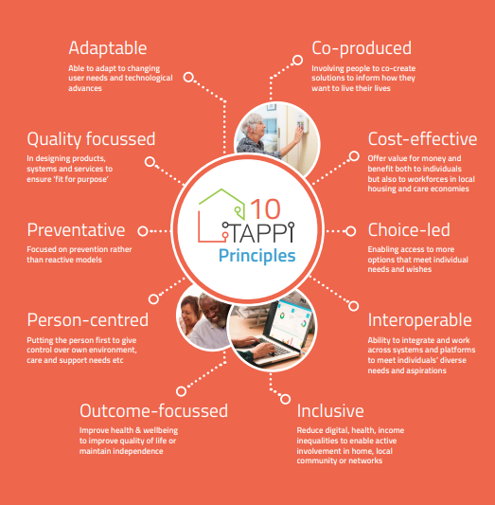
Include technology,
but not in any form.
Co-produced Involving people to co-create
solutions to inform how they want to live their lives
Adaptable Able to adapt to changing user needs and technological advances
Cost-effective
Offer value for money and benefit both to individuals but also to workforces in local
housing and care economies
Quality-focussed
In designing products,
systems and services to
ensure ‘fit-for-purpose’
The Technology for our Ageing Population Report, provides information about what characteristics technology in the home should have.
These are key principles that will facilitate the adaptation of all stakeholders and the proper efficiency of the devices installed
Preventative Focused on prevention
rather than reactive models
Choice-led
Enabling access to more options that meet individual
needs and wishes
Person-centred
Putting the person first to give control over own environment, care and support needs etc
Interoperable
Ability to integrate & work across systems & platforms to meet individuals’ diverse
needs and aspirations
Outcome-focussed
Improve health & well-being to improve quality of life or maintain independence
Inclusive
Reduce digital, health, income inequalities to enable active involvement in home, local community or networks
Click here

Slide 18
03
Care Workers and Technology

Slide 19
The situation of Care Workers
Covid-19 has worsened the working conditions of care workers around the world, due to the shortage of biosafety equipment, scarce of infection control systems, lack of recognition programs and work incentives, and finally physical and psychological abuse and discrimination by patients, which has an impact on their mental health.
According to the American Healthcare Association (AHCA) and National Centre for Assisted Living (NCAL), long-term care facilities are facing the worst labour crisis of any healthcare sector today.
The Bureau of Labour Statistics data from November 2021 shows that nursing and residential care facilities lost over 11,000 jobs.

Slide 20
How Technology Can Help Care Workers for Seniors
Improve Scheduling
There are so many technologies, such as CarePredict, that allow care workers to working conditions and preparedness by being able to recognise and identify the higher demand periods with their patients.
For example, an assisted living facility using CarePredict identified specific times during the day when there was an increased and consistent demand.
This allows facilities to: Optimise staffing based on resident needs.
Click here

Slide 21
How Technology Can Help Care Workers for Seniors
Seamless client visits
The possibility to record every visit made by each worker in an App or software, allows all the teammates to know the behaviour of each client or patient.
Being able to know if the person to be cared for is aggressive (or having a more disruptive day) allows others to know if they should be prepared or even take the decision to send a professional with more experience in this type of situation.
As well as having this information, the company can upload the specific learning achieved on the file/page of this client/patient, allowing care workers to improve their skills before visits.

Slide 22
How Technology Can Help Care Workers for Seniors
Education
Following the last point…the generation of health and housing care leaders require support if they are to continue to develop themselves and their teams and services.
The education of professionals within these sectors is crucial in enabling a cultural shift so that staff understand the value and use of technology, and how it can support them in effective caregiving, as well as improving the quality of life of the people being cared for.
Providing them with the right technology being able to give their opinion every week or month in order to know how they feel while they are working, how they believe that they can improve their skills…

Slide 23
04
Is not just a theory, it is a reality. Examples.

Slide 24
Technology For… Care Workers.
Cobots are computer-controlled robotic devices worn around the waist and lower back, which support carers in lifting, holding, and moving people without assistance and with less risk of injury.
Cobots ensure that carers maintain the correct posture for physical tasks.
Carers were less fatigued and felt less strained completing their care duties.
Reduces the need for double-up care packages, and meets increasing demand.
Key Aims and Achievements
Cobots - Collaborative Robots in Care - YouTube

Slide 25
Technology For…Patients
Brain Injury Rehabilitation Trust (BIRT) is an organisation specialising in the care, rehabilitation and treatment of brain injuries.
Among their various actions, they offer innovative rehabilitation through technology.
One example of this is technology specially adapted for people with quadriplegia.
#TEC Stories Paul - touch screen technology transforming lives of those with disabilities - YouTube

Slide 26
Technology For…Companies
Alaya Care Software, is an App available for Smartphones and Tablets, that allows caregivers to schedule their visits, route details, billing, risk assessments, time tracking, client data, and form reporting. Consequently, it allows the companies to follow the progress of their workers and the opinion of their patients in real time.
Electronic Visit Verification | AlayaCare Home Care Software - YouTube

Slide 27
05
About this MOOC

Slide 28
Change is always the result of true learning.
Leo Buscaglia

Slide 29
Digi-Human Senior Care MOOC
The project result is a professional development course in a MOOC format, that provides Care Workers with the basic skills to assist and care for seniors through Ambient Assisted Living (AAL) technologies.
Care Workers, at the end of the MOOC will be able to:
Test AAL devices to assist and care for older adults;
Deliver care and treatment interventions via AAL technologies, with a strong humanised component;
Manage at a basic level the multifunctionality of devices;
Understand and use some of the data produced by the technologies.

Slide 30
The MOOC is composed of:
Training Content Area
Composed of 3 different modules, it takes an in-depth look at new technologies and their application in the care sector through a theoretical and practical methodology.
Tools
Training Content Area
The course provides an array of tools (videos, infographics, manuals) to make learning easier for the student.
Tools
Learning Environment
Learning Environment
A professional learning platform has been created to make it more accessible to any type of care worker.

Slide 31
E-Structure of the MOOC
Technology applied to physical activity, healthy lifestyles and preventing cognitive decline
Module 1
Module 3
Digital technologies for the healthcare field
Digital Literacy
Digital Apps for Health care Management
Module 2
Human Digital Skills
Social
Activities Apps

Slide 32
If you need more information…
Don't forget that collaboratively the partners of the Housing Care project have also created a learner’s guide or handbook that will help you to get the most out of this MOOC.
In this Guide you will find:
Information about the project and the partners
Details about the course and the modules
Tips for study
How to follow and use the MOOC
Click here

Slide 33
Congratulations!
You have taken the first step on what will be an amazing journey…Let’s do it!
www.housingcare.net

