Slide 1
Learner’s Guide to Support the MOOC
www.housingcare.net
2022-2024

Slide 2
contents
01
Introduction
02
The Project
03
The Partners
04
The MOOC: Digi-Human Senior Care
05
The Modules of MOOC
06
Some things you should know

Slide 3
01
Introduction

Slide 4
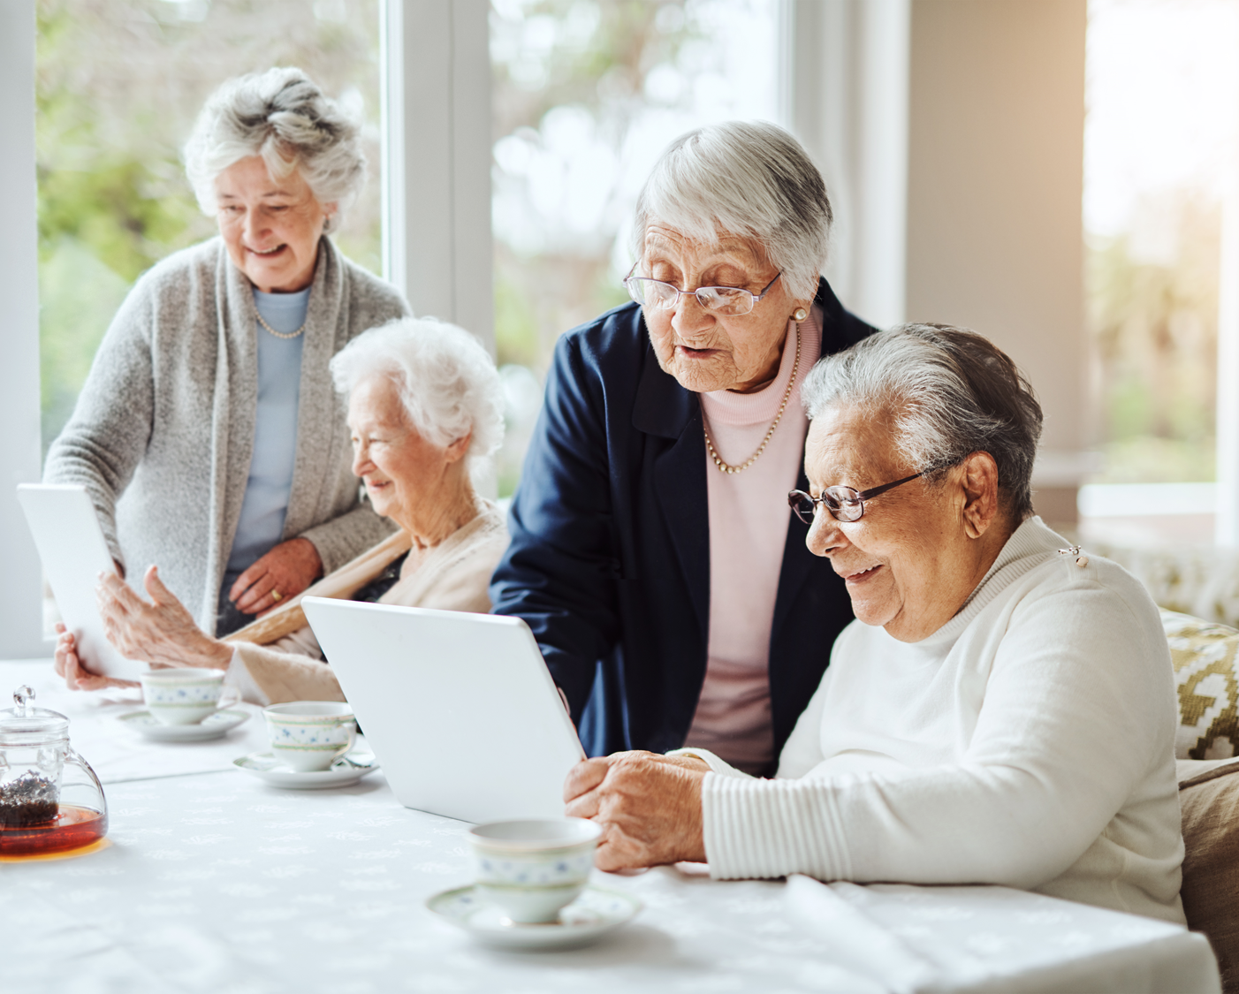
Introduction
Welcome to the Housing Care MOOC: Reframing Skills for Senior Carers. A free online resource developed by all the partners involved in this European Erasmus+ Project, "Housing Care”. This project arises with the intention of improving the quality of life of dependent seniors through the updating and training in new technologies for care workers.
A sector, as the years go by, will become larger and more important, since as the data shows, the population over 65 years of age is going to increase dramatically. Therefore, the percentage of people in need of specialised personal care adapted to the current social situation will also increase.
The Housing Care Project aims to offer a new perspective on care, adapted to the present day and whose main driver for change is the adoption of new technologies both inside and outside the home of seniors.
With this course those workers related to the care sector will have the possibility to update their knowledge and improve their skills with the intention of enhancing their quality of work and, therefore, their general well-being.
In addition, the companies where they work will be able to expand the range of services offered to their clients, demonstrating an innovative action that aims to improve the quality of their care for dependent persons.
From this Project, we not only offer companies or organisations the opportunity to improve the services they offer, but also the quality of work from their employees. A company that has in its plan a series of actions aimed at improving the skills and knowledge of its workers, will be a company that is valued, both inside and outside the company. A company in which both customers/clients and employees feel loved and valued.

Slide 5
Why we created the Housing Care Project?
The latest data from recent research (WHO, 2021) indicates that between 2020 and 2030, the percentage of the world's population aged 60 and over will increase by 34%, that the number of people aged 60 and over currently exceeds the number of children under the age of five, and that by 2050, the number of people aged 60 and over will exceed the number of adolescents and young people aged 15 to 24. This change in the demographic pyramid will gradually bring about a change in the way we conceive society today, a society that has committed itself to "supporting" the older generation. A support wheel that will gradually have to change its shape in order to adapt to the new social situation it is facing.
It should not be forgotten that we have recently experienced a global pandemic that has seriously affected people's lives, changing life as we have conceived it up to now and worsening the conditions of those with some of their capacities reduced. Some studies report that Covid-19 has caused more than half of dependent people, and also some care workers, to experience a significant reduction in their physical and emotional well-being. Consequently, there has been an increase in the use of anxiolytics and antidepressants. As well as increased sadness and loneliness, feelings of fear, low self-esteem, boredom and insecurity.
This increase in workload will, in turn, result in care workers having more responsibility, more users, and longer hours. This has a significant impact on their quality of work, their personal quality of life and their physical and emotional well-being. A sector of the workforce that also needs some of the care they receive. This is the main reason why we created this course: to provide care workers with the necessary skills to be able to carry out their work efficiently and to improve their quality of life, as well as that of their users/clients.
It would be a mistake for us to create such a project if we do not consider new technologies.
There is a wealth of technology that can give more security to dependent persons by improving their health, well-being and emotional state and can help care workers to better manage their tasks, conduct remote follow-up sessions, or have more resources to be able to scale up their intervention.
Can technology be the great ally of care workers?

Slide 6
02
The Project

Slide 7
HO.USING. CA.RE. –(USING REframed Skills in Senior HOusing CAre
HOUSING CARE: USING REframed Skills in Senior HOusing CAre, belong’s to Eramus+ projects and as its main objective contributes to reducing the risk of unemployment of Senior Care Providers and making the European Senior Care system sustainable.
The aging of the population increases the need for Senior Care services. However, there is a decrease in the available workforce. It is therefore necessary to take advantage of the benefits offered by technology. This situation makes it essential to eliminate any risk of inadequacy in active care workers. The risk is not only their unemployment but also the crisis of the European Senior Care and Long-Term Care systems.
Our objectives are:
Develop adequate levels of knowledge and skills in the humanised (person-centred) use of AAL (Ambient-Assisted Living) or E-Health technologies by Care Workers
Update the competences of care workers to the evolving needs of their work.
Develop the capacity to implement organic training on the use of humanised AAL or E-Health technologies that are appropriate and attractive to women workers
Develop the ability to match new market needs in terms of quality and quantity through appropriate skills of care workers.
These are the various resources we hope to develop over the two years of the project.
Human-Digit MOOC: up-skilling course that provides Care Workers with the basics of supporting and caring for seniors through the inclusion AAL & E-Health technologies.
Human-Digit Work-Based Learning Toolkit: The digital toolkit contains a set of useful tools for designing and implementing hands-on learning activities addressed to Care Workers to be implemented in a work-based pathway.
Project Results

Slide 8
03
The Partners

Slide 9
Meet The Partners:
1
Fundación Ageing Lab
Ageing Social non-profit foundation from the city of Jaén (Spain) created with the aim of becoming a network of knowledge about ageing, We are part of a wide research and dissemination network thanks to our Living Lab, accredited within the European Network of Living Labs (Enoll) that allows us to participate in several national and international projects (Erasmus plus and H2020). In this project they have the responsibility to bring the necessary care-givers' point of view, which is why they are the main coordinators of the MOOC Course: Digi-Human Senior Care.
2
Il Mio futuro
Il Mio lavoro is made up of an innovative team in the field of Lifelong Learning Systems, with the aim to support people in their personal and professional growth. In today’s complex world where rules and roles change continuously, Il mio lavoro supports people in reaching a proper personal self-fulfilment condition. Il mio lavoro Srl is the coordinator of the Erasmus+ Cooperation Project named Housing Care. It is responsible for coordinating all results that have to be created during the project. It manages all partners in order to reach the planned objectives. So, they oversee all the project activities.
3
Tecsos
“Fundación Tecnologías Sociales (TECSOS), translated as Social Technologies Foundation” is a non-profit entity created in 2002, by the Spanish Red Cross and Spanish Vodafone Foundation. In this project, the TECSOS team is involved as experts in applying technologies to increase seniors’ personal autonomy, to complement the formation and the other partners with their technological knowledge in combination with our social point of view and motivations.

Slide 10
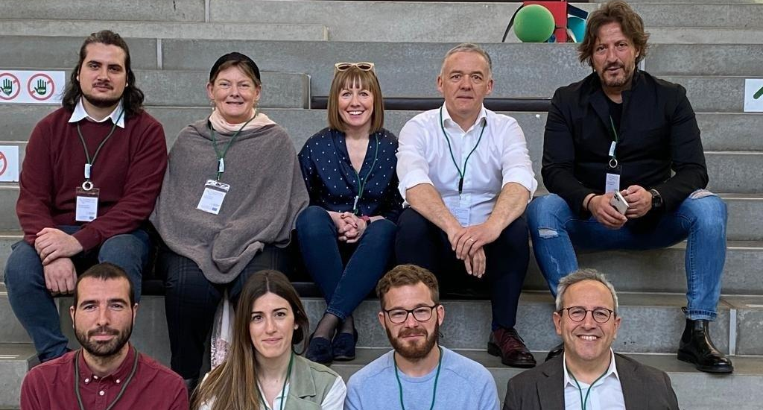
Project Partners Continued…
4
SOSU Østjylland
SOSU Østjylland is a public vocational educational institution (VET) in Denmark, that provides basic education in the field of social and health care for seniors, childcare and service assistants in healthcare settings. In this project, they have the responsibility to create the environment to develop competencies in designing training activities in Work Based Learning and enabling tutoring continuously in VET. Their experience in the field of education brings to the project indispensable knowledge to be able to develop the modules and materials that have been elaborated.
5
Momentum
With over 20 years experience in EU projects, they are passionate about developing & facilitating learning experiences that engage & motivate learners and so will contribute to content, while also being responsible for the Design and facilitation of the project learning platform. With the aim to provide a website that is user-centric yet contemporary and up-to-date. Their team will also coordinate all pilot-testing and user evaluations. Due to Momentum’s vast experience in marketing and dissemination, they will lead this task to enhance the delivery of all project resources and to ensure the sustainability and reach of our Housing Care project are carried well into the future.
6
Roscommon Leader Partnership
Roscommon Leader Partnership, is a non-governmental organisation that works for the betterment of the people of County Roscommon, Ireland. They have a role in such diverse subjects as education, tourism, enterprise, environment, recreation, social inclusion and assistance to the unemployed to name but a few. RLP has a special interest in promoting digital skills. The organisation spearheaded a successful bid to the 'Getting Citizens Online’ programme under the Department of Communications, Climate Action and Environment to up skill and train citizens in digital skills.
7
Italia Salute
Italia Salute srl has been operating in the social and health sector for several years and stands out for having invested in the innovation of rehabilitation services provided in its centers. The company has among its members, business and professional realities of long experience and high professionalism in the sector. Since its establishment, the company has worked on new concepts of Healthcare, developing efficiency and highly professional services accessibility to all. In its outpatient centers, the company, makes use of the contribution of professionals in the sector, provides services in various areas including cognitive, motor, neurological and psychological rehabilitation.

Slide 11
04
The MOOC:
Digi-Human Senior Care

Slide 12
“
I feel the capacity to care is
the thing which gives life its deepest significance
”
PABLO CASALS
The MOOC: Digi-Human Senior Care
One of the main proposals of the Housing Care Project was to create a MOOC (Massive Online Open Course) for care workers in order to give them the ability to assist and care for dependent persons through Ambient Assisted Living (AAL) technologies.
But, before that... What is a MOOC Course and what makes it so interesting?
A MOOC is an online course with the option of free and open registration, a publicly-shared curriculum, and open-ended outcomes. MOOCs integrate social networking, and accessible online resources, and are facilitated by leading practitioners in the field of study. Most significantly, MOOCs build on the engagement of learners who self-organise their participation according to learning goals, prior knowledge and skills, and common interests. The great strength of MOOCs lies in their ability to link segments of knowledge. From a connectivism conception, where the creation of knowledge is based on the establishment of connections, the greater the number of segments, the more learning possibilities there are in each course.
The Digi-Human Senior Care MOOC will contribute to your professional development as a care worker, improving your knowledge of new ways of caring for dependent people through new technologies. Your professional skills will be fully rewarded, understanding that care can be perfectly compatible with today's technological devices.
The Care Workers, at the end of the MOOC will be able to:
Test Ambient Assisting Living & E-Health devices to assist and take care of seniors;
Practice assistance and care interventions using these technologies, integrated with a strong humanised component;
Manage the multi-functionality of devices at a basic level;
Understand and use some of the data produced by the technologies.
If you don't know what Ambient Assisted Living is ...... You are in the right place.
Ambient Assisted Living (AAL) refers to technical solutions that help people with disabilities or seniors to lead a more independent life or enable autonomous living towards old age.
It is in this course that you will learn these kinds of things and MUCH MORE!

Slide 13
The MOOC: Digi-Human Senior Care
What will you find in the course: Digi-Human Senior Care?
This course created by all the partners of the Housing Care project is an educational tool designed to have an estimated duration of 30 hours, distributed in:
20 hours of theoretical content: In which the most detailed, in-depth and specific information related to the new forms of care through technology, as well as audiovisual content, the latest news and research on the subject, and recommendations to broaden your knowledge on the subject are mixed.
10 hours of practical content: A course of this kind would be useless without a part that aims to consolidate all the knowledge learned. A practical part in which you will find all kinds of exercises, from a quiz to planning a work calendar. All exercises are designed to be completed within an estimated timetable which is always indicated.
Features of the MOOC that you need to know before you start.
The MOOC course has been developed with the most up-to-date information related to AAL & E-Health technologies and devices for seniors, in which you will be able to learn how to: Set-up, control, and maintain assistive and care devices; Basic technology health-care procedures; Organisation and assistance in teleconsultation Use of the most popular Health Apps; Sensor functioning check, IoT Infrastructure check-ups and Data management literacy
From the Housing Care Project perspective, we approach the MOOC from a human care mentality so that the approach to work will incorporate assistive technology, however, we believe that the work you do with technology should never lose sight of whom you are working with: people with physical and emotional needs who want to be actively listened to without the feeling that technology is over- involved or replacing their carer.
That is why the MOOC is oriented from an empathetic perspective and approach; encouraging the initiative towards autonomy of both users and workers; analysing the benefits of warm and respectful communication, through awareness and engaging the person towards collaboration according to their capabilities. This is the only way to preserve human dignity.
We wouldn’t do anything if we didn’t include exercises and self-assessments in order to see your progress and to be able to check that you have learned the theoretical part well. We have developed a self-reflective curriculum that allows students to reinforce and put into practice the theoretical part, through Self-reflective learning and continuous personal improvement and lifelong learning

Slide 14
Some General Instructions for the Course
Here are some instructions (which you can follow or not) to make it easier for you to study.
This course is scheduled to last an estimated 30 hours. These hours can be distributed as you wish and according to your schedule.
These hours can be distributed however you like and according to your schedule. Our advice is that you dedicate an hour a day from Monday to Friday, being able to rest on weekends.
Keep in mind that the entire course is about 240-280 slides. That means, if you spend an hour a day, you will have to review about 10 – 12 slides.
You should also know that throughout the course you will find external documents and videos, which have a certain duration. In that case, do not hesitate to reduce the number of slides, and occupy exclusively the time that you have scheduled.
Finally…We all have days when we are more tired than others. So, if one day you don’t part-take in the course, that's fine. You deserve to rest. You will catch up but please don’t give up!
Study techniques that will take your learning to another level
Do your own Mind Map. A mind map summarises and organises ideas. If you do it well, it can save you many hours of study time.
Buy a notebook just for the course. Write down everything you think is interesting. Then you be able to come back to it whenever you want.
The best way to learn is to be curiously active. Ask yourself questions about the subjects and do your best to answer them on your own.
Put what you have learned into practice. In the course you will find a wide variety of easily applicable technology. Take advantage of it and test them out!
Especially, don't forget to enjoy yourself. Learning new things is a wonderful experience, whatever your age.

Slide 15
05
The Modules of MOOC

Slide 16
Module 1
Digital Literacy Skills
In this module we explore the necessity of developing our technological skills and abilities in our daily lives, especially in the care sector. We take an in-depth look at the most important aspects related to technology: theoretical aspects, parts that make up the devices, as well as the benefits of use it.
Summary
Developing the digital skills of care workers.
Understand terminology related to technology and its devices.
Know and learn how to use many care-oriented devices.
Knowing when to use each of the resources offered by the devices and their applications in the care work environment.
Main Objectives
The importance of digital literacy in our everyday lives
The Effective use of Smartphones
Effective use of a Smart Tablet (IT Tablet)
Effective use of a Smart TV
Creating Awareness of how Data Security must be considered
Contents
Laptop
Smartphone
Smart Tablet
Smart TV
Devices
Learner Exercises
Slide 24 – Task 1: Practice setting up an email account
Task 2: Browse the internet. Searching for websites
Slide 75 – Checking if your won devices are data encrypted
Some Resources
Set Up a Smartphone for an Older Family Member [How-To] – YouTube
How to Download and Install Apps on Your Samsung Smart TV in 2 Minutes! – YouTube
Sony Android TV | How to update your Sony TV – YouTube

Slide 17
Module 2
Human digital Skills
Summary
In this module we delve into how we should put digital skills into practice in our day to day. The importance and benefits of these skills in our health and how they can help Care Workers in their workplace. The positive effect that technology has on communication is exposed and how it can help you to get closer to dependent people or seniors.
Apply rules and tools to support Care Workers’ health, quality of life and longevity.
Establish empathetic communication and a safe virtual environment through technology
Transfer digital skills to seniors and support them in the use of technology.
Improve communication with colleagues to keep a serene working atmosphere through technology
Main Objectives
Contents
Work Life Balance and Quality of life
Digital Empathy and Communication
Teaching Technologies to Seniors
Work environment and Cooperation
Laptop
Smartphone
Smart Tablet
Smart TV
VR Goggles
Devices
Learner Exercises
Slide 26 – Practice in management of work and daily life using simple tools)
Slide 57 – Recognising different communication styles used by you and analysing how to improve your way to communicate with clients and colleagues
Some Resources
Daily Calm | 10 Minute Mindfulness Meditation |Be Present
How to Build A Routine
https://www4.istat.it/it/anziani/cultura-uso-dei-media-e-nuove-te

Slide 18
Module 3/1
Digital Apps for Healthcare Management
In Module 3 we will focus on three topics that have an impact on seniors’ health. In this Topic/section, we discuss the importance of promoting personal autonomy and the positive effects on the health of seniors. We then focus on technology developed to manage the effects of the most common diseases in seniors, including diabetes.
Summary
Main Objectives
Promote personal autonomy in seniors
Provide care workers the technology related to monitor health conditions.
Learn how to find the correct Apps etc to manage a health condition using diabetes as an example.
Contents
What is personal autonomy?
Managing Health Conditions with Technology
Selecting Apps to Manage Health
Devices
Beat Diabetes
The OneTouch Reveal
Bezzy T2D
The Hero Pill Dispenser
Learner Exercise
Slide 24 – Reflective thinking: how can you help and support those that you care for become more independent and to develop autonomy
Some Resources
Older people tell us what the right to autonomy and independence means to them - YouTube
How to Promote Independence – YouTube

Slide 19
Module 3/2
Technology applied to physical activity, healthy lifestyles and prevent cognitive decline
Summary
In this section, we present the importance and need to incorporate healthy lifestyles (physical and cognitive) into the lives of older people and how it can be done through the technology we have at our disposal. Likewise, it is invited to incorporate cognitive stimulation games into care.
Main Objectives
Promote healthy lifestyles in seniors
Provide Care Workers with the tools to improve the well-being of their users
Know and learn how to use many care-oriented devices.
Show the importance of video games in the prevention of cognitive deterioration
Technologies to support physical activities
Fluid Balance Technology for Seniors
Healtlh Lifestile
Technologies to support Healthy lifestyle
Prevent cognitive decline playing
Contents
Bracelets or wearables
Smartphone
Virtual Reality
Consoles
Devices
Learner Exercises
Slide 60 – Developing a healthy hydration plan
Slide 72 – Learn about the Dommus Management App
Some Resources
DSource: Bruno, C., Collier, A., Holyday, M., & Lambert, K. (2021)
https://hidratespark.com/
https://www.cdc.gov/aging/pdf/healthy-aging-in-action508.pdf

Slide 20
Module 3/3
Social activities apps
In this last part of Module 3, we will see the Apps more related to social needs. We show the necessity to incorporate the care sector with this technology, and how it would benefit our society as a consequence. There are a lot of seniors suffering from loneliness and the technology can be one of the ways to solve this situation.
Summary
Main Objectives
Show the positive relationship between technology and society.
Create awareness of how we can use technology in order to promote the social interaction
Learn how we can use social networks for our benefit.
Show what kind of Apps feature cultural places and intersts.
Social Activities
Social interaction/apps
Entertainment Apps
Cultural Apps
Contents
Spotify
Gioia+ app
Familyar
Netflix
Devices
Learner Exercise
Slide 119 – Open Google Art & Culture, and explore all the functions and visit somewhere new.
Some Resources
https://www.youtube.com/watch?v=PxpNtOIFRm4
https://www.youtube.com/watch?v=XnAvz8J6Nq0

Slide 21
“
Your mind is like a parachute: it only works if it’s opens.
”
Albert Einstein

Slide 22
06
Some things you should know

Slide 23
Suggested Time Management Structure:
This MOOC has been created with an estimated duration of approximately 30 hours (20h of theoretical section + 10 of practical section)
You are free to do it in your own way, however, we offer you a suggestion:
Module | Estimated time
Introduction | 1,30h approx.
Module 1 | 6h approx.
Module 2 | 6h approx.
Module 3 | Topic 1 | Topic 2 | Topic 3
 | 2h approx. | 2h approx. | 2h approx.

Slide 24
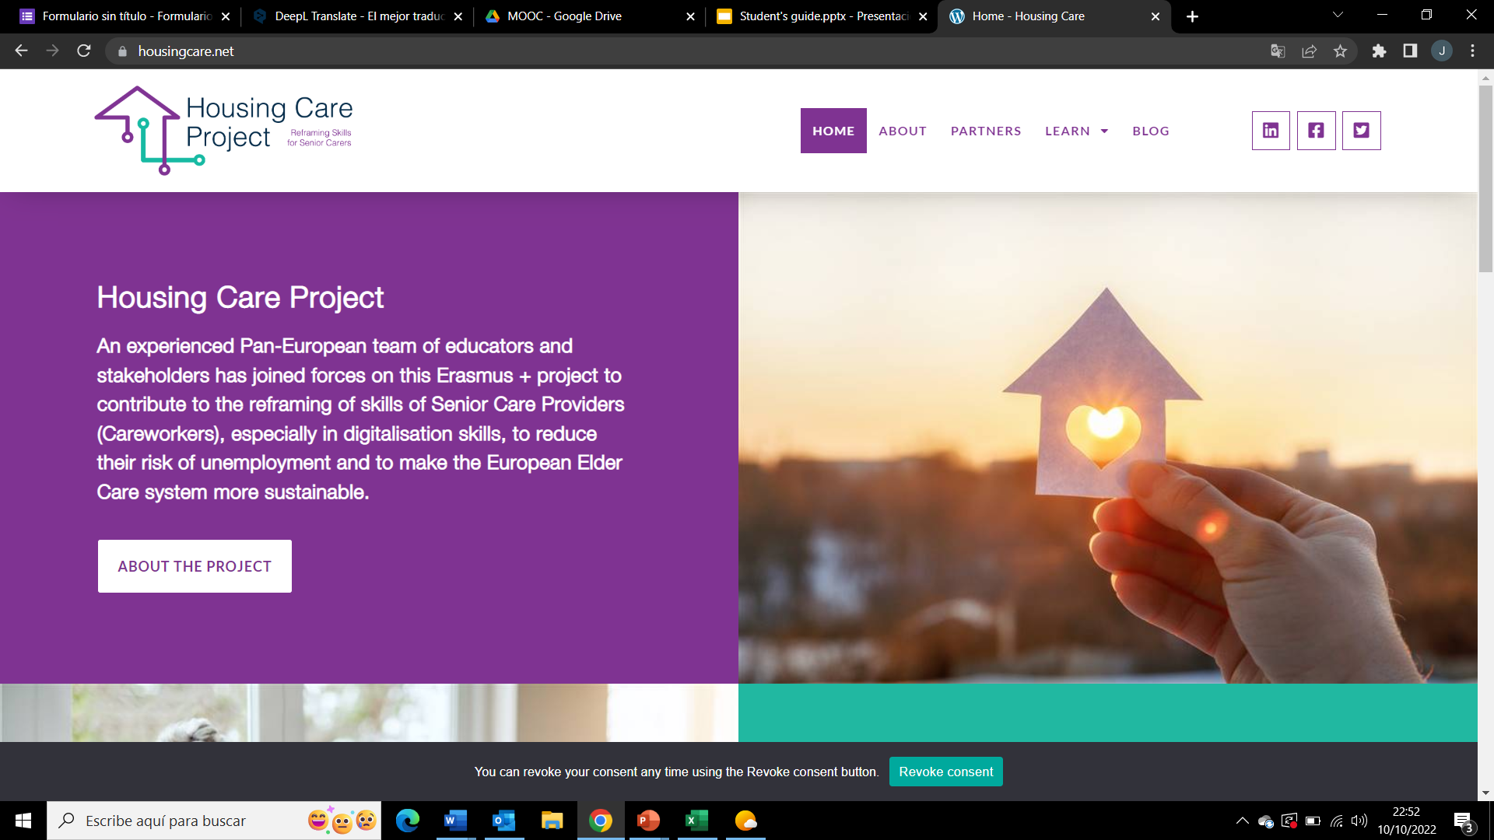
Get Started!
All our Resources are available on the Project website
Website Here
follow your journey
﻿www.housingcare.net

